Slide 1
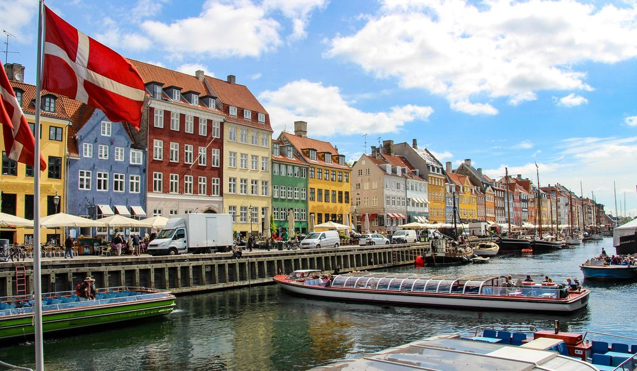
DENMARK

Slide 2
Tivoli

Slide 3
Kronborg Castle

Slide 4
Råbjerg Mile

Slide 5
The Danish Riviera

Slide 6
Odense

Slide 7
The Little Mermaid

Slide 8
Danae Mavromati
The right holiday for me

