Slide 1
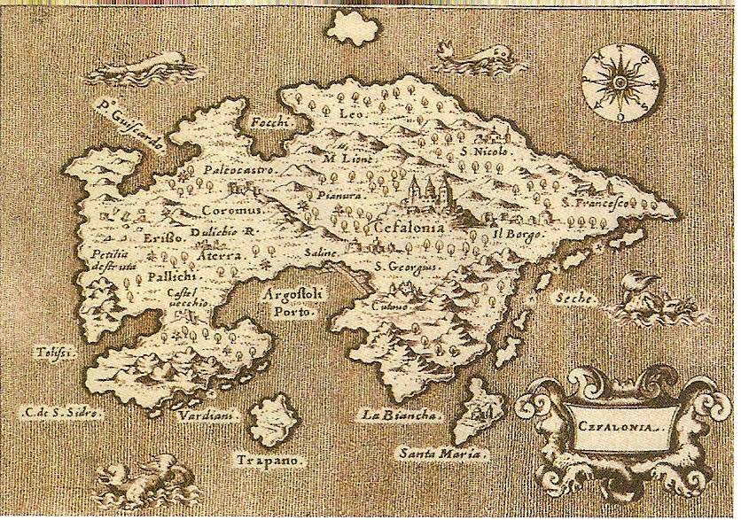
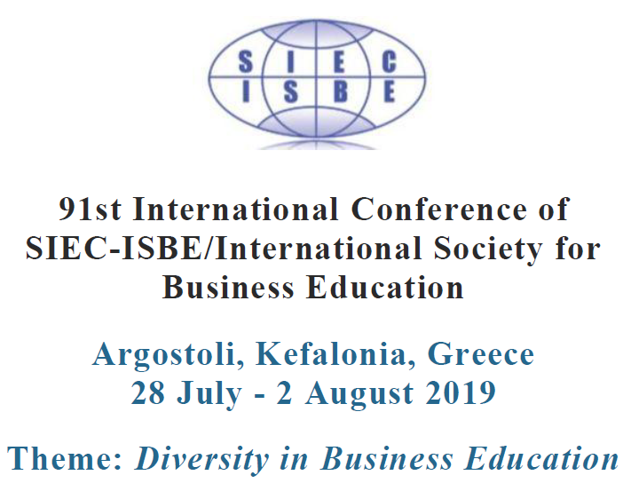
Kefalonia land of travellers, conquerors and traders
Dr Elias Toumasatos

Slide 2
The history of a place is the history of its people
From ancient times, the Greek world is a galaxy of various “constellations”
Many communities, organized in relative autonomy
Mobility of people (to and from existing communities, migration and establishment of new communities)
Greeks are easily integrated in their new environment, mainly by dynamically participating in the economic life of their regions

Slide 3
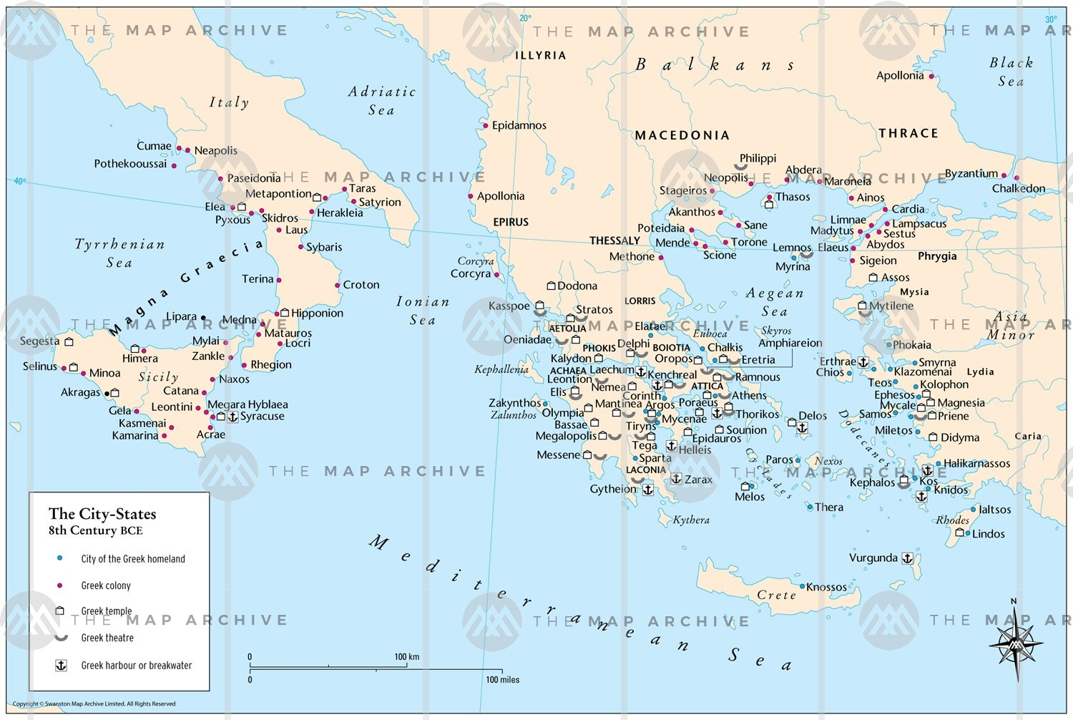
Ancient Greece: city states
Source: The Map Archive

Slide 4
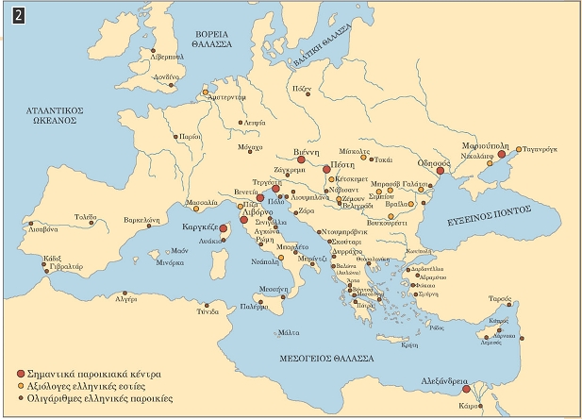
Greek communities in Europe early 19th c. AD
Source: wikipedia

Slide 5
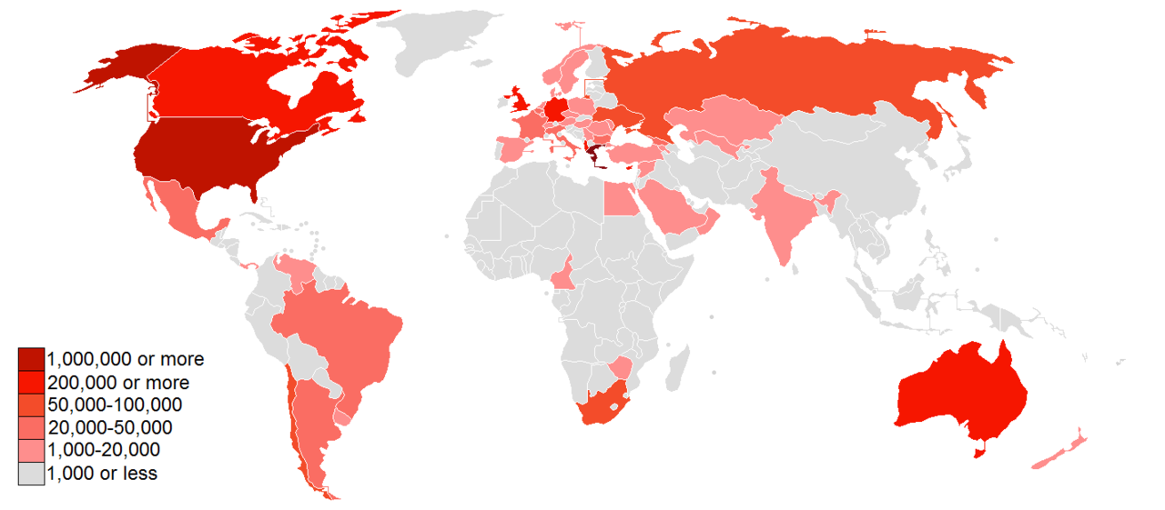
Greek communities worldwide today
Source: wikipedia

Slide 6
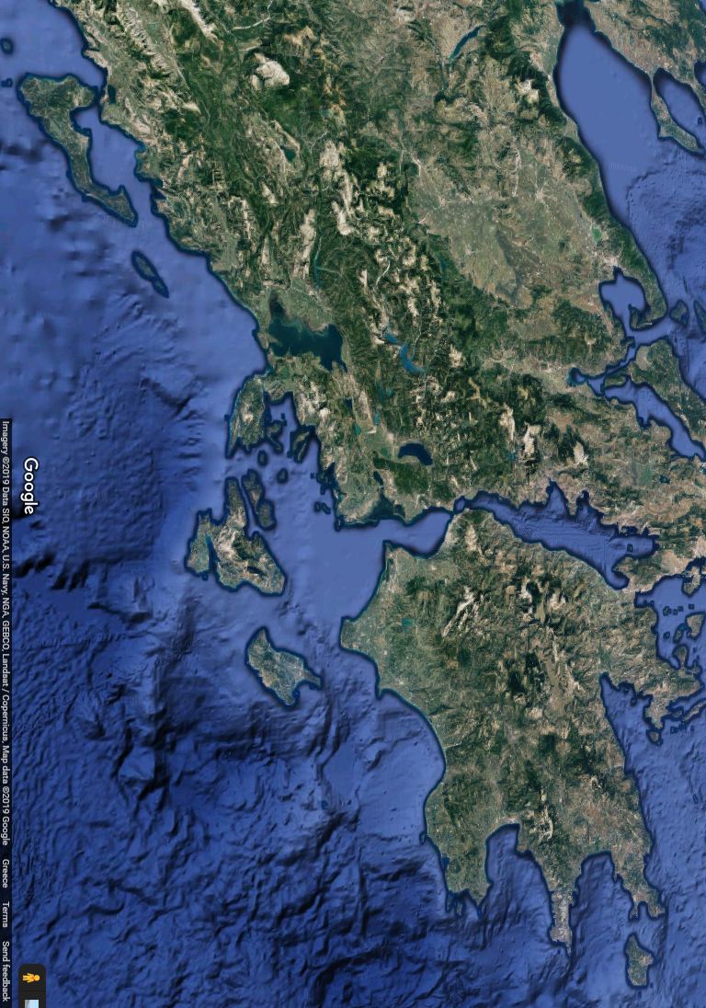
Even in smaller regions local entities are also “galaxies” of communities: Ionian islands [Eptanesa]
Corfu
Paxi
Lefkas
Ithaki
Kefalonia
Zante
Kythera

Slide 7
The “Ionian Space” is not only a geographical, but also a political, economic and cultural space. A galaxy with its own constellations
Corfu
Paxi
Lefkas
Ithaki
Kefalonia
Zante
Kythera

Slide 8
Every island has its unique characteristics in the fields of economy, politics and culture. At the same time, there is a connecting line that creates the “Ionian Greek” cultural identity
Corfu
Paxi
Lefkas
Ithaki
Kefalonia
Zante
Kythera

Slide 9
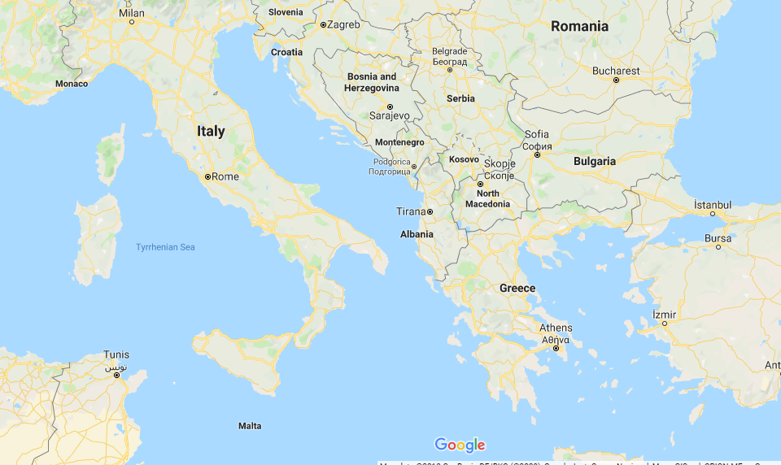
On the threshold between western Europe and the Balkans
In the years of the Ottoman Empire, Ionian islands , then under the administration of Venice, were the eastern border of the western world
After becoming a part of the new Kingdom of Greece, they became the western border of the new-born Balkan nation -states
Kythera

Slide 10
Geography explains History: Kefalonia
Insularity
Mountaininess
Lack of sufficient arable land
High seismicity (… land of earthquakes)
Vicinity with Peloponnese
Between Italy and the Balkans
Western Conquerors instead of Ottomans

Slide 11
Geography explains Economy Economy creates History: Kefalonia
Insularity | Pirate invasions . Settlements far from shore Sailors and fishermen to survive
Mountaininess | Insufficient road network (until 19th century AD) Insufficient communication between settlements Low population density Stockraising preferable to agriculture
Lack of sufficient arable land | Stockraising and cheese making take the lead Small properties “create” land on mountain slopes by building terraces Bigger properties are less in number, but more powerful
High seismicity | Reconstruction works necessary after seismic catastrophes create demand for builders and craftsmen (that are also farmers and shepherds) Migration (interior and international) = MOBILITY (unlike most agricultural societies based on stable settlements)

Slide 12
Geography explains Economy Economy creates History: Kefalonia
Vicinity with continental Greece | Exchanges with the opposite coast : Cheesemakers, craftsmen and … brides Cultural approach with continental Greece is stronger than in Corfu or Zante Kefalonia becomes the destination of immigrants from Continental Greece (esp. in the years of Ottoman Empire, from Eastern Roman and Venetian cities that fell to Ottoman Turks)
Between East and West | Easier migration to Western Europe Universities in Europe become destinations for wealthy youngsters A passage for fugitives from the Ottoman Empire to the West A “theatre of operations” in big wars (esp. between Venice and the Ottoman Empire) An important commercial station for traders that sail the Adriatic, the Ionian, and the Mediterranean see, and consequently a strategic point for any conqueror (Emperor or pirate)

Slide 13
Geography explains Economy Economy creates History: Kefalonia
Western conquerors instead of Ottomans | Kefalonia becomes part of the Venetian financial network Economic transactions with the West Legislation, administration and economic system more similar to the West than to the Ottoman-ruled Balkans Strong cultural bonds to the West (in art, music, literature and language) To a certain point, young members of the social elite are educated in Europe . Mercenary soldiers of various origins are settling in Kefalonia – enriching the island’s cultural diversity

Slide 14
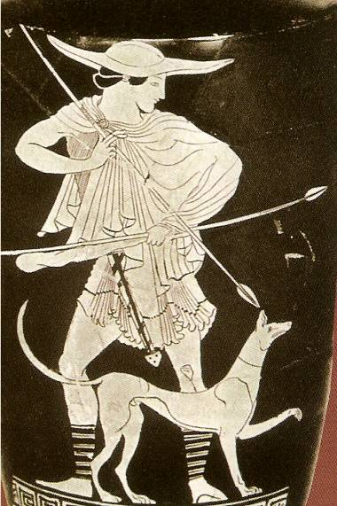
The name: Kefalos
Kefalonia < Kephallenia < Kefalos
Son of Hermes, a charmer, abducted by Eos, father of Faethon (the morning star)
A hunter – accidentally killed his jealous wife Prokris

Slide 15
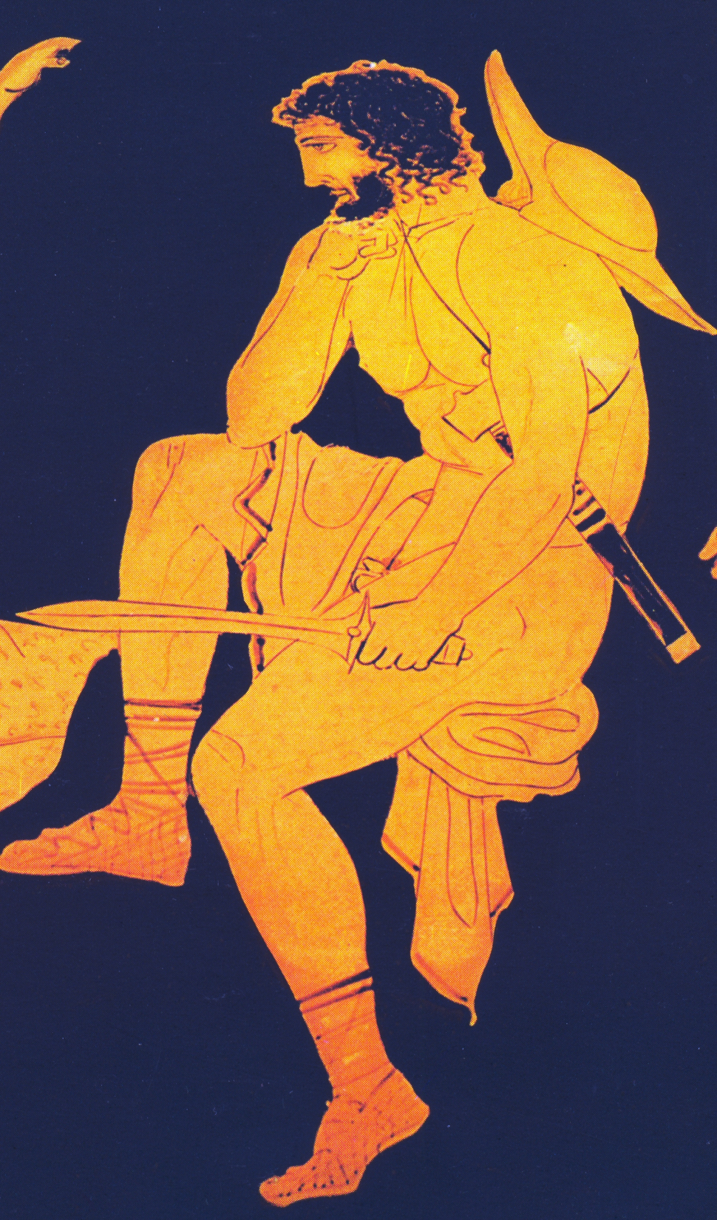
Odysseus
King of “the gallant kefalonians” (Ithaca, Kefalonia, Zakynthos)
Ingenious, crafty and determined
A leader, a traveller, a survivor
After Troy fell, he wandered around the world for a decade before returning to Ithaca – but where is Ithaca?

Slide 16
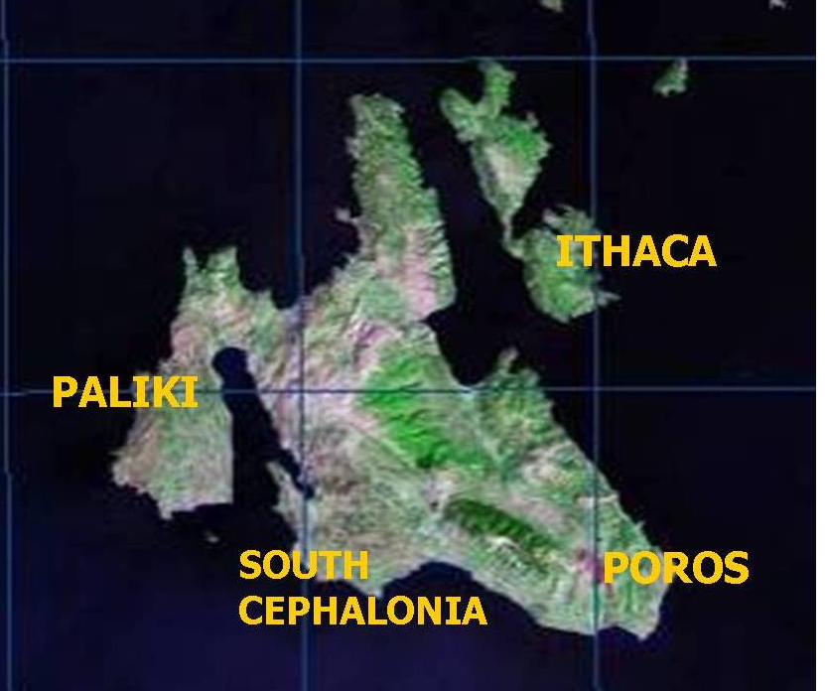
Where is Ithaca?
Today’s Ithaca
Poros (SE Kefalonia)
Paliki
Livathos (South Kefalonia)
Erisos (N Kefalonia)
Excavations and geological research

Slide 17
Poseidon’s wrath
Odysseus blinded Polyphemos, son of Poseidon, god of sea and earthquakes
Poseidon’s wrath lasts forever: Kefalonians are still shaken by earthquakes and sail on the seas

Slide 18
A place in history
On the edge where the plates of Europe and Africa collide
South of the Adriatic, in the middle of Meditteranean
Between Italy and the Balkan peninsula, on the edge between Western and Eastern Europe

Slide 19
An island’s history in three words
Earthquakes
Conquerors
Travels all around the world
Moving earth, moving people

Slide 20
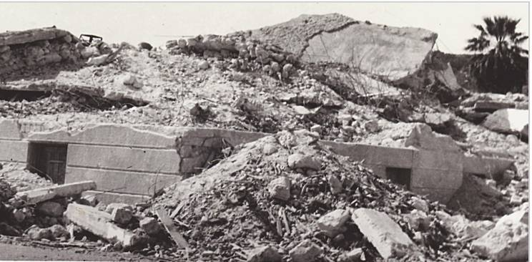
Earthquakes
From 1469 to today more than 120 earthquakes of magnitude >5.0 have hit Kefalonia. Many have caused total destruction of the island.
A physical phenomenon as a historical factor

Slide 21
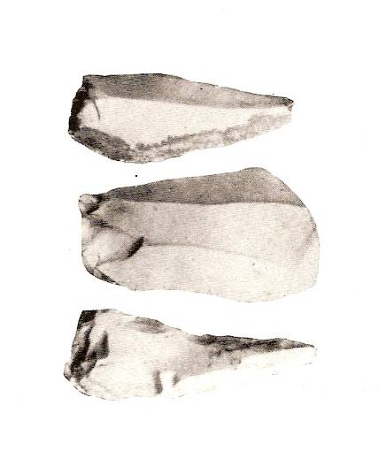
Paleolithic era
app. 50.000 BC: nomads in caves
Stone tools found in various places, especially in N and SE Kefalonia

Slide 22
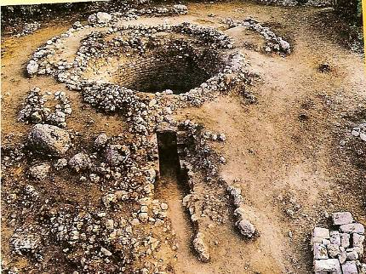
Bronze Age and Mycenaean era
An important Bronze Age Center
Cyclopean walls and tombs, pottery all around the island
A big Mycenaean tomb in Tzannata (13th century BC) indicates a glorious Bronge Age past
The Mycenaean Tomb found in Tzannata, SE Kefalonia

Slide 23
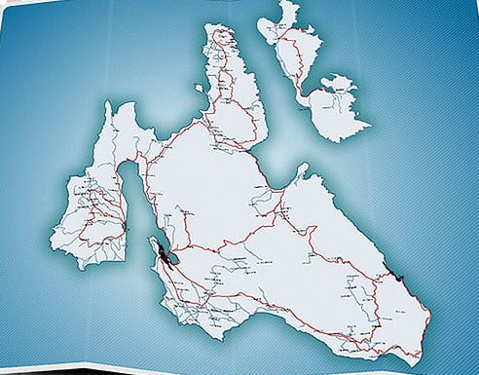
Same island, different city states: The Ancient Kefalonian Tetrapolis
SAMI
PALI
KRANI
PRONI

Slide 24
Same island, different city states: Different allies, different currency
Fortifications (possibly for the fear of each other)
Alliances with Corinth, Athens, Sparta
SAMI
PALI
KRANI
PRONI

Slide 25
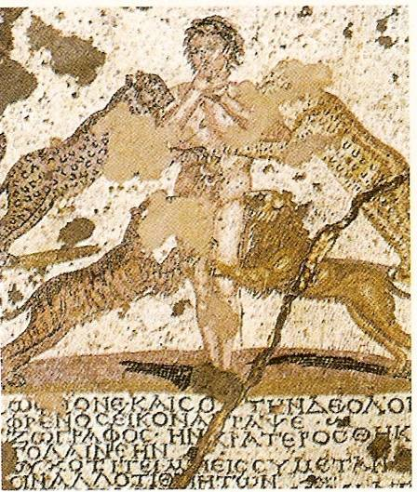
Hellenistic and Roman times
Alliances: Athens
226 BC: Kefalonia joins Aetolic Confederation – The power is in the ships
Unsuccessful attack by Philippos of Macedonia
189 BC. After Sami falls to Rome, Kefalonia becomes part of Roman Empire

Slide 26
Same island, different city states: or even Pentapolis ? ☺
PANORMOS
SAMI
PALI
KRANI
PRONI

Slide 27
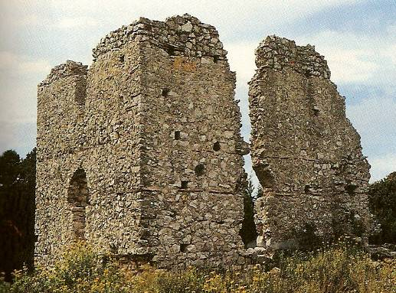
Early centuries AD: An important centre on the north
Important Roman findings in Skala and Fiscardo
The Early Christian Church of Fiscardo – a temple the size of Aya Sofia
A possible naval centre

Slide 28
East Roman Empire era: Thema of Kefallinia
8th century AD
Ionian Islands and the region of Bari (Italy)
Trade point
Defense point (mainly against Arab pirates)
1085 Roberto Guiscardo conquers Kefalonia

Slide 29
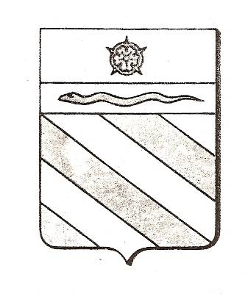
1185-1479: Conquerors from the West
1185: Normans: Admiral Margaritone (Sicilian pirate)
1195: The Orsini Family (Sicilian branch of a noble Roman family)
Matteo Orsini. The Palatine County of Cephalonia and Zante
Feudal economy: Baronies

Slide 30
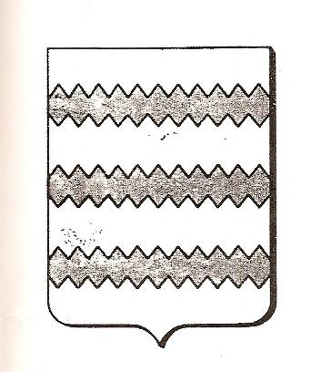
1324-1479: Napoli
1324: Giovanni, Count of Gravina conquers Kefalonia
1357: The County of Kefalonia is given to the family of Tocchi (nobles from Napoli)
Francesca, widow of Carlo Toccho, calls herself “Queen of Romans”- a medieval Penelope

Slide 31
The Turks in Kefalonia (1479-1481 and 1485-1500)
Ahmed pasa invades the Tocchi County – the Palatine County of Cephalonia ends in bloodshed
The Tocchi regain Kefalonia in 1481
First (short) Venetian domination in 1483
1485: Venice submits Kefalonia to Sultan Bayazit
The kaza of Kefalonia: violence, strict legislation (kanuname), taxes, desolation

Slide 32
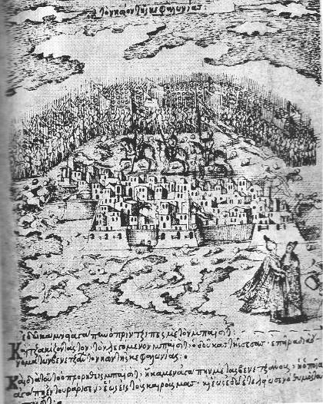
La Serenissima (1500-1797)
1499-1503: Venice wins 2nd war against Ottoman Empire
1500: Conquest of Kefalonia by the Venetians (supported by the Spaniards )
Venetian domination lasts almost 300 years

Slide 33
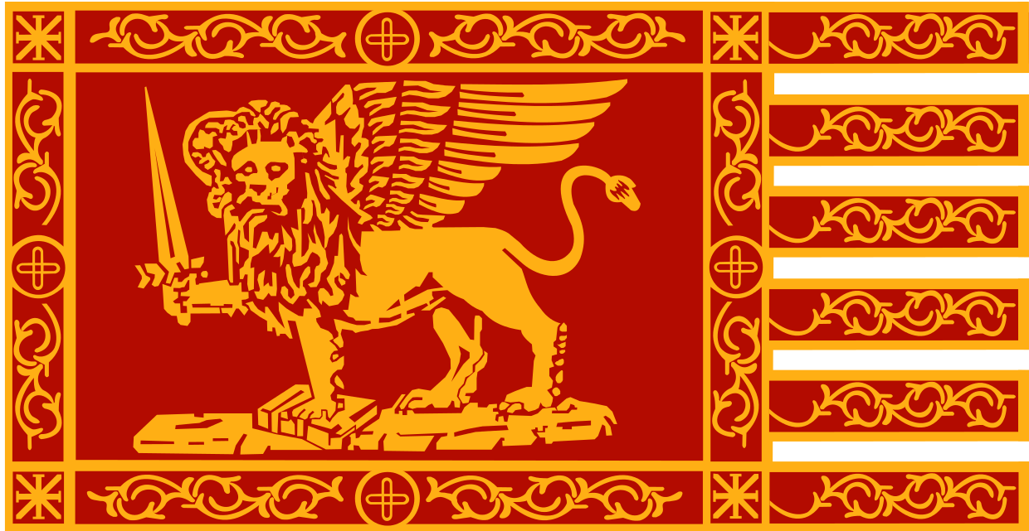
Venetian administration
Central
Administration
(Venice)
Local Venetian
authorities
(Corfu>Kefalonia)
Community
Council (local
Nobles –Libro d’ Oro)

Slide 34
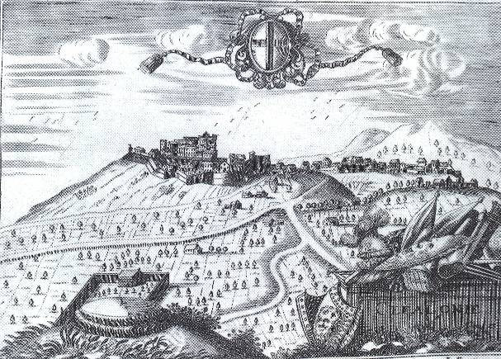
The venetian capital: Fortress of St. George (1500-1757)
“La citta di Cefalonia”

Slide 35
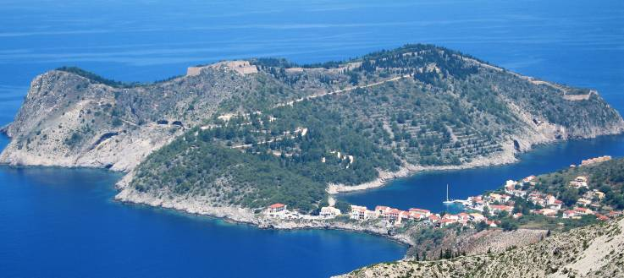
An unsuccessful plan: The fortress of Assos
1593: A defense plan as well as a vision for a new capital
One of the biggest fortresses in Greece – never became what it was designed for.
Leucas returned to Venice meanwhile. No water

Slide 36
People moving, Venice in decline
7 wars against the Turks
Venice losing its possessions in Eastern Mediterranean (Cyprus, Crete, mainland of Greece)
People moving from there to Kefalonia and the other Ionian Islands (Nobles, artists, painters, sculptors and scholars)
Cephalonians study in Italy (Venice, Padova, Pisa) – contact with European philosophy, arts and science

Slide 37
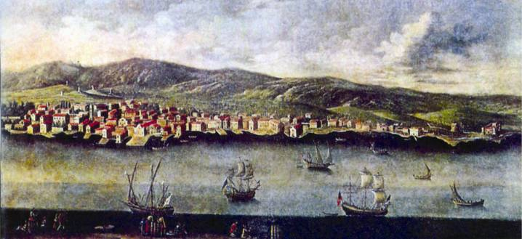
A new capital and a falling empire
In 1757, the small harbour of Argostoli becomes capital of Kefalonia
Lixuri in fury
In 1797, Napoleon conquers Venice. “La Serenissima” is history

Slide 38
1797-1798: Democratic French
1797: The French arrive in Cephalonia (enthusiastic locals)
The tree of liberty is planted in Argostoli – The Libro d’ Oro on fire
Democratic reforms
Social changes, according to the
ideology of the French Revolution

Slide 39
1798-1799: Russians and Turks
Dissatisfaction against the French came up very soon
Reasons: Financial problems and Russian propaganda
October 1798: Russian and Turkish conquer Cephalonia
Negotiations to declare an independent state

Slide 40
1800-1807: La Repubblica Settinsulare
The first “independent” Greek state in modern history (under the protection of Turkey)
All seven Ionian Islands
4 constitutions – local governors
Public disorder

Slide 41
1807-1809: Second French domination
In 1807, the French give an end to the Repubblica Settinsulare
This time, the Imperial French = no longer democracy =
… = disorder once more…
+ the British propaganda
= Oct. 1809: The French give in to the British fleet.

Slide 42
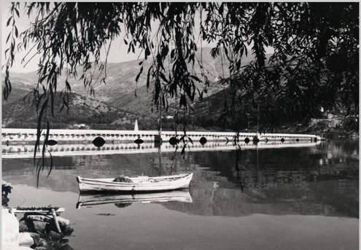
1809-1815: The first British domination
A new elite (those who cooperated with the British)
Charles Philippe de Bosset (military commander of Cephalonia) conducts public works (like the Bridge of Argostoli)

Slide 43
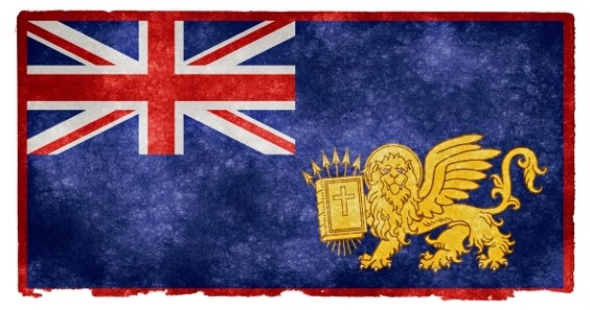
1815-1864: The “Ionian State”
The “United States of the Ionian Islands”. The second Greek State in History, though really a protectorate
Agricultural economy – no industrial revolution in the Ionian
Gradually a new class of traders evolves throughout the century

Slide 44
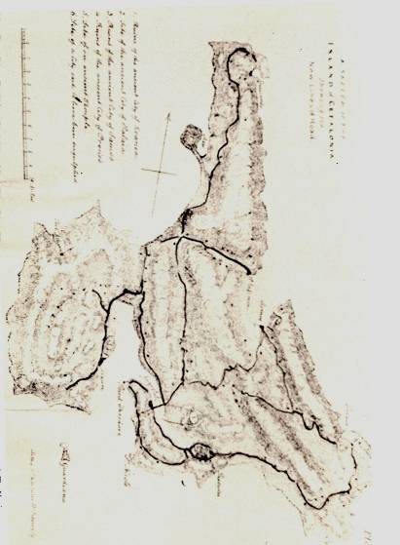
The British Protectorate
Public works (public buildings and road network)
Constitution and Parliaments
Economic crisis
Harsh administration
despotism

Slide 45
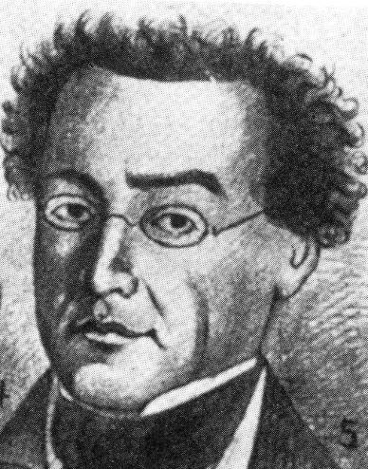
The Radicals
The vision of union with mother Greece
The vision of social reforms
The main representatives from Cephalonia
Educated, from noble families, with progressive ideas
Imprisonments and exiles

Slide 46
The press and the revolutions
1848: Free newspapers
Public reading societies
Writers
Dynamic attitude of Ionian Parliament members
1833, 1848-1849: Uprisings in Argostoli and SE Cephalonia

Slide 47
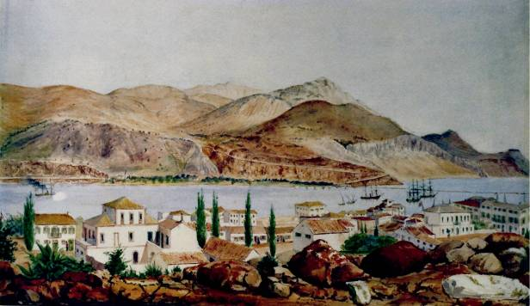
1864: Union with Greece
1863: Ionian Parliament votes for Union with Greece
The UK “offers” the islands to Greece, as a “gift” to new King George
21 May: The British are gone. Cephalonia is now a part of the Kingdom of Greece.

Slide 48
The “Incorporation” (1864 and on)
Becoming a part of Greece (legislation, taxation, and administration)
Eye to Athens: Kefalonians move there to study and work
Kefalonians in Athens: Administration, Education, the Arts and Politics
Participation in early socialist movements in Continental Greece: Rokkos Hoidas, Marinos Antipas.

Slide 49
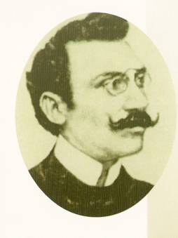
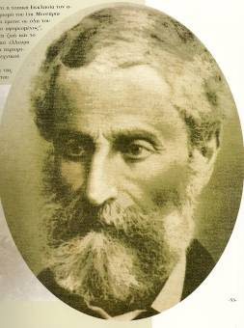
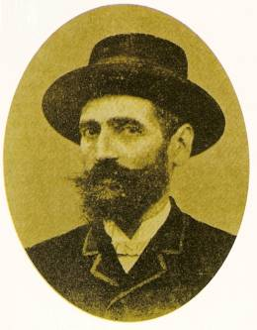
The golden era of satiric poetry (Mid 19th – early 20th century)
Georgios Molfetas
Andreas Lascaratos
Mikelis Avlichos

Slide 50
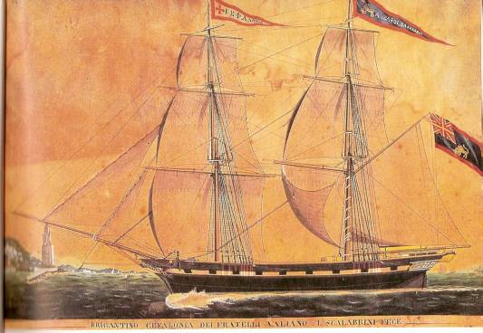
The kefalonian diaspora - Europe
The Black Sea
Romania - Danube
United Kingdom
France (Marseilles)
Ottoman Empire (Constantinople and Asia Minor)
Alexandria
Trade, stock markets, Shipping

Slide 51
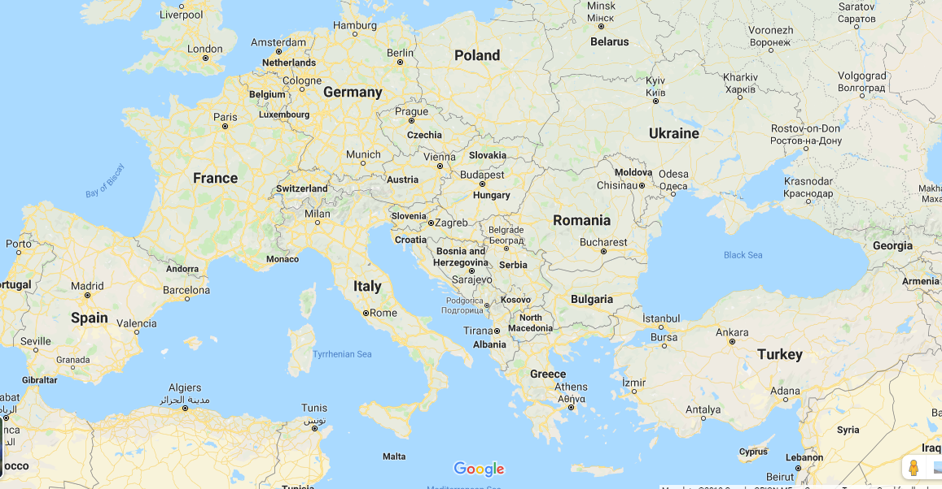
Kefalonian business networks in Europe – late 19th century
Vagliano Bros network

Slide 52
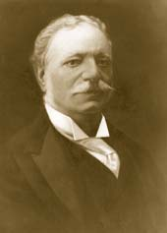
Early 1900s: The benefactors (Entrepreneurs of the diaspora)
Panagis Vallianos (and his brothers)
Marinos Corgialenios
Panagis Harokopos etc.
Donations and charities for facilities the State couldn’t afford (Hospital, Library, Public Schools etc.)
Marinos Corgialenios

Slide 53
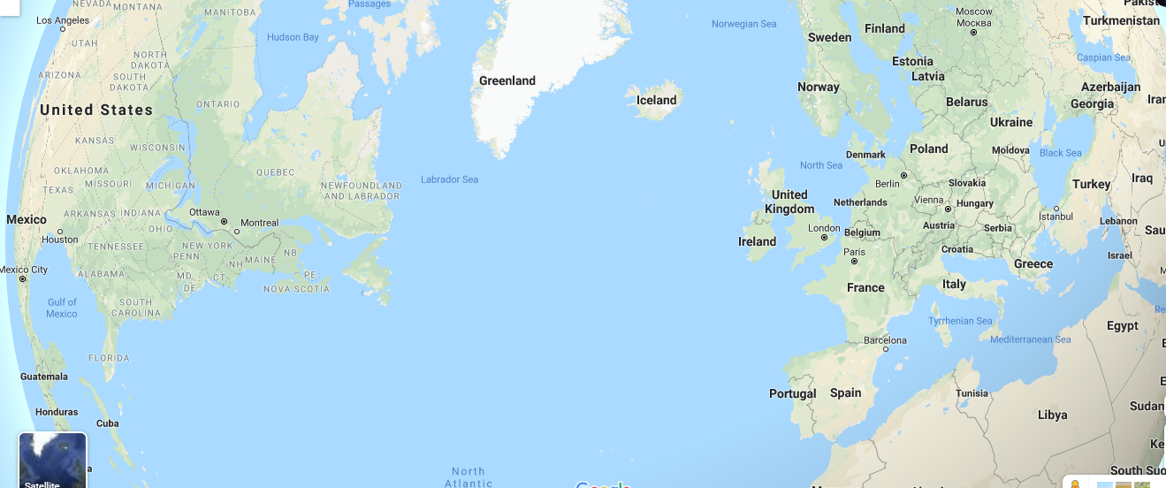
Early 1900s: Migration wave
United States
The continental Greece
Black Sea (Russia, until 1917)

Slide 54
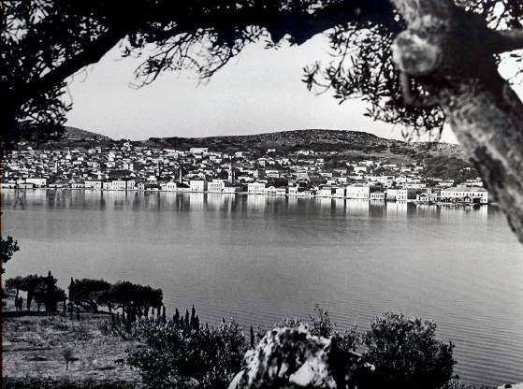
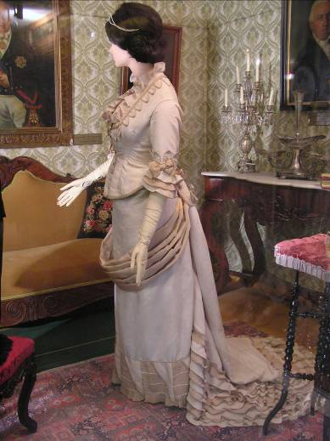
The society in early 20th cent.: The urban world
Two main categories:
The old noble families
The new bourgeoisie (merchants, doctors and lawyers, administration personnel)
Live in Argostoli and Lixouri
Access to education (many study abroad)
Mostly influenced from Western European Culture

Slide 55
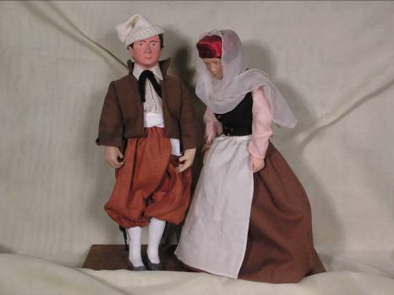
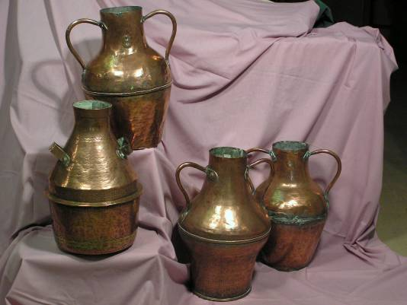
The society in early 20th cent.: The rural world
Very limited access to education
Very high numbers of illiteracy
Poverty and low life expectancy
Cultural characteristics more similar to the Balkan rural world
Very low possibility for ascending social mobility
Ways to break the cocoon:
Migration
Becoming a sailor
For many years (until 1970s), the income of rural families is supported by immigrants’ and sailors’

Slide 56
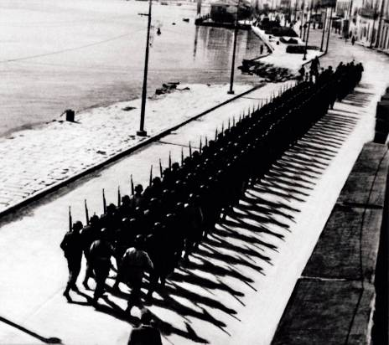
1940-1953: 2nd world war and the hard times
1941-1943: Italian occupation
Sep. 1943: German-Italian conflict ends up with thousands of Italian soldiers deceased
1943-1944: German occupation
Resistance
1945-1949: Greek Civil War

Slide 57
End of an era: The 1953 earthquakes
A milestone in Kefalonia’s modern history
Three major earthquakes in four days (6.4, 6.8, 7.2)
27.659 out of 33.300 buildings collapsed
455 people died – thousands left the island
One of the major catastrophes in modern Greek history

Slide 58
The central square of Argostoli before…

Slide 59
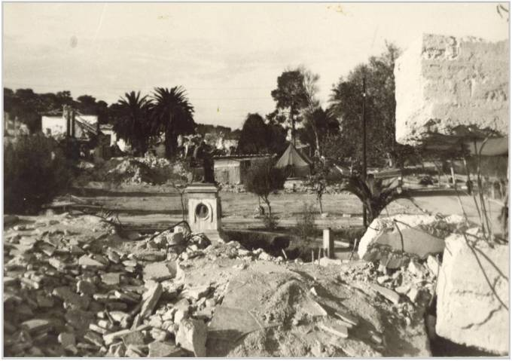
… and after the earthquakes

Slide 60
What was left of the city of Argostoli

Slide 61
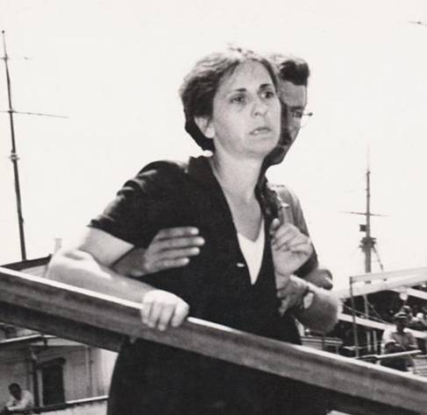
Post-earthquake migration
Continental Greece (Athens, Patras)
United States
Canada
South Africa (Zambia, Zimbabwe, South African Republic)
Australia
United Kingdom

Slide 62
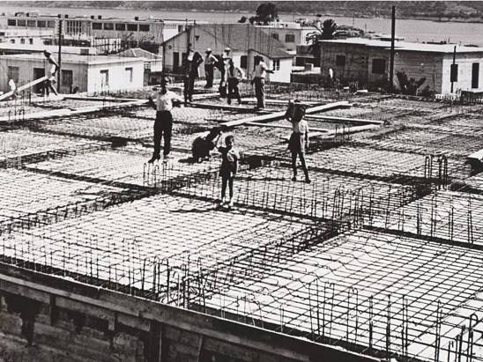
Reconstruction
1953-early 1960s
Architectural tradition was not preserved
Stronger buildings – more attention on construction materials and techniques
Villages moved (Farsa), though towns were not re-designed
Recession

Slide 63
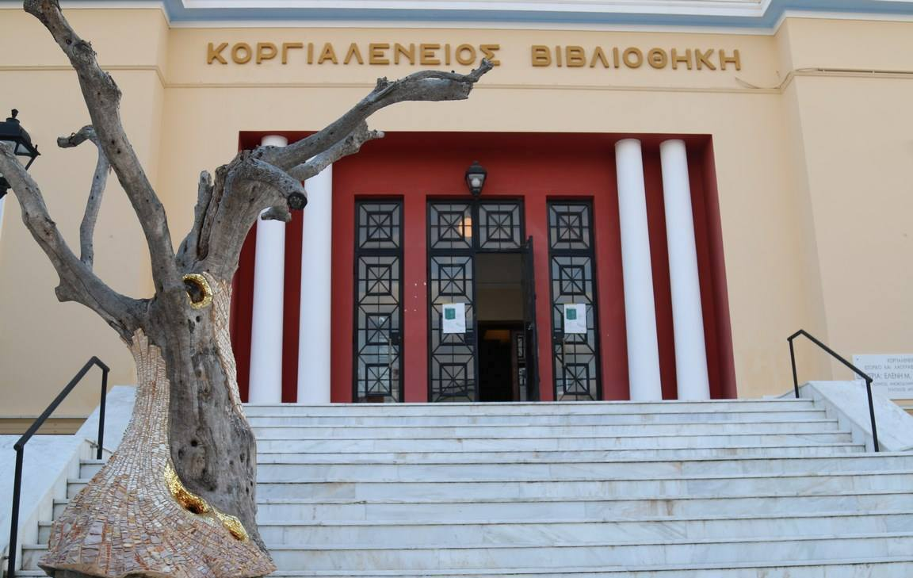
Milestones (Culture)
1960s: Reconstruction of Corgialenios Library and the Philharmonic School
1994: Re-opening of Kefalos Theatre
1998: First higher education school in Argostoli
2000s: Foundation of Technological Institute of Ionian Islands (now Ionian University)

Slide 64
Population of Kefalonia 1863-2011

Slide 65
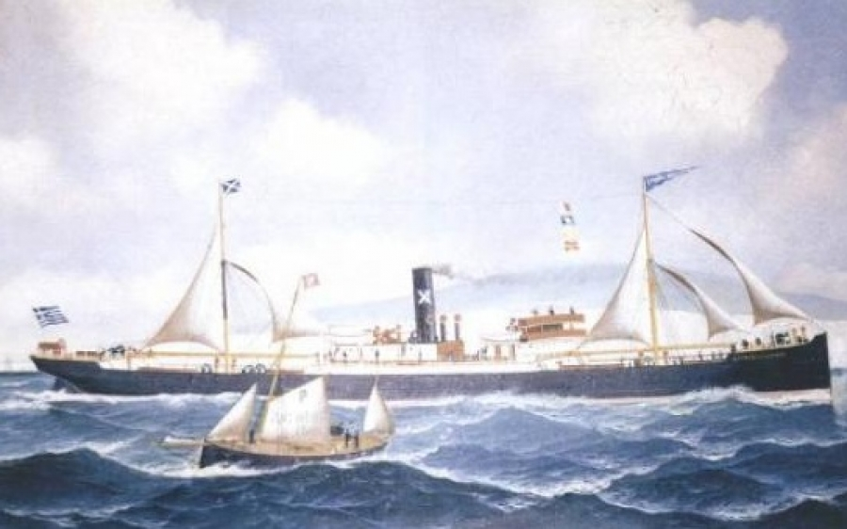
The shipowners: A leading role in the 20th century
20th century families of shipowners
Vergotis
Lykiardopoulos
Yannoulatos
Athanassoulis
Markessinis
Potamianos
Vallianos
Metaxas
Louzis
Fokas
Tsitselis
Svoronos etc.

Slide 66
Development
Mid 1980s: The beginning
Tourism changes the island
Support from the EU
Strict construction legislation
A new wave of reconstruction in the 1990s
Integration of craftsmen and builders from the Balkans (mostly Albania)
A number of Kefalonians, born between 1960-1985 remain or return to the island
Tourism creates income, that strengthens households and enterprises against the great recession of 2010s
Brain drain
Once travellers, now hosts - a change of attitude..

Slide 67
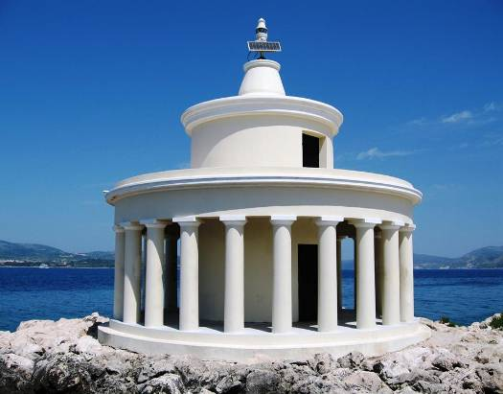
The new field
Tourism
Construction
Services
Trade
Winery
Fisheries
Agricultural products
(Olive oil and cheese)
Stock-farming
Energy (wind power)

Slide 68
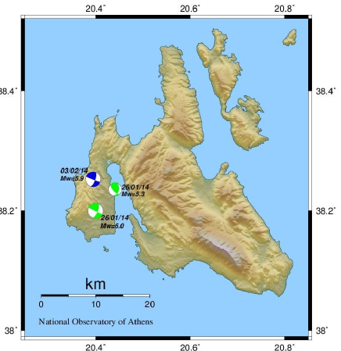
The twin earthquakes (2014)
January 26, February 3: Two earthquakes of the same magnitude (6.0, 5.9) shake the island

Slide 69
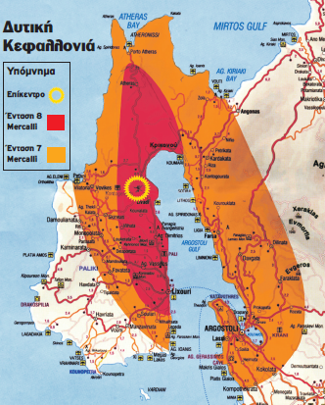
The affected area The peninsula of Paliki

Slide 70
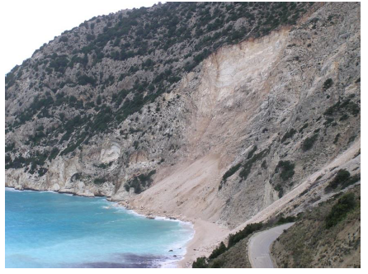
Big landslides and rockfalls

Slide 71
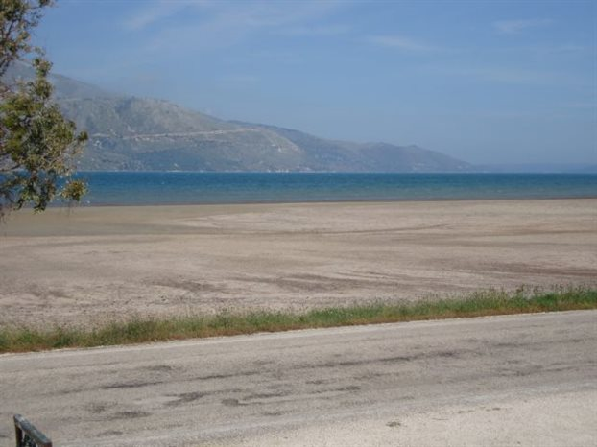
A new shore is revealed in Livadi

Slide 72
Two months after, the people of Lixouri celebrate the carnival. Life has to move on.

Slide 73
It takes strength to get over whatever gets on your way… Strength and humour

Slide 74
So, what happens when your life is torn apart?

Slide 75
You can always build a bridge

Slide 76
And, the road is open again!

Slide 77
So, no matter what,
The light has to stay ON

Slide 78
What’s next?
Charming landscape to preserve
Preservation of our cultural heritage
Devotion to sustainable development
Willingness to travel and recreate

Slide 79
Thank you for your attention
… and wish you a pleasant stay!

