Slide 1
From Amanda Gorman to Lord Byron
The past as source of inspiration

Slide 2
In her TED-Ed talk about poetry, inaugural poet Amanda Gorman asked the students these two questions…
Whose shoulders do you stand on?
What do you stand for?
Do you remember her answer?

Slide 3
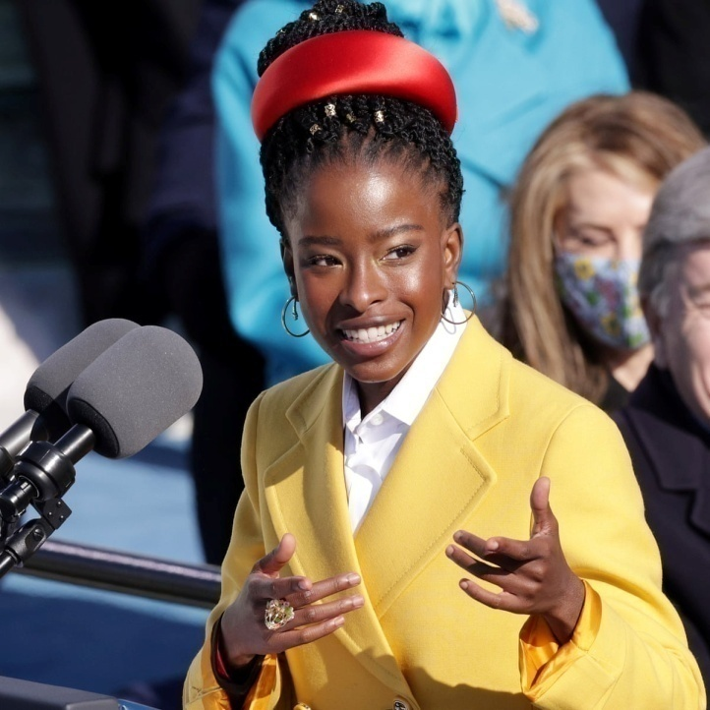
What would your answer be? (think about it and save your answer for later…)
I am the daughter of black writers,
who are descended from freedom fighters,
who broke their chains and changed the world.
They call me.

Slide 4
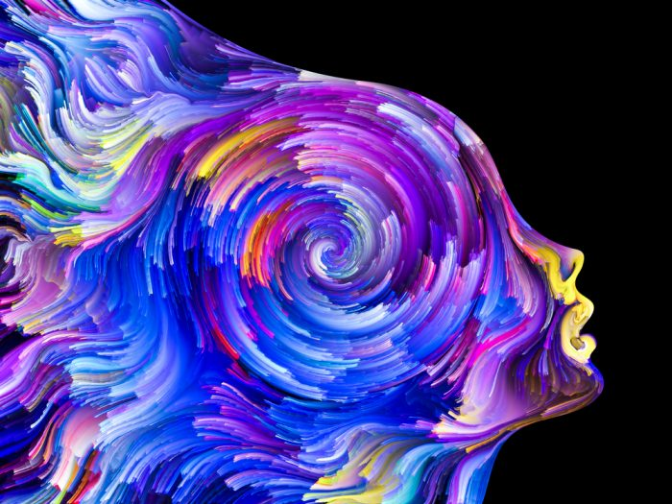
What defines our identity? Write your ideas in the chat box!

Slide 5
What defines our identity?
Family
Environment
Life experiences
History
Values
Actions
Other?

Slide 6
Our identity, who we are, also defines what we stand for, in other words, our values and beliefs which give us a purpose in life.

Slide 7
What does it mean to be Greek?
Think of any words (nouns, adjectives, verbs) that are associated with Greece and Greek people and write them in the chat box!

Slide 8
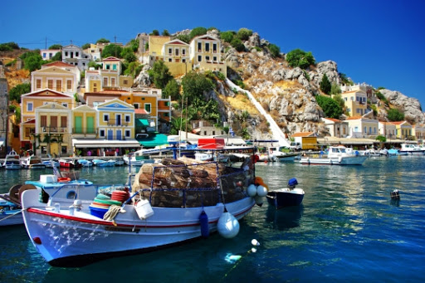
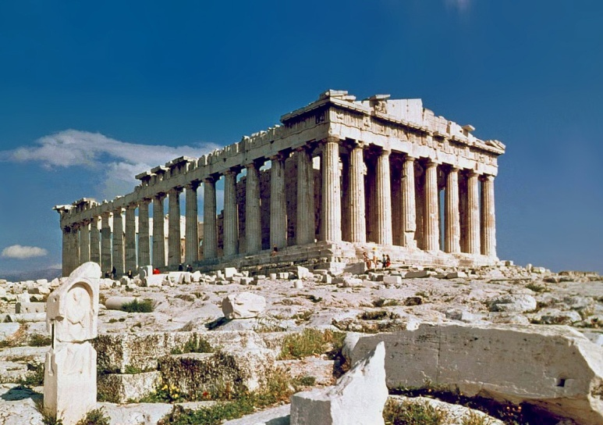
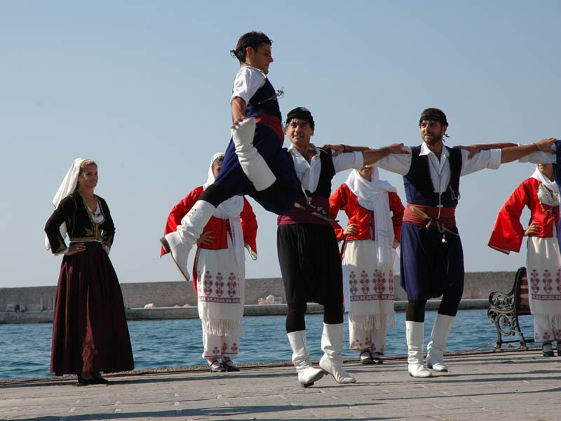
What does it mean to be Greek?
joy
fight
proud
inventive
stubborn
history
democracy
freedom
art
faith
passion

Slide 9
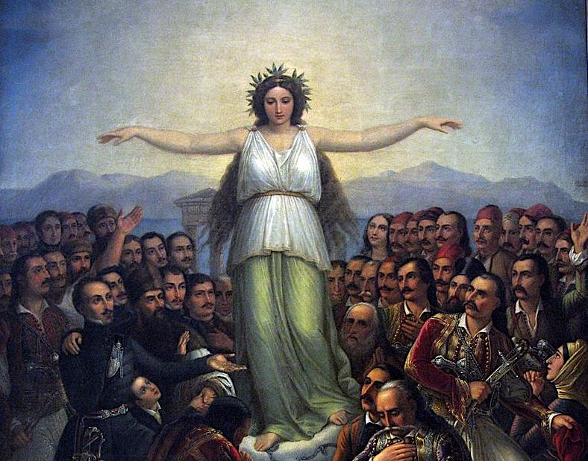
How does our past define/inspire us?

Slide 10
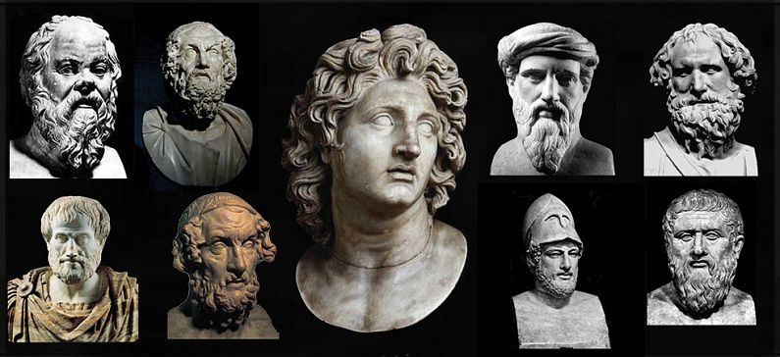
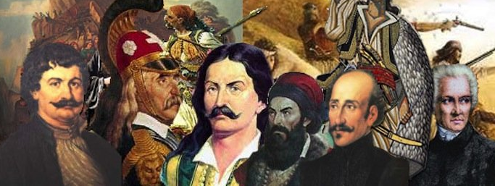
"Honorary ancestors are…
People who might not be related to you by birth or by blood, but who are more than worth saying their names, because you stand on their shoulders all the same.”

Slide 11
"We are all Greeks. Our laws, our literature, our religion, our arts, have their roots in Greece…" "Hellas" - Percy Byshe Shelley

Slide 12
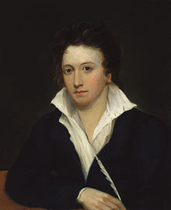
Hellas (extract) by Percy Bysshe Shelley (1822) (Listen to the poem and answer the questions that follow.)
The world's great age begins anew,
The golden years return,
A brighter Hellas rears its mountains
From waves serener far;
Another Orpheus sings again,
And loves, and weeps, and dies.

Slide 13
A new Ulysses leaves once more
Calypso for his native shore.
Another Athens shall arise,
And to remoter time
Bequeath, like sunset to the skies,
The splendour of its prime;

Slide 14
Oh cease! must hate and death return?
Cease! must men kill and die?
Cease! drain not to its dregs the urn
Of bitter prophecy.
The world is weary of the past,
Oh might it die or rest at last!

Slide 15
Greece as a source of inspiration
In the early 19th century, many European poets, writers, artists and thinkers were inspired by the Greek civilization and ideals and supported the Greek people in their uprise against the Ottoman Empire.
These people were called Pilhellenes and played an important role in the success of the Greek War of Independence.
Some of these poets and artists belonged to the Romantic Movement.
Do you know any of them?

Slide 16
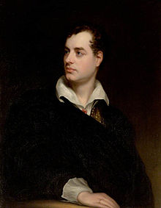
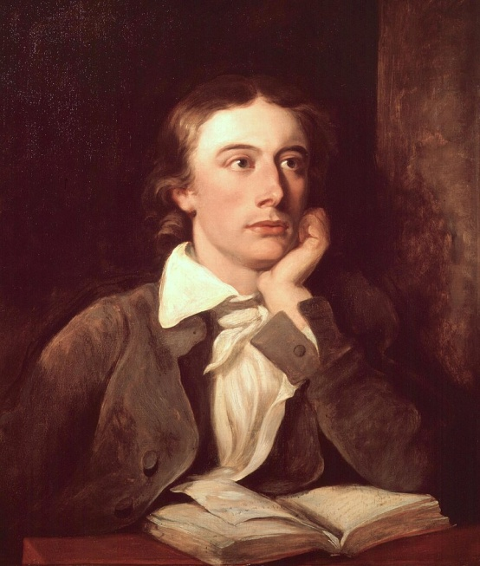
Some English romantic poets & Philhellenes
John Keats
(1795 – 1821)
George Gordon Byron /
Lord Byron
(1788 – 1824)
Percy Bysshe Shelley
(1792 – 1822)

Slide 17
The Romantic Movement
Romanticism (also known as the Romantic era) was a movement in arts, music and literature that originated in Europe towards the end of the 18th century, and was at its peak from 1800 to 1850.
It focused on:
the individual
the glorious past (history, folk art)
nature
emotions
ideal love
freedom
rebellion against authority
Source: Wikipedia

Slide 18
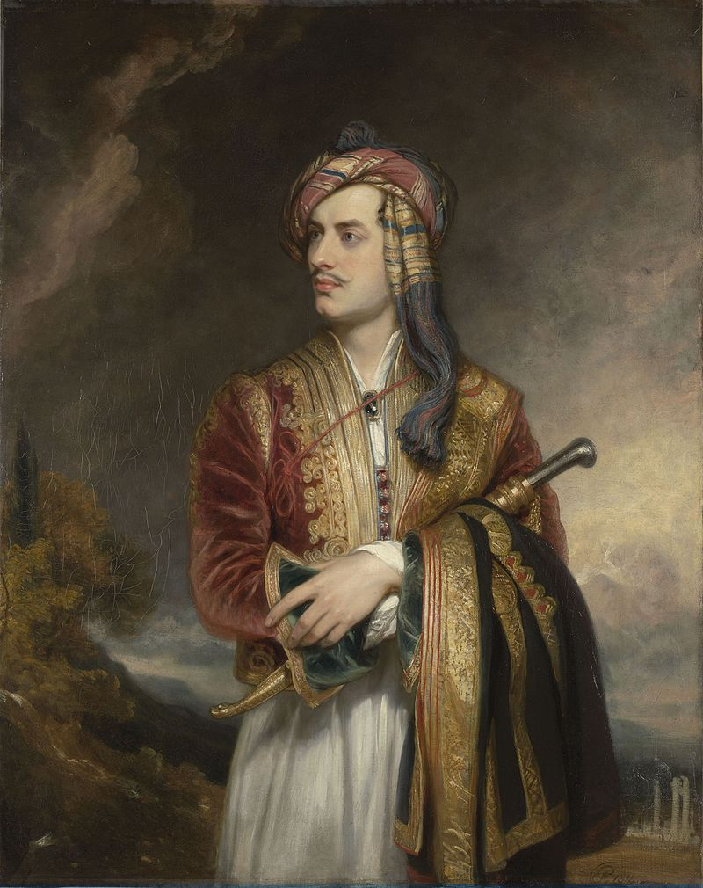
The Isles of Greece by Lord Byron (Listen to the poem and complete the missing words.)
The isles of Greece, the isles of Greece!
Where burning Sappho loved and sung,
Where grew the arts of war and ________,
Where Delos rose, and Phoebus sprung!
Eternal summer gilds them yet,
But all, except their _______, is set...
Τα νησιά της Ελλάδας, τα νησιά της Ελλάδας!
Όπου η Σαπφώ με παθος αγάπησε και τραγούδησε,
όπου ανατράφηκαν οι τέχνες του πολέμου και της ειρήνης,
όπου αναδείχτηκε η Δήλος, και ξεπετάχτηκε ο Φοίβος!
Το αιώνιο καλοκαίρι τα χρυσώνει ακόμα,
αλλά τα πάντα, εκτός από τον ήλιο τους, έχουν δύσει...

Slide 19
The mountains look on Marathon—
And Marathon looks on the sea;
And musing there an hour alone,
I dreamed that Greece might still be _________;
For standing on the Persians' grave,
I could not deem myself a __________.
Τα βουνά κοιτάζουν στο Μαραθώνα—
κι ο Μαραθώνας κοιτάζει στη θάλασσα•
κι ονειροπολώντας εκεί μια ώρα μόνος,
ονειρεύτηκα πως η Ελλάδα θα μπορούσε να'ταν ακόμα ελεύθερη•
Αφού στεκόμενος στον τάφο των Περσών,
δεν θα μπορούσα να φανταστώ τον εαυτό μου σκλάβο.

Slide 20
And where art thou, my country?
On thy voiceless shore
The heroic lay is tuneless now—
The heroic bosom _________ no more!
And must thy lyre, so long divine,
Degenerate into ________ like mine?
Και που 'σαι 'σύ; Χώρα μου;
την άφωνη ακτή σου
Το ηρωικό τραγουδι εχει σωπασει πια—
η ηρωική καρδιά πλέον δεν χτυπα!
Κι η θεία λύρα σου
Πρέπει στα δικά μου τα χέρια να ξεπέσει;

Slide 21
Trust not for _________ to the Franks —
They have a king who buys and sells;
In native swords, and native ranks
The only hope of ________ dwells;
But Turkish force, and Latin fraud,
Would break your shield, however broad
Μην εμπιστεύεστε τους Φράγκους για λευτεριά—
έχουν ένα βασιλιά που πουλάει κι αγοράζει•
στα ντόπια σπαθιά, και στα ντόπια χέρια
κατοικεί η μοναδική ελπίδα θάρρους•
μα Τούρκικη δύναμη , και Λατινική απάτη,
θέλει να σπάσει την ασπίδα σας όσο φαρδιά και να 'ναι.

Slide 22
Place me on Sunium's marbled steep,
Where nothing, save the waves and I,
May hear our mutual murmurs sweep;
There, swanlike, let me sing and _______:
A land of slaves shall ne'er be mine—
Dash down yon cup of Samian wine!
Βάλτε με στου Σουνίου τα μαρμάρινα απόκρημνα
που τίποτα, πέρα από τα κύματα και εμένα,
θα μπορούμε ν' ακούμε τ' αμοιβαία γογγυτά μας να σαρώνουν•
εκεί, κύκνεια, άστε με να τραγουδήσω και να πεθάνω:
μια γη των σκλάβων ποτέ δεν θα 'ναι δικιά μου—
Ρίξε κατάχαμα την κούπα με το
σαμιώτικο κρασί!

Slide 23
What does the poet advise Greek people to do/not to do?
Why does he refer to Greece as ‘my country’?
What does he dream of?

Slide 24
On 19th April 1824, Lord Byron dies of fever in Missolonghi. Two months before his death, on his 36th birthday, he composes his last poem…

Slide 25
January 22nd, Missolonghi On this Day I Complete my Thirty-Sixth Year
‘Tis time this heart should be unmoved,
Since others it hath ceased to move:
Yet though I cannot be beloved,
Still let me love!

Slide 26
My days are in the yellow leaf;
The flowers and fruits of Love are gone;
The worm—the canker, and the grief
Are mine alone!
The fire that on my bosom preys
Is lone as some Volcanic Isle;
No torch is kindled at its blaze
A funeral pile.
The hope, the fear, the jealous care,
The exalted portion of the pain
And power of Love I cannot share,
But wear the chain.

Slide 27
But ’tis not thus—and ’tis not here
Such thoughts should shake my Soul, nor now,
Where Glory decks the hero’s bier,
Or binds his brow.
The Sword, the Banner, and the Field,
Glory and Greece around us see!
The Spartan borne upon his shield
Was not more free.
Awake (not Greece—she is awake!)
Awake, my Spirit! Think through whom
Thy life-blood tracks its parent lake
And then strike home!

Slide 28
Tread those reviving passions down
Unworthy Manhood—unto thee
Indifferent should the smile or frown
Of beauty be.
If thou regret’st thy Youth, why live?
The land of honourable Death
Is here:—up to the Field, and give
Away thy breath!
Seek out—less often sought than found—
A Soldier’s Grave, for thee the best;
Then look around, and choose thy Ground,
And take thy rest.
Missolonghi, 1824

Slide 29
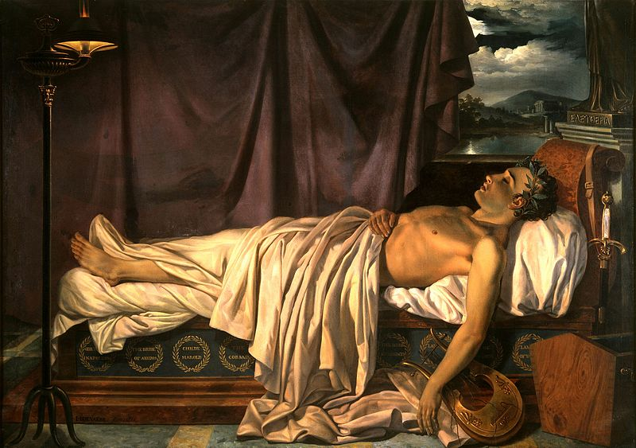

Slide 30
What does he regret?
What gives him a purpose?

Slide 31
Let's go back to where we started…
Whose shoulders do you stand on?
What do you stand for?
Maybe Gorman’s ‘mantra’ can help you answer the questions…
I am the son/daughter of ______________________
who descended from ___________________________
who _____________________________________
They call me.

Slide 32
Maybe Gorman’s ‘mantra’ can help you answer the questions… [just replace the parts in brackets with your own ideas]
I am the [daughter of black writers],
who are descended from [freedom fighters],
who [broke their chains and changed the world].
They call me.

Slide 33
I am the daughter of freedom fighters
Who are descended from ancient thinkers
Whose ideas changed the world.
They call me.

Slide 34
Credits to Luke Prodromou for:
the videos of Hellas and The Isles of Greece https://www.youtube.com/channel/UCzB4_DsZZOUkNvHFomDRD-g
the extract from Hellas and the bilingual version of The Isles of Greece
https://www.facebook.com/luke.prodromou.90

