Slide 1
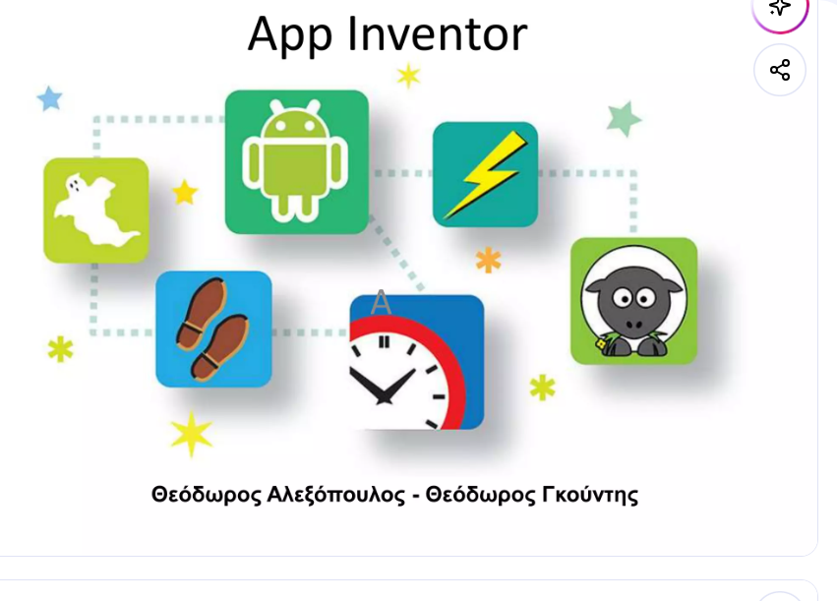
https://www.slideshare.net/slideshow/app-inventor-55717420/55717420#2

Slide 2
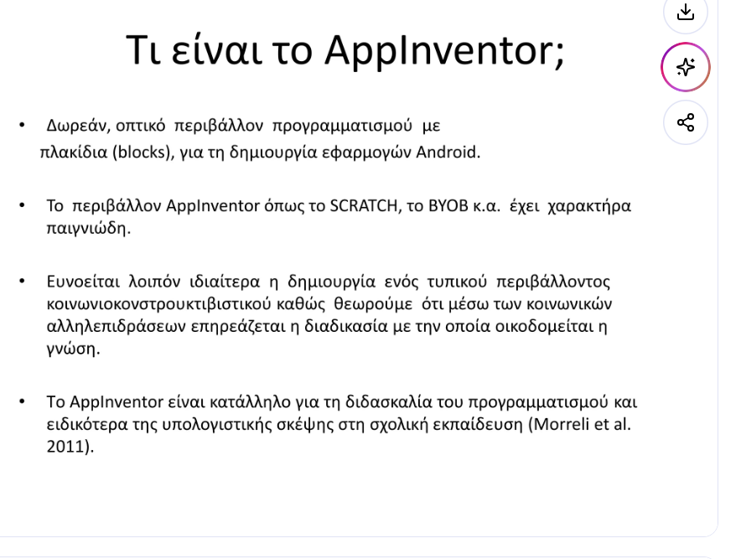

Slide 3
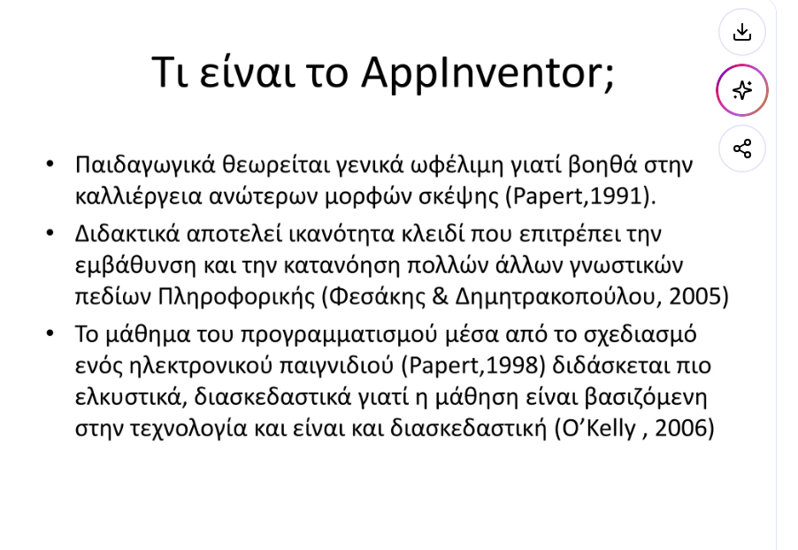

Slide 4
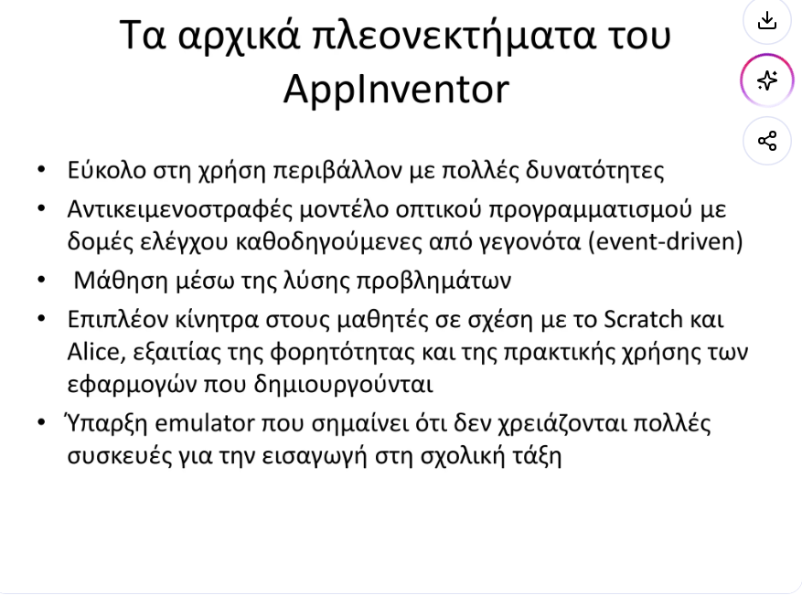

Slide 5
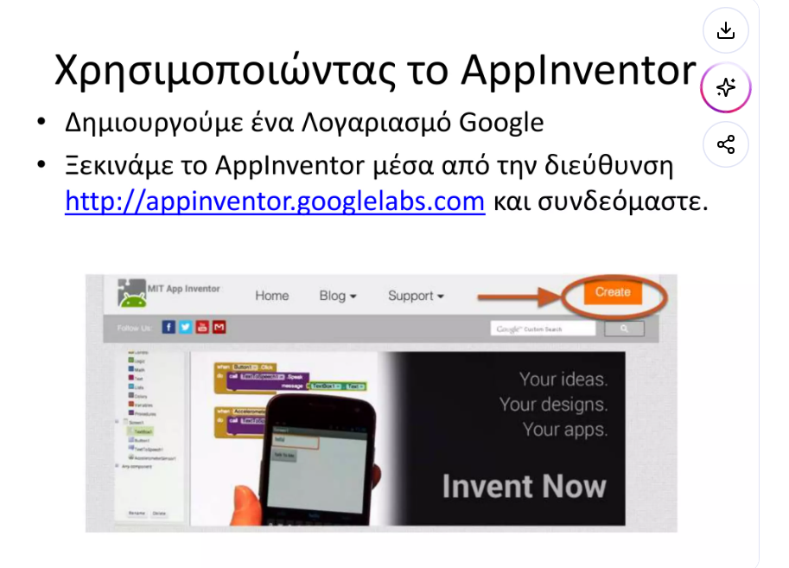

Slide 6
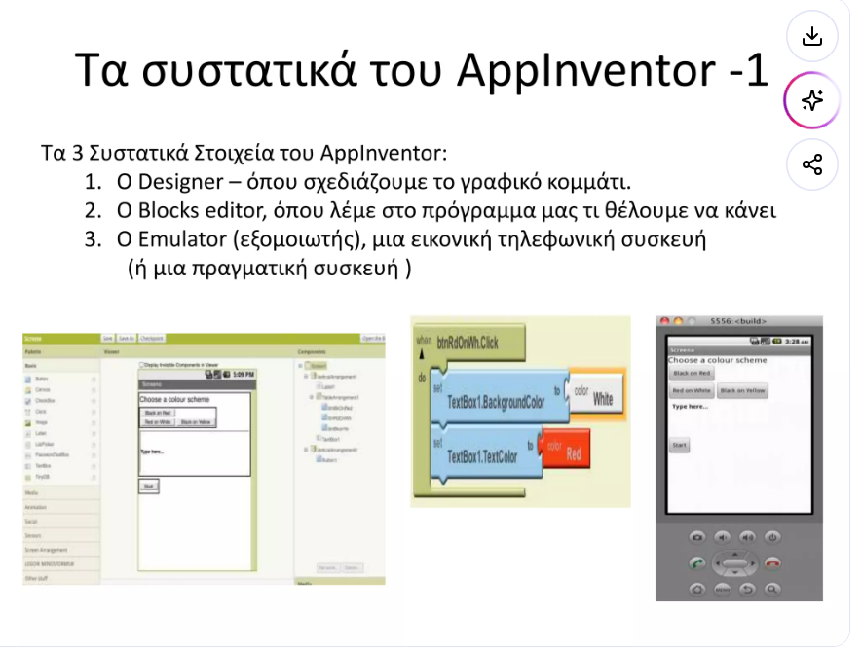

Slide 7
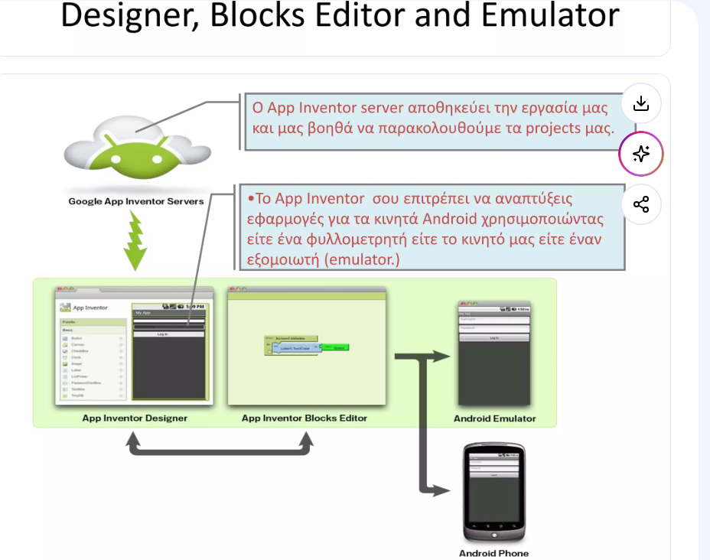

Slide 8
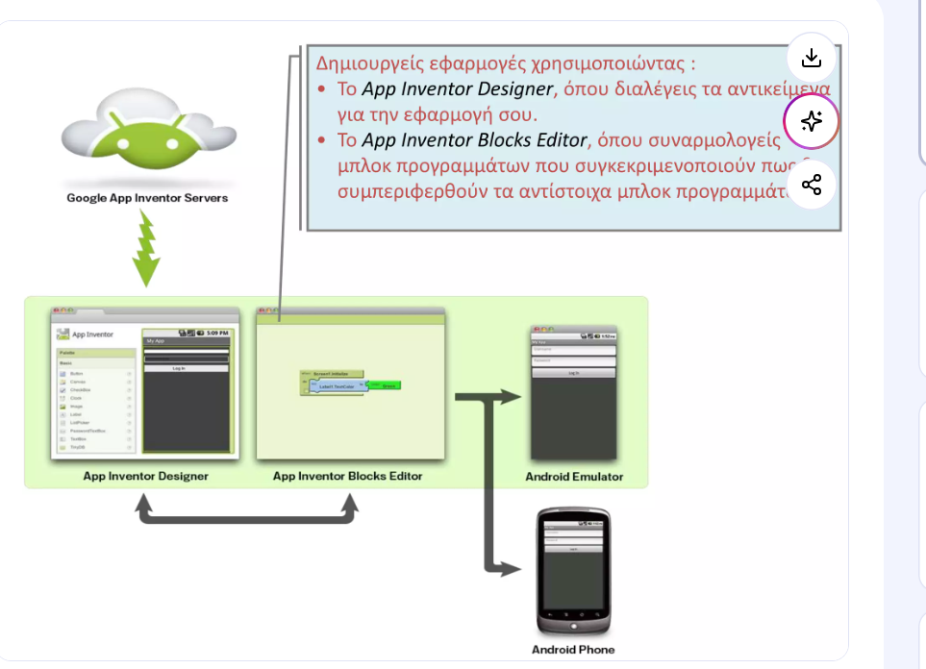

Slide 9
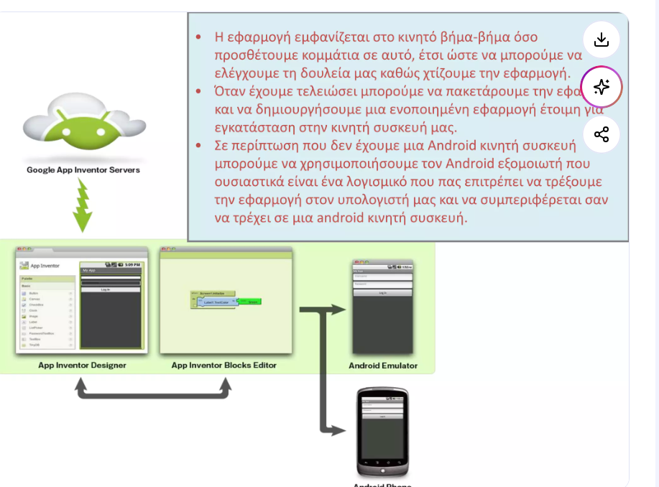

Slide 10
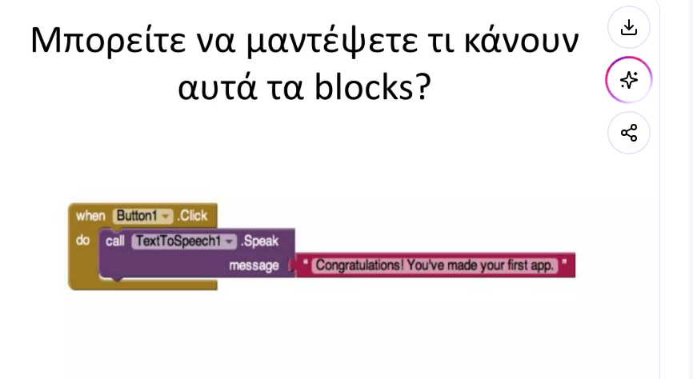

Slide 11
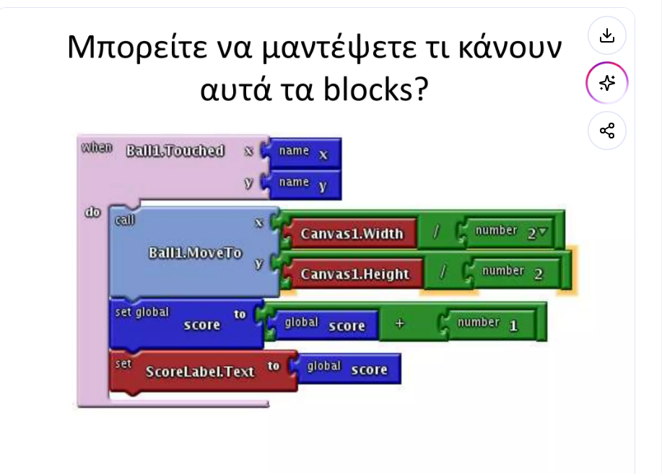

Slide 12
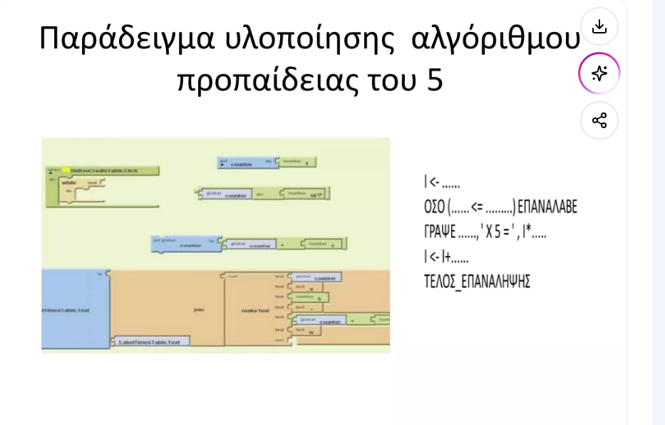

Slide 13
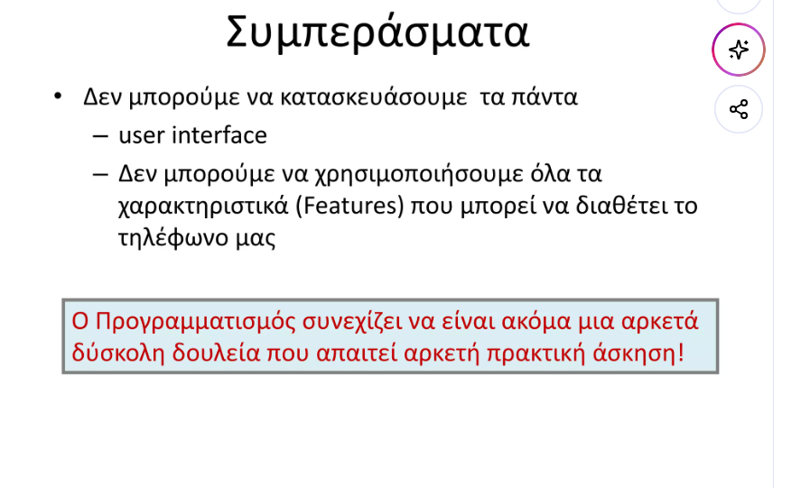

Slide 14
Παρουσιαση
https://www.slideshare.net/slideshow/app-inventor2-93349152/93349152#10
https://www.slideshare.net/slideshow/app-inventor2-1-hello-purr/67578271#1

Slide 15
app inventor
https://okiriostonipologiston.blogspot.com/2016/01/appinventor.html

