Slide 1

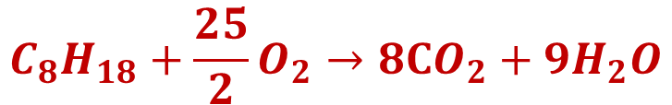

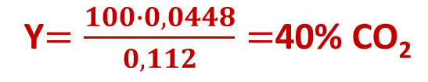
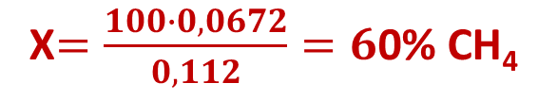

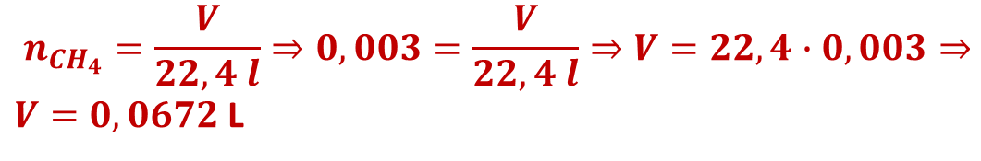
$$n_{C_{8}H_{18}}=\frac{m}{M_{rC_{8}H_{18}}}=\frac{1,14}{12∙8+18∙1}=\frac{1,14}{114}=\frac{1}{100}=0,01 mol$$
$$C_{8}H_{18}+\frac{25}{2}O_{2}→8CO_{2}+{9H}_{2}O$$
1 mol | 25/2 mol | 8 mol | 9 mol
0,01 mol |  | X=;
$$x=\frac{0,01∙8}{1}=0,08 mol$$
$$n_{{CO}_{2}}=\frac{V}{22,4 l}⇒V=n_{{CO}_{2}}∙22,4 l⇒V=22,4∙0,08=1,792 l$$
$$CH_{4}+2O_{2}→CO_{2}+{2H}_{2}O$$
$n_{H_{2}Ο}=\frac{m}{M_{rH_{2}Ο}}⇒n_{H_{2}Ο}=\frac{0,108}{2∙1+16}⇒n_{H_{2}Ο}=0,006 mol$
1 mol | 2 mol | 1 mol | 2 mol
X=; |  |  | 0,006 mol
$$n_{CH_{4}}=\frac{V}{22,4 l}⇒0,003=\frac{V}{22,4 l}⇒V=22,4∙0,003⇒$$
$V=0,0672$ L
$x=\frac{0,006∙1}{2}=0,003$mol
Χ$=\frac{100∙0,0672}{0,112}=6$0% CH₄
Στα 0,112 L βιοαερίου τα 0,0672 L είναι CH₄ και τα 0,0448 L είναι CO₂
Υ$=\frac{100∙0,0448}{0,112}=$40% CΟ₂
Στα 100 ml βιοαερίου τα Χ=; ml είναι CH₄, τα Υ=; ml είναι CO₂

Slide 2

CH₂=CH₂ + Cl₂
CH₂-CH₂
I Cl
I Cl
1 mol | 1 mol | 1 mol
X=; | Y=; | 0.04 mol
$$n_{C_{2}H_{4}Cl2 }=\frac{m}{M_{rC_{2}H_{4}Cl2}}=\frac{3,96}{12∙2+4∙1+2∙35,5}=\frac{3,96}{98}=0,04 mol$$
$$x=\frac{0,04∙1}{1}=0,04 mol$$
$$n_{C_{2}H_{4}}=\frac{V}{22,4}⇒0,04=\frac{V}{22,4}⇒V=0,04∙22,4⇒V=0, 896 L$$
$n_{Cl2}=\frac{m}{M_{rCl2}}⇒0,04=\frac{m}{2∙35,5}=\frac{m}{70}⇒m=0,04∙70⇒m=2,8$g

Slide 3


CH₂=CH₂ + H₂O
H₂SO₄
CH₃-CH₂-OH
1 mol | 1 mol | 1 mol
0,1 mol |  | x=;
$$n_{C_{2}H_{4} }=\frac{m}{M_{rC_{2}H_{4}}}=\frac{2,8}{12∙2+4∙1}=\frac{2,8}{28}=0,1 mol$$
$$x=\frac{0,1∙1}{1}=0,1 mol$$
$n_{C_{2}H_{5}OH}=\frac{m}{M_{rC_{2}H_{5}OH}}⇒0,1=\frac{m}{2∙12+6∙1+16}=\frac{m}{46}⇒m=0,1∙46⇒m=4,6$g

Slide 4
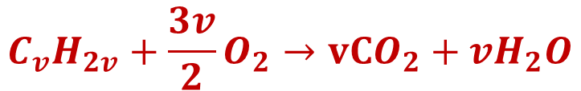


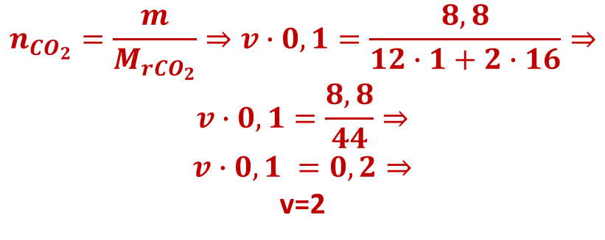
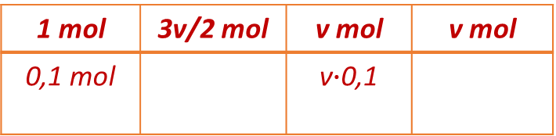
$$C_{v}H_{2v}+\frac{3v}{2}O_{2}→vCO_{2}+{vH}_{2}O$$
1 mol | 3v/2 mol | v mol | v mol
0,1 mol |  | ν$∙$0,1
$$n_{{CO}_{2}}=\frac{m}{M_{r{CO}_{2}}}⇒v∙0,1=\frac{8,8}{12∙1+2∙16}⇒$$
$$v∙0,1=\frac{8,8}{44}⇒$$
$$v∙0,1 =0,2⇒$$
v=2
CH₂=CH₂ + H₂
CH₃-CH₃
1 mol | 1 mol | 1 mol
0,1 mol | x=;
$${Άρα C}_{2}H_{4}$$
$$x=\frac{0,1∙1}{1}=0,1 mol$$
$$n_{H_{2}}=\frac{V}{22,4}⇒0,1=\frac{V}{22,4}⇒V=0,1∙22,4⇒V=2, 24 L$$

Slide 5

CH₂=CH₂ + Br₂
CH₂-CH₂
I Br
I Br
1 mol | 1 mol | 1 mol
0,1 mol | Y=;
$$y=\frac{0,1∙1}{1}=0,1 mol$$
$n_{Br2}=\frac{m}{M_{rBr2}}⇒0,1=\frac{m}{2∙80}=\frac{m}{160}⇒m=0,1∙160⇒m=16$g

Slide 6




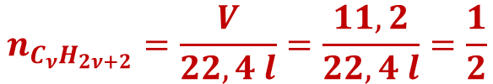
$$Αλκενιο Α:C_{4}H_{8}$$
$$n_{C_{4}H_{8}}=\frac{m}{M_{rC_{4}H_{8}}}=\frac{11,2}{12∙4+8∙1}=\frac{11,2}{56}=0,2 mol$$
$$C_{4}H_{8}+6O_{2}→4CO_{2}+{4H}_{2}O$$
1 mol | 6 mol | 4 mol | 4 mol
0,2 mol | X=;
$${Αλκανιο Β: C}_{ν}H_{2ν+2}$$
$$x=\frac{0,2∙6}{1}=1,2 mol$$
$$n_{C_{ν}H_{2ν+2}}=\frac{m}{M_{rC_{ν}H_{2ν+2}}}=\frac{29}{12∙ν+\left(2∙ν+2\right)∙1}=\frac{29}{14ν+2}$$
$$n_{C_{ν}H_{2ν+2}}=\frac{V}{22,4 l}=\frac{11,2}{22,4 l}=\frac{1}{2}$$
$\frac{29}{14ν+2}$=$\frac{1}{2}⇒2∙29=14ν+2⇒58−2=14ν⇒56=14ν⇒$ν=$\frac{56}{14}⇒ν=4$
$${Άρα αλκανιο Β: C}_{4}H_{10}$$

Slide 7
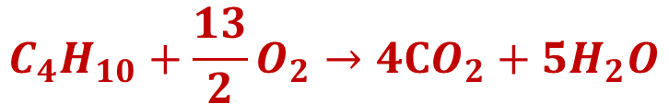
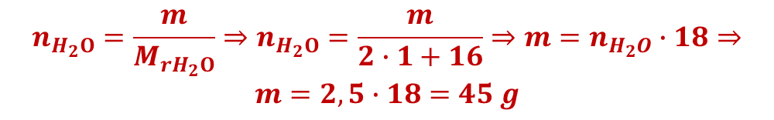


$${Άλκανιο Β: C}_{4}H_{10}$$
$$n_{C_{4}H_{10}}=\frac{m}{M_{rC_{4}H_{10}}}=\frac{29}{12∙4+10∙1}=\frac{29}{58}=\frac{1}{2}=0,5 mol$$
$$C_{4}H_{10}+\frac{13}{2}O_{2}→4CO_{2}+{5H}_{2}O$$
$$n_{H_{2}Ο}=\frac{m}{M_{rH_{2}Ο}}⇒n_{H_{2}Ο}=\frac{m}{2∙1+16}⇒m=n_{H_{2}O}∙18⇒$$
$$m=2,5∙18=45 g$$
1 mol | 13/2 mol | 4 mol | 5 mol
0,5 mol |  |  | X=;
$$x=\frac{0,5∙5}{1}=2,5 mol$$

Slide 8

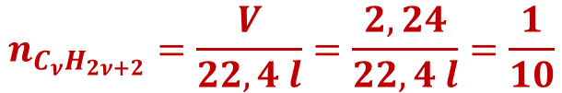
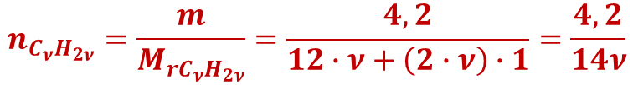
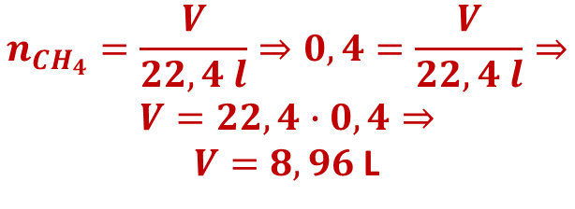
CH₂=CH₂ + ΗCl
CH₃-CH₂
I Cl
1 mol | 1 mol | 1 mol
0,4 mol | x=;
$${Αλκενιο Β: C}_{ν}H_{2ν}$$
$$x=\frac{0,4∙1}{1}=0,4 mol$$
$$n_{C_{ν}H_{2ν}}=\frac{m}{M_{rC_{ν}H_{2ν}}}=\frac{4,2}{12∙ν+\left(2∙ν\right)∙1}=\frac{4,2}{14ν}$$
$$n_{CH_{4}}=\frac{V}{22,4 l}⇒0,4=\frac{V}{22,4 l}⇒$$
$$V=22,4∙0,4⇒$$
$V=8,96$ L
$$n_{C_{ν}H_{2ν+2}}=\frac{V}{22,4 l}=\frac{2,24}{22,4 l}=\frac{1}{10}$$
$\frac{4,2}{14ν}$=$\frac{1}{10}⇒4,2∙10=14ν⇒42=14ν⇒$ν=$\frac{42}{14}⇒ν=$3
$${Άρα αλκανιο Β: C}_{3}H_{6}$$

Slide 9
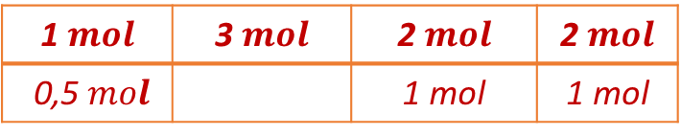

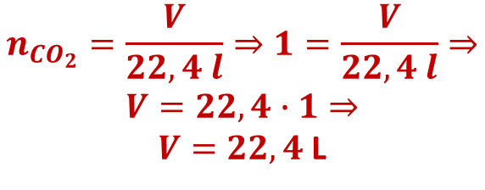
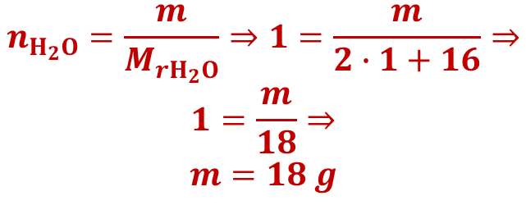
$$C_{2}H_{4}+3O_{2}→2CO_{2}+{2H}_{2}O$$
1 $mοl$ | 3 $mοl$ | 2 $mοl$ | 2 $mοl$
0,5 $mοl$ |  | 1 mοl | 1 mοl
$$n_{Η_{2}Ο}=\frac{m}{M_{rΗ_{2}Ο}}⇒1=\frac{m}{2∙1+16}⇒$$
$$1=\frac{m}{18}⇒$$
$$m=18 g$$
$$n_{CO_{2}}=\frac{V}{22,4 l}⇒1=\frac{V}{22,4 l}⇒$$
$$V=22,4∙1⇒$$
$V=22,4$ L

Slide 10

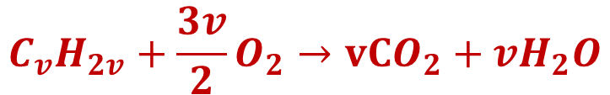

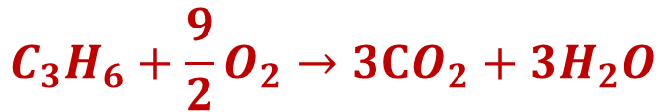

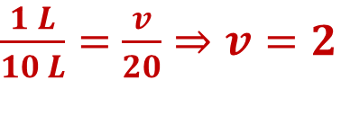
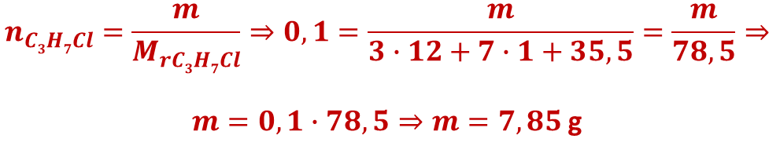
$$C_{v}H_{2v}+\frac{3v}{2}O_{2}→vCO_{2}+{vH}_{2}O$$
1 L | 3v/2 L | v L | v L
10 L |  | 20 L
$\frac{1 L}{10 L}=$ $\frac{v}{20}⇒v=2$
$${Άρα C}_{2}H_{4}$$
$$C_{3}H_{6}+\frac{9}{2}O_{2}→3CO_{2}+{3H}_{2}O$$
CH₃CH=CH₂ + ΗCl
CH₃CH-CH₃
1 L | 9/2 L | 3 L | 3 L
10 L | X=;
I Cl
1 mol | 1 mol | 1 mol
0,1 mol |  | Y=;
$$x=\frac{10∙9}{1∙2}=45 L$$
$$y=\frac{0,1∙1}{1}=0,1 mol$$
$$n_{C3H7Cl}=\frac{m}{M_{rC3H7Cl}}⇒0,1=\frac{m}{3∙12+7∙1+35,5}=\frac{m}{78,5}⇒$$
$m=0,1∙78,5⇒m=7,85$g

Slide 11

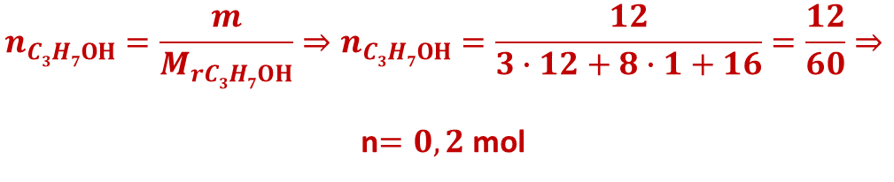
$$C_{v}H_{2v}+\frac{3v}{2}O_{2}→vCO_{2}+{vH}_{2}O$$
1 L | 3v/2 L | v L | v L
10 L |  | 20 L
$\frac{1 L}{10 L}=$ $\frac{v}{20}⇒v=2$
$${Άρα C}_{2}H_{4}$$
$$C_{3}H_{6}+\frac{9}{2}O_{2}→3CO_{2}+{3H}_{2}O$$
CH₃CH=CH₂ + Η₂Ο
CH₃CH-CH₃
1 L | 9/2 L | 3 L | 3 L
10 L | X=;
I ΟΗ
1 mol | 1 mol | 1 mol
X=; |  | 0.2 mol
$$x=\frac{10∙9}{1∙2}=45 L$$
2-προπανόλη
x$=\frac{0,2∙1}{1}=0,2 mol$
$$n_{C3H7ΟΗ}=\frac{m}{M_{rC3H7ΟΗ}}⇒n_{C3H7ΟΗ}=\frac{12}{3∙12+8∙1+16}=\frac{12}{60}⇒$$
n$=0,2$ mol

Slide 12

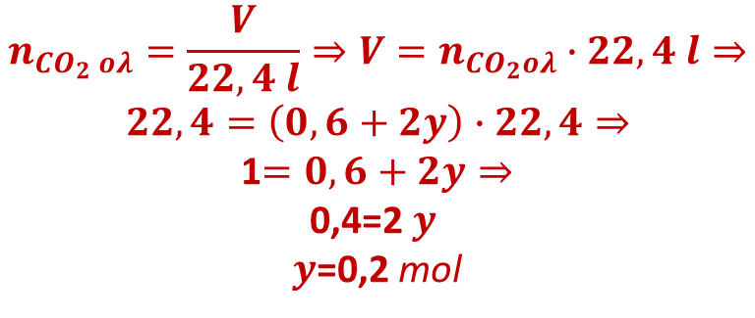


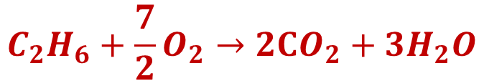
$$n_{C_{2}H_{4}}=\frac{m}{M_{rC_{2}H_{4}}}=\frac{8,4}{12∙2+4∙1}=\frac{8,4}{28}=0,3 mol$$
$$C_{2}H_{4}+3O_{2}→2CO_{2}+{2H}_{2}O$$
1 mol | 3 mol | 2 mol | 2 mol
0,3 mol |  | X=;
$x=\frac{0,3∙2}{1}=0,6$mol
$$C_{2}H_{6}+\frac{7}{2}O_{2}→2CO_{2}+{3H}_{2}O$$
$$n_{{CO}_{2} ολ}=\frac{V}{22,4 l}⇒V=n_{{CO}_{2}ολ}∙22,4 l⇒$$
$$22,4=\left(0,6+2y\right)∙22,4⇒$$
1$=0,6+2y⇒$
0,4=2 $y$
$y$=0,2 mol
1 mol | 7/2 mol | 2 mol | 3 mol
y mol |  | 2y mol
$${νC}_{2}H_{4}→−\left(C2H4\right)v−$$
$MB_{πολυμερούς}=ν∙ΜΒ_{μονομερούς}⇒56000=ν∙\left(2∙12+4∙1\right)⇒56000=ν∙28⇒ν=\frac{56000}{28}$=>ν=2000 μονομερή

Slide 13
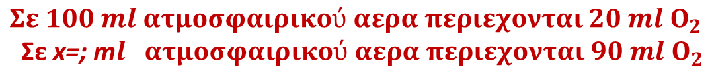

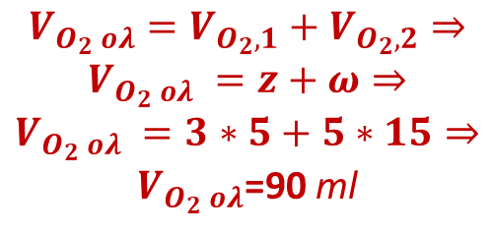
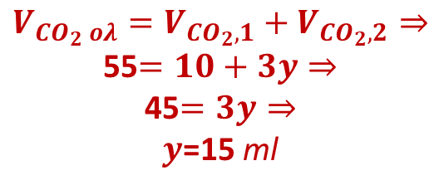



$$C_{2}H_{4}+3O_{2}→2CO_{2}+{2H}_{2}O$$
$x=\frac{2∙5}{1}=10$ml
1 ml | 3 ml | 2 ml | 2 ml
5 ml | z=; | X=;
$$V_{{CO}_{2} ολ}=V_{{CO}_{2},1}+V_{{CO}_{2},2}⇒$$
55$=10+3y⇒$
45$=3y⇒$
$y$=15 ml
$$V_{O_{2} ολ}=V_{O_{2},1}+V_{O_{2},2}⇒$$
$$V_{O_{2} ολ} =z+ω⇒$$
$$V_{O_{2} ολ} =3∗5+5∗15⇒$$
$V_{O_{2} ολ}$=90 ml
$$C_{3}H_{8}+5O_{2}→3CO_{2}+{4H}_{2}O$$
1 ml | 5 ml | 3 ml | 4 ml
y ml | ω=; | 3y ml
$$Σε 100 ml ατμοσφαιρικού αερα περιεχονται 20 ml Ο_{2}$$
Σε x=; m$l ατμοσφαιρικού αερα περιεχονται 90 ml Ο_{2}$
$$x=\frac{90∙100}{20}=450 ml$$

Slide 14

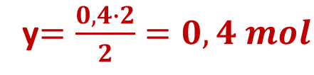



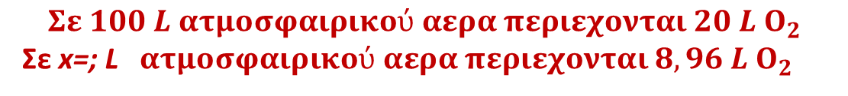
$n_{H_{2}O}=\frac{m}{M_{rH_{2}O}}=\frac{7,2}{2∙1+16}=\frac{7,2}{18}$=0,4 mol
$$CH_{4}+2O_{2}→CO_{2}+{2H}_{2}O$$
1 mol | 2 mol | 1 mol | 2 mol
x=; | y=; |  | 0,4 mol
$$x=\frac{0,4∙1}{2}=0,2 mol$$
$$n_{{CH}_{4}}=\frac{V}{22,4 l}⇒V=n_{{CH}_{4}}∙22,4 l⇒V=22,4∙0,2=4,48 L$$
y$=\frac{0,4∙2}{2}=0,4 mol$
Άρα 4,48 L CH₄ και 1,12 L CO₂
$$n_{O_{2}}=\frac{V}{22,4 l}⇒V=n_{O_{2}}∙22,4 l⇒V=22,4∙0,4=8,96 L$$
$$Σε 100 L ατμοσφαιρικού αερα περιεχονται 20 L Ο_{2}$$
Σε x=; L$ατμοσφαιρικού αερα περιεχονται 8,96 L Ο_{2}$
$$x=\frac{8,96∙100}{20}=44,8 L$$

Slide 15
$$Αλκενιο Α:C_{4}H_{8}$$
$$n_{C_{4}H_{8}}=\frac{m}{M_{rC_{4}H_{8}}}=\frac{11,2}{12∙4+8∙1}=\frac{11,2}{56}=0,2 mol$$
$$C_{4}H_{8}+6O_{2}→4CO_{2}+{4H}_{2}O$$
1 mol | 6 mol | 4 mol | 4 mol
0,2 mol | X=;
$${Αλκανιο Β: C}_{ν}H_{2ν+2}$$
$$x=\frac{0,2∙6}{1}=1,2 mol$$
$$n_{C_{ν}H_{2ν+2}}=\frac{m}{M_{rC_{ν}H_{2ν+2}}}=\frac{29}{12∙ν+\left(2∙ν+2\right)∙1}=\frac{29}{14ν+2}$$
$$n_{C_{ν}H_{2ν+2}}=\frac{V}{22,4 l}=\frac{11,2}{22,4 l}=\frac{1}{2}$$
$\frac{29}{14ν+2}$=$\frac{1}{2}⇒2∙29=14ν+2⇒58−2=14ν⇒56=14ν⇒$ν=$\frac{56}{14}⇒ν=4$
$${Άρα αλκανιο Β: C}_{4}H_{10}$$

Slide 16
$${Άλκανιο Β: C}_{4}H_{10}$$
$$n_{C_{4}H_{10}}=\frac{m}{M_{rC_{4}H_{10}}}=\frac{29}{12∙4+10∙1}=\frac{29}{58}=\frac{1}{2}=0,5 mol$$
$$C_{4}H_{10}+\frac{13}{2}O_{2}→4CO_{2}+{5H}_{2}O$$
$$n_{H_{2}Ο}=\frac{m}{M_{rH_{2}Ο}}⇒n_{H_{2}Ο}=\frac{m}{2∙1+16}⇒m=n_{H_{2}O}∙18⇒$$
$$m=2,5∙18=45 g$$
1 mol | 13/2 mol | 4 mol | 5 mol
0,5 mol |  |  | X=;
$$x=\frac{0,5∙5}{1}=2,5 mol$$

