Slide 2
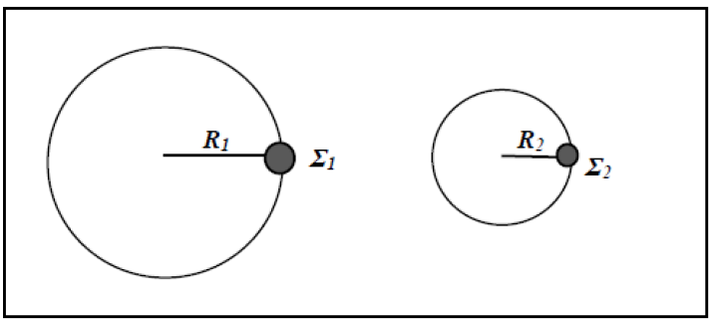
α₁
α₂
υ₂
υ₁

Slide 3
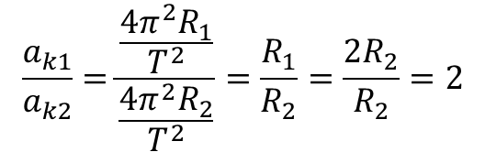
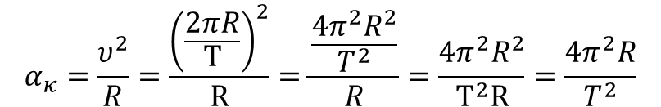

$$α_{κ}=\frac{υ^{2}}{R}=\frac{{\left(\frac{2πR}{Τ}\right)}^{2}}{R}=\frac{\frac{4π^{2}R^{2}}{T^{2}}}{R}=\frac{4{π^{2}R}^{2}}{Τ^{2}R}=\frac{4π^{2}R}{T^{2}}$$
$$\frac{a_{k1}}{a_{k2}}=\frac{\frac{4π^{2}R_{1}}{T^{2}}}{\frac{{4π}^{2}R_{2}}{T^{2}}}=\frac{R_{1}}{R_{2}}=\frac{2R_{2}}{R_{2}}=2$$
$$a_{k1}={2∙a}_{k2}$$

Slide 4




α΄ τρόπος
$$θ_{λ}=2π+θ_{ω}$$
$$ω_{λ}Δt=2π+ω_{ω}Δt$$
$\frac{2π}{Τ_{λ}}Δt$=2π+$\frac{2π}{Τ_{ω}}Δ$t
$\frac{1}{Τ_{λ}}Δt$-$\frac{1}{Τ_{ω}}Δ$t=1
$\left(\frac{Δt}{Τ_{λ}}−\frac{Δt}{Τ_{ω}}\right)$=1
$\left(\frac{Τ_{ω}−Τ_{λ}}{{Τ_{ω}∙Τ}_{λ}}\right)$ $Δt$=1
$Δt$=$\frac{{Τ_{ω}∙Τ}_{λ}}{Τ_{ω}−Τ_{λ}}$
$Δt$=$\frac{12∙60∙60∙60∙60}{12∙60∙60−60∙60}$=
$\frac{12∙60∙60}{11}$=$\frac{12}{11}h$
β΄ τρόπος
$$S_{λ}=2πR+S_{ω}$$
$$u_{λ}Δt=2πR+u_{ω}Δt$$
$\frac{2πR}{Τ_{λ}}Δt$=2πR+$\frac{2πR}{Τ_{ω}}Δ$t
$\frac{1}{Τ_{λ}}Δt$-$\frac{1}{Τ_{ω}}Δ$t=1
$\left(\frac{Δt}{Τ_{λ}}−\frac{Δt}{Τ_{ω}}\right)$=1
$\left(\frac{Τ_{ω}−Τ_{λ}}{{Τ_{ω}∙Τ}_{λ}}\right)$ $Δt$=1
$Δt$=$\frac{{Τ_{ω}∙Τ}_{λ}}{Τ_{ω}−Τ_{λ}}$
$Δt$=$\frac{12∙60∙60∙60∙60}{12∙60∙60−60∙60}$=
$\frac{12∙60∙60}{11}$=$\frac{12}{11}h$
θ_{λ}
θ_{ω}
$$Τ_{ω}=12∙60∙60 s$$
$$Τ_{λ}=60∙60 s$$

Slide 5

$$F_{k}=mα_{κ}=m\frac{υ^{2}}{R}=m\frac{{\left(ωR\right)}^{2}}{R}=m\frac{ω^{2}R^{2}}{R}=mω^{2}R$$
$\frac{Τ_{θ}}{Τ_{θ}}=\frac{mω_{1}^{2}R}{mω_{2}^{2}\frac{R}{2}} η΄ 1=\frac{2∙ω_{1}^{2}}{ω_{2}^{2}} η^{′}ω_{2}^{2}=$ $2∙ω_{1}^{2}$ η΄ $ω_{2}=\sqrt{2∙ω_{1}^{2}} η΄ω_{2}=ω_{1}\sqrt{2 } η^{′}\frac{ω_{1}}{ω_{2}}$=$\frac{1}{\sqrt{2}}$ η΄$\frac{ω_{1}}{ω_{2}}$=$\frac{\sqrt{2}}{\sqrt{2}\sqrt{2}}$=$\frac{\sqrt{2}}{2}$
$Άρα \frac{ω_{1}}{ω_{2}}$=$\frac{\sqrt{2}}{2}$ οπότε σωστή είναι η επιλογή β

Slide 6
$$F_{k}=mα_{κ}=m\frac{υ^{2}}{R}=m\frac{{\left(ωR\right)}^{2}}{R}=m\frac{ω^{2}R^{2}}{R}=mω^{2}R=m{\left(2πf\right)}^{2}R=m4π^{2}f^{2}R$$
$\frac{F_{1}}{F_{2}}=\frac{m4π^{2}f_{1}^{2}R_{1}}{m4π^{2}f_{2}^{2}R_{2}}=\frac{f_{1}^{2}R_{1}}{f_{2}^{2}R_{2}}$ άρα σωστή απάντηση είναι η α: $\frac{F_{1}}{F_{2}}=\frac{f_{1}^{2}R_{1}}{f_{2}^{2}R_{2}}$

Slide 7




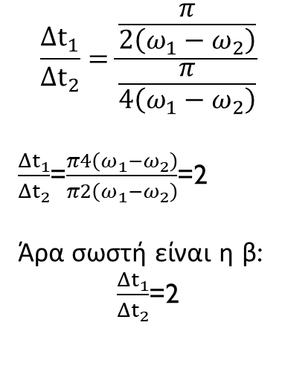
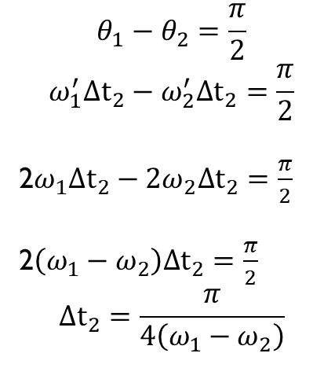
$$θ_{1}+(\frac{π}{2}−θ_{2})=π$$
$$θ_{1}−θ_{2}=π−\frac{π}{2}$$
$$θ_{1}−θ_{2}=\frac{π}{2}$$
$$\frac{{Δt}_{1}}{{Δt}_{2}}=\frac{\frac{π}{2\left(ω_{1}−ω_{2}\right)}}{\frac{π}{4\left(ω_{1}−ω_{2}\right)}}$$
$\frac{{Δt}_{1}}{{Δt}_{2}}$=$\frac{π4\left(ω_{1}−ω_{2}\right)}{π2\left(ω_{1}−ω_{2}\right)}$=2
Άρα σωστή είναι η β:
$\frac{{Δt}_{1}}{{Δt}_{2}}$=2
$$θ_{1}−θ_{2}=\frac{π}{2}$$
$$ω_{1}{Δt}_{1}−ω_{2}{Δt}_{1}=\frac{π}{2}$$
$$\left(ω_{1}−ω_{2}\right){Δt}_{1}=\frac{π}{2}$$
$${Δt}_{1}=\frac{π}{2\left(ω_{1}−ω_{2}\right)}$$
$$θ_{1}−θ_{2}=\frac{π}{2}$$
$$ω_{1}^{′}{Δt}_{2}−ω_{2}^{′}{Δt}_{2}=\frac{π}{2}$$
2$ω_{1}{Δt}_{2}−{2ω}_{2}{Δt}_{2}=\frac{π}{2}$
2$\left(ω_{1}−ω_{2}\right){Δt}_{2}=\frac{π}{2}$
$${Δt}_{2}=\frac{π}{4\left(ω_{1}−ω_{2}\right)}$$
θ₂
Λ
Κ
π/2-θ₂
θ₁

Slide 8


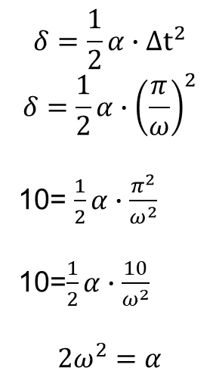

$$επιταχυνόμενη:δ=\frac{1}{2}α∙{Δt}^{2}$$
$$δ=\frac{1}{2}α∙{Δt}^{2}$$
$$δ=\frac{1}{2}α∙{\left(\frac{π}{ω}\right)}^{2}$$
10= $\frac{1}{2}α∙\frac{π^{2}}{ω^{2}}$
10=$\frac{1}{2}α∙\frac{10}{ω^{2}}$
$$2ω^{2}=α$$
_{Β}
$Δt$=$\frac{T}{2}=\frac{\frac{2π}{ω}}{2}=\frac{2π}{2ω}=\frac{π}{ω}$
_{Α}
_{Κ}
$$Άρα σωστη$$
$$απαντηση η α:$$
$$α=2ω^{2}$$

Slide 9



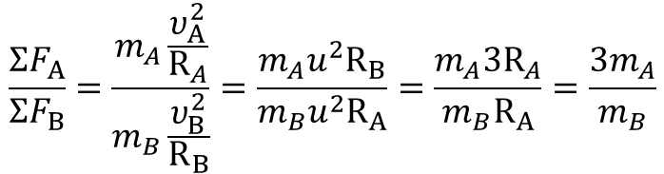


$${ΣF}_{Α}=m_{A}\frac{υ_{Α}^{2}}{R_{A}}$$
$${ΣF}_{Β}=m_{B}\frac{υ_{Β}^{2}}{R_{Β}}$$
$$\frac{{ΣF}_{Α}}{{ΣF}_{Β}}=\frac{m_{A}\frac{υ_{Α}^{2}}{R_{A}}}{m_{B}\frac{υ_{Β}^{2}}{R_{Β}}}=\frac{m_{A}u^{2}R_{Β}}{m_{B}u^{2}R_{A}}=\frac{m_{A}3R_{A}}{m_{B}R_{A}}=\frac{{3m}_{A}}{m_{B}}$$
$$\frac{{3ΣF}_{B}}{{ΣF}_{Β}}=\frac{{3m}_{A}}{m_{B}}$$
$${ΣF}_{k}=mα_{κ}=m\frac{υ^{2}}{R}$$
$\frac{3}{1}=\frac{{3m}_{A}}{m_{B}}$=> $\frac{m_{A}}{m_{B}}$=$\frac{3}{3}⇒\frac{m_{A}}{m_{B}}\text{=}\text{1}$
$$Άρα σωστη απαντηση η γ: \frac{m_{Β}}{m_{Α}}\text{=}\text{1}$$

