Slide 1

Rubbish
are source of pollution and diseases

Slide 2

Rubbish pollute the environment

Slide 3

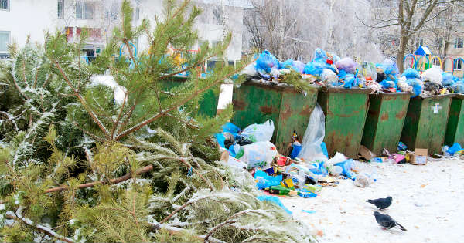
Earth pollution:
There are plastics and rubbish everywhere, in the streets and the forests.

Slide 4
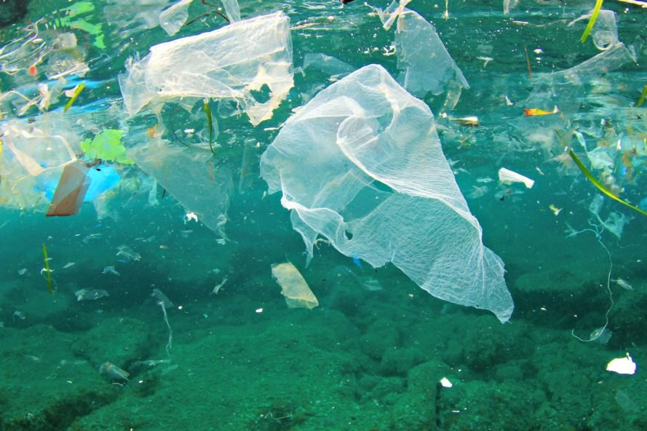
Sea pollution
There are rubbish on the beach and in the sea. When we throw plastics in the sea, sea animals and fish eat the plastics and die

Slide 5
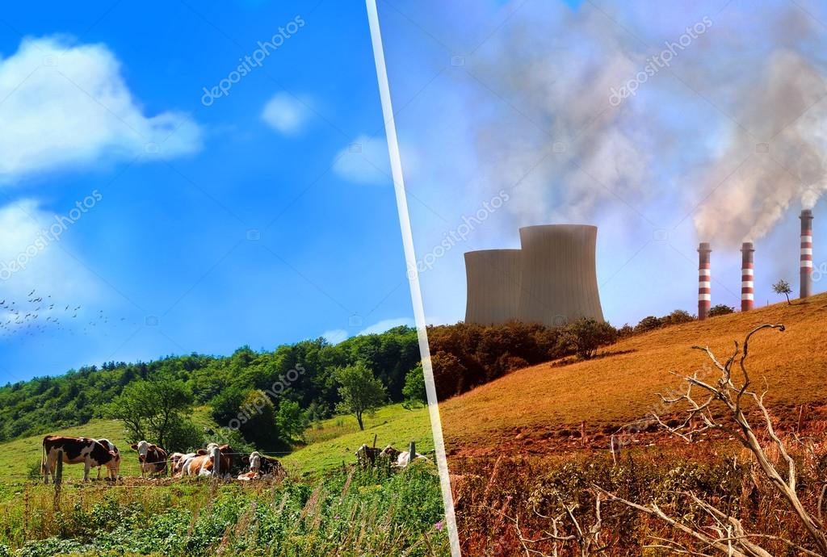
3. Air pollution
The factories that make plastics pollute the air because they use oil.

Slide 6

Conclusion
We must
1] Reduce rubbish
2] Re-use old things
AND OF COURSE…
3] RECYCLE

