Slide 1
REDUCE

Slide 2
REDUCE
The less rubbish we produce, the best for the environment.

Slide 3
1] Use re-fillable apparatus. We save the money and protect the environment.
2]Buy no packaging food . The less rubbish we produce, the best for the environment
3]Avoid too much packaging.
4]Stop using plastic cups and plates
5]Use re-usable bottles of water.
6] Think about compost.

Slide 4
7]Don’t use plastic bags, invest on cloth.
animals save the planet\The Animals Save the Planet - Supermarket Bags.mp4

Slide 5

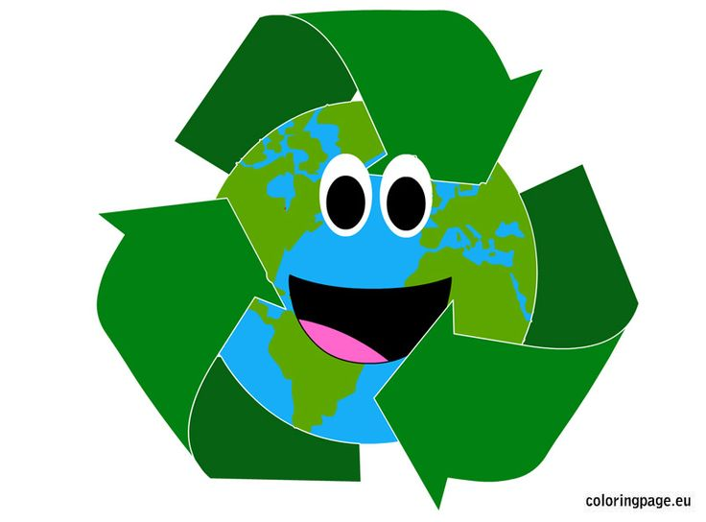

Slide 6
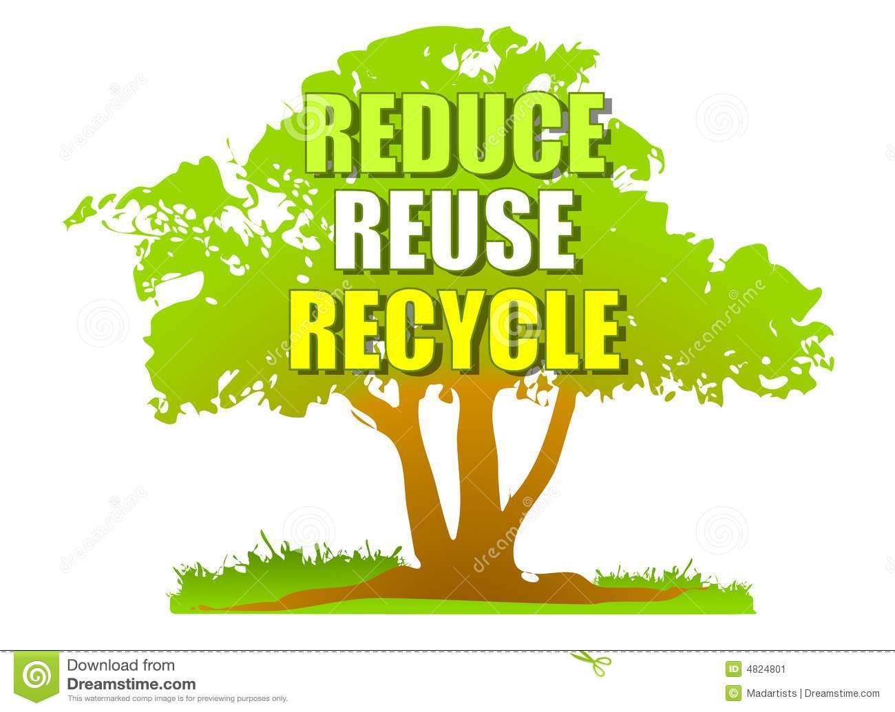

Slide 7

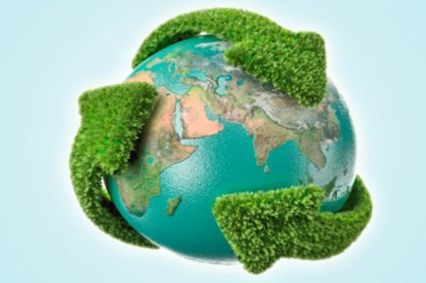


Slide 8



Slide 9

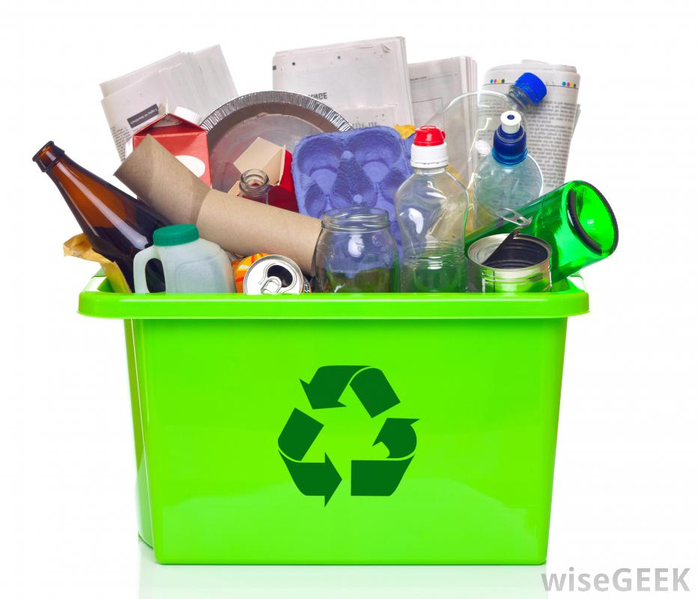

Slide 10


Slide 11
