Slide 1
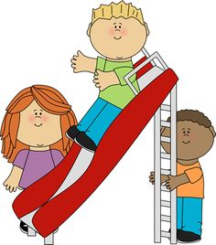
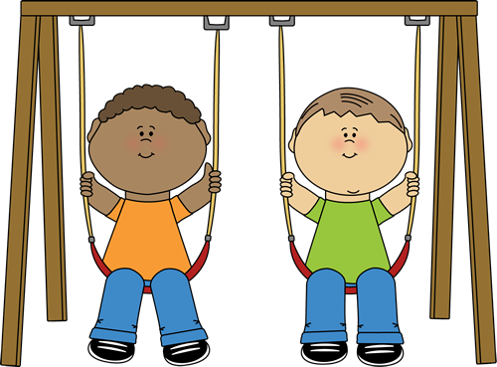
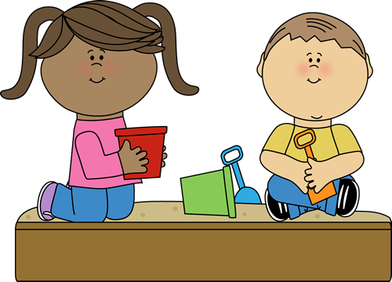
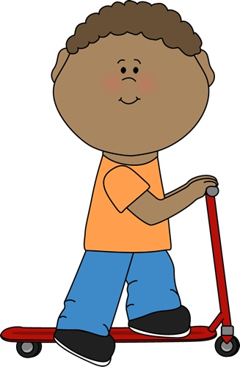
At the playground
Sami_lahiji@yahoo.com
BP1.C
Unit 9

Slide 2
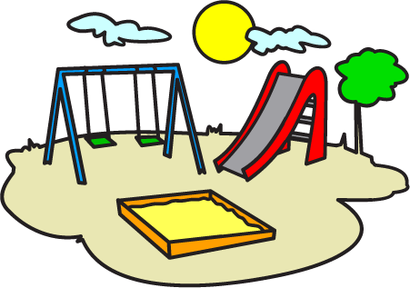
He is dancing.

Slide 3
He is catching the butterflies.

Slide 4
He is eating sandwich.

Slide 5
She is kicking a ball.

Slide 6
They are singing.

Slide 7
He is riding a bike.

Slide 8
She is jumping rope.

Slide 9
They are roller skating.

Slide 10
He is throwing a ball.

Slide 11
They’re playing a game.

Slide 12
Are they playing a game?
Yes, they are.

Slide 13
Is he riding a skateboard?
No, he isn’t.

Slide 14
Is she jumping rope?
No, she isn’t

Slide 15
Is he catching butterflies?
Yes, he is.

Slide 16
Is she singing?
Yes, she is.

Slide 17
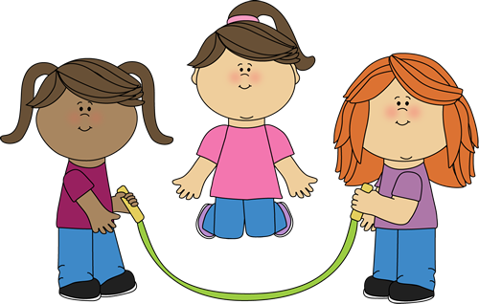
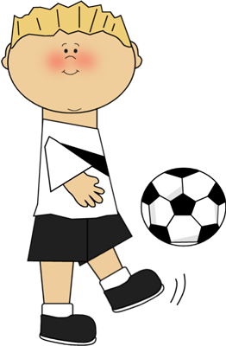
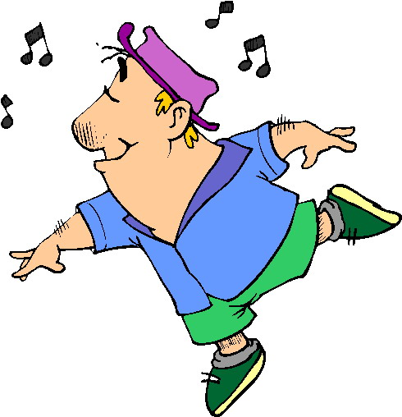
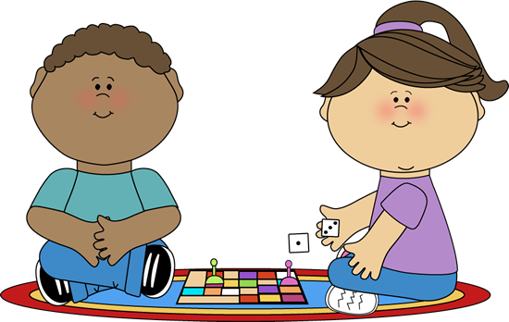
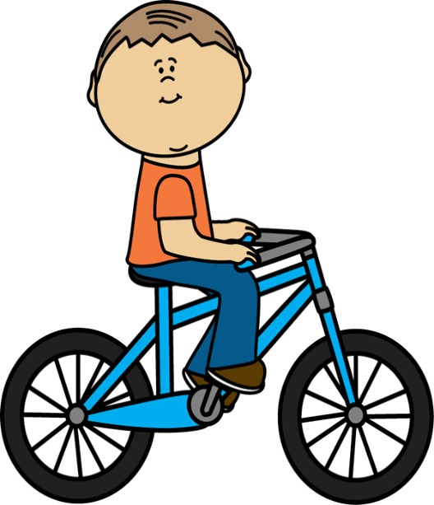
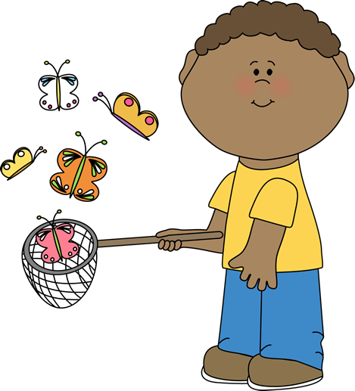
Good luck

