Slide 1
The Great Schism
The Christian Church: how completely did the Great Schism transform Christianity?

Slide 2
I can explain why the Christian Church split in two in 1054.

Slide 3
Church
Holy Spirit
liturgy
schism

Slide 4
The Church is the organisation of the Christian religion.
In Christianity, the Holy Spirit is the manifestation of God in the world.
Liturgy means the form in which worship is conducted.
A schism is a split between strongly opposed parties.

Slide 5
The Great Schism
Differences in geography
Differences in belief
Why did the split happen in 1054?

Slide 6
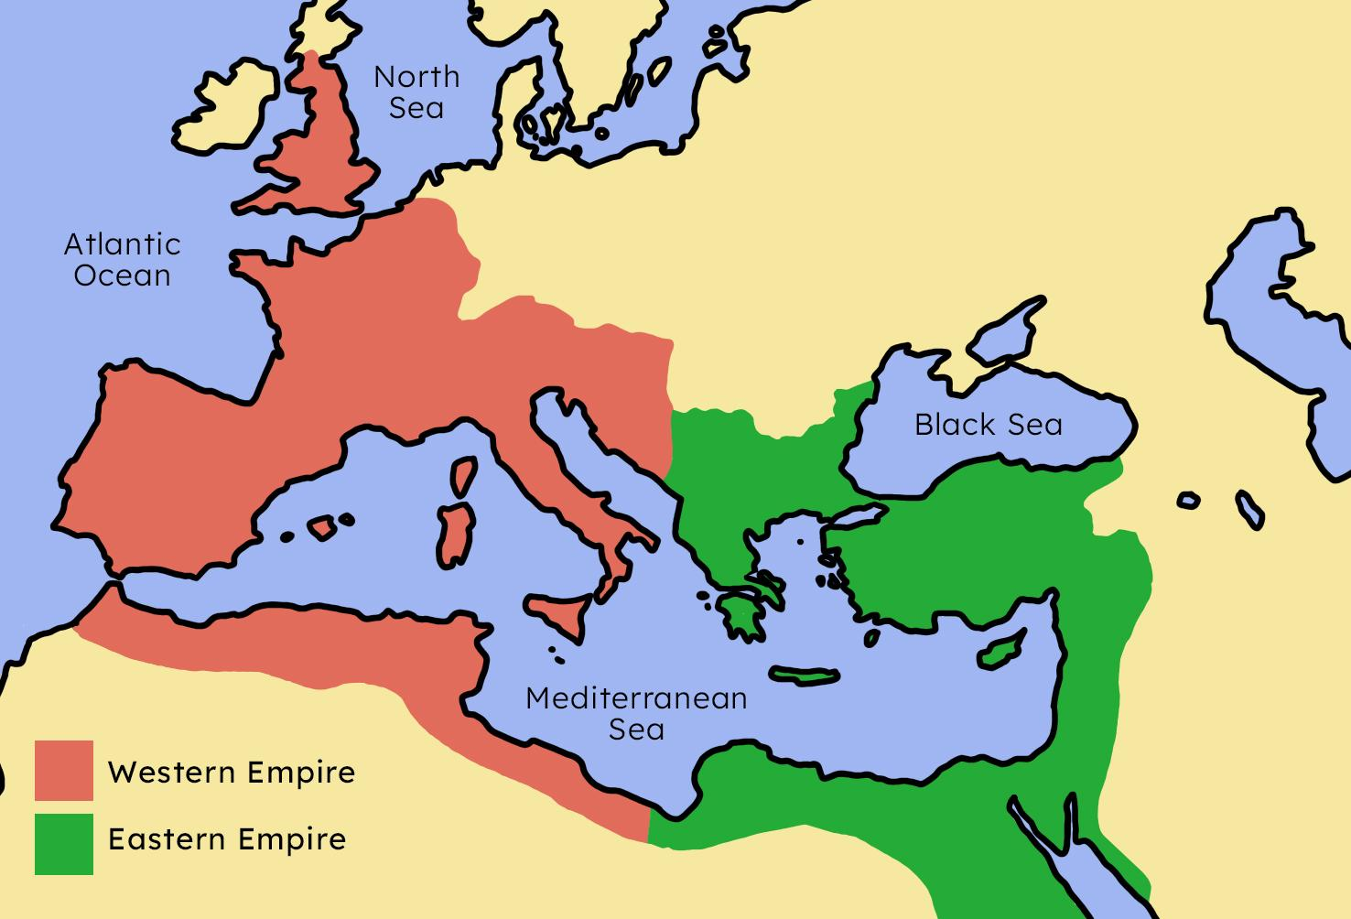
Differences in geography
A
Map of the split in the Roman Empire into East and West

Slide 7
Differences in geography
Important bishops were called ‘patriarchs’ in the Eastern Roman Empire.
Patriarchs worked together to lead the Church in the East, but not in the West.
Patriarchs worked together to lead the Church in both the East and the West.

Slide 8
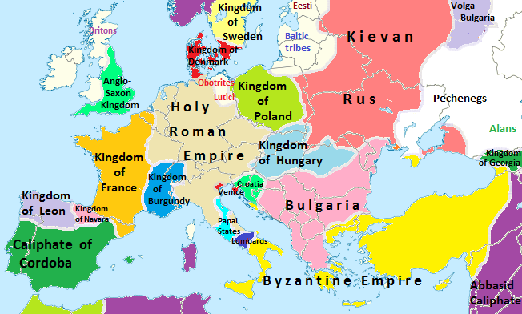
Differences in geography
A
Map of Europe in 1000 CE. The Western Roman Empire had fragmented into different kingdoms, whilst the Eastern Roman Empire, though reduced, was still mostly
stable
Mandramunjak, CC BY-SA 3.0 <https://creativecommons.org/licenses/by-sa/3.0>, via Wikimedia Commons

Slide 9
Differences in geography
Which two cities were the centres of Christianity by the 7th century?
Constantinople
Lhasa
Mecca
Rome

Slide 10
Differences in geography
Colour-code the features of the Western and Eastern Churches.
led by a single pope
present in several kingdoms
language used was Greek
led by several patriarchs
present in a single empire
language used was Latin
thought one person should have complete authority over all of the Church
thought authority should be shared amongst several people in the Church

Slide 11
Differences in geography
Colour-code the features of the Western and Eastern Churches.
led by a single pope
present in several kingdoms
language used was Greek
led by several patriarchs
present in a single empire
language used was Latin
thought one person should have complete authority over all of the Church
thought authority should be shared amongst several people in the Church

Slide 12
The Great Schism
Differences in geography
Differences in belief
Why did the split happen in 1054?

Slide 13
Differences in belief
The filioque (‘and the Son’) controversy was a major difference in belief between the Western and Eastern Christian Churches.
B
Father
Son
Father
Western Church
Eastern Church
Holy Spirit
Holy Spirit
Son

Slide 14
Differences in belief
What does ‘filioque’ mean?
‘and the Father’
‘and the Son’
‘and the Holy Spirit’

Slide 15
Differences in belief
Discuss:
Why was it a problem that the Western and Eastern Churches began to show differences in belief and liturgy?
showed that they were not united anymore
concerns that one Church is ‘wrong’ - all followers would not be able to enter Heaven
could lead to further arguments
could result in two separate religions

Slide 16
Differences in belief
Write one paragraph explaining how religious beliefs and liturgy were different between the Eastern and Western Churches.
Try and include the following in your answer:
Holy Spirit
Eucharist
unleavened bread
leavened bread

Slide 17
Differences in belief
Write one paragraph explaining how religious beliefs and liturgy were different between the Eastern and Western Churches.
Your answer could include:
One way in which religious beliefs and liturgy were different between Eastern and Western Churches was their beliefs about the origins of the Holy Spirit. The Eastern Church believed the Holy Spirit came only from God, whereas the Western Church believed it came from God and Jesus. Another difference was what kind of bread each Church used during the Eucharist. The Western Church used unleavened bread whereas the Eastern Church used leavened
bread and dipped it in wine.

Slide 18
The Great Schism
Differences in geography
Differences in belief
Why did the split happen in 1054?

Slide 19
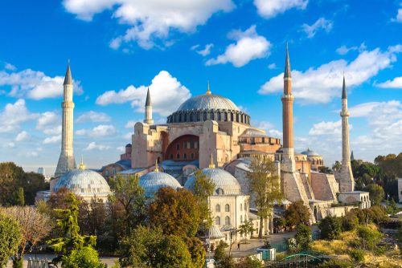
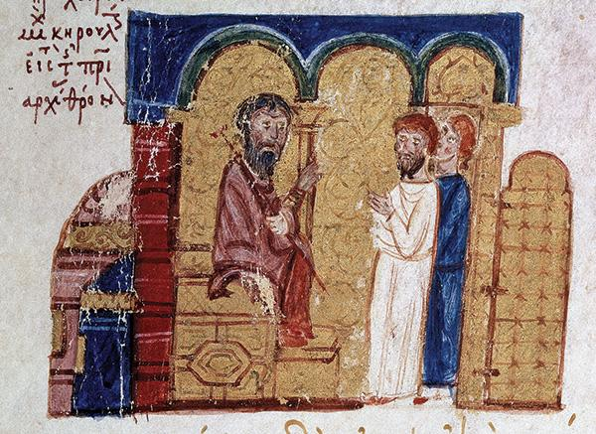
Why did the split happen in 1054?
C
Painting of Patriarch Michael Cerularius (seated)
Photo of the Hagia Sofia
MINCIUS, Giovanni (?-ca. 1073/1074) ©1998-2015 Salvador Miranda. (arms, Antipope Benedictus X)Biblical Archaeology Review 41:4, July/August 2015 Strata: In History: Kerularij and Humbert, Public domain, via Wikimedia Commons
Shutterstock/Sergii Figurnyi

Slide 20
Why did the split happen in 1054?
What does it mean to ‘excommunicate’ someone?
to exclude them from the Church
to publicly execute them
to stop talking to them

Slide 21
Why did the split happen in 1054?
Map of the split in the Roman Empire, which was mirrored by the split in the Christian Church
C
The Latin cross
The Eastern Orthodox cross

Slide 22
Why did the split happen in 1054?
The Great Schism of 1054 was the first time the Church had seen any splits.
The Church had only recently recovered from another large schism just a few years previously.
The Church had previously suffered several ‘little schisms’, which had been repaired.

Slide 23
Why did the split happen in 1054?
How important were the events of 1054 in creating a schism in the Christian Church? Explain your answer.
You could include one of the following to support your answer:
the excommunication of leading Churchmen
arguments over power
differences in language and location
differences in belief and liturgy

Slide 24
Why did the split happen in 1054?
How important were the events of 1054 in creating a schism in the Christian Church? Your answer may include:
The events of 1054 were quite important in creating a schism in the Christian Church, but they were not the most important thing that caused the schism. Other schisms had happened before but were repaired, so this one could have been repaired too, except the Church had been drifting apart for hundreds of years due to differences in belief and liturgy. Therefore, the the main reason the Church suffered the Great Schism was that the Eastern and Western Churches were just too different from each other by 1054.

Slide 25
The Great Schism
The Eastern and Western Churches began to drift apart due to being isolated from each other after the fall of the Western Roman Empire.
The Eastern and Western Churches began to develop differences in belief and liturgy.
The Great Schism of 1054 was a major change to the Christian Church, which led to the development of the separate Roman Catholic and Eastern Orthodox Churches.

Slide 26
© Oak National Academy 2024.
Produced in partnership with Future Academies Trust.
Licensed on the Open Government Licence v3.0, except where otherwise stated. See Oak terms and conditions.

