Slide 1

In this lesson we learn about:
The Language of Social Media

Slide 2

SOCIAL MEDIA
Activity 1. With your classmate , try to create a definition for the term Social Media

Slide 3

SOCIAL MEDIA:
websites and applications which people use to create and/or share messages, ideas, images, videos, etc as part of an online community.

Slide 4
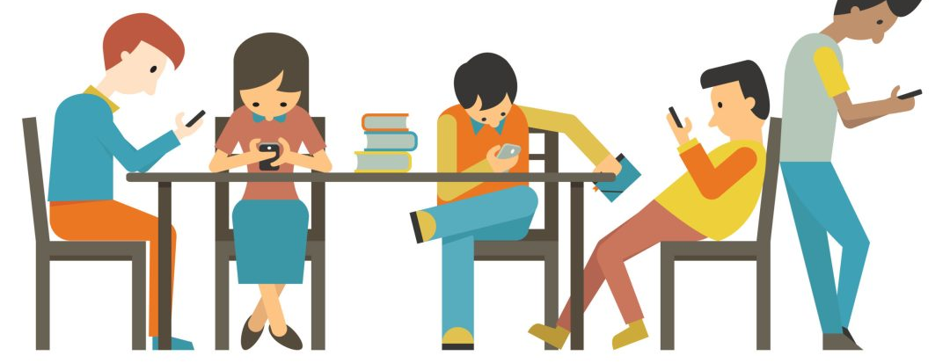
Activity 2. With your classmate, name as many social media websites and applications as you can in 30”.

Slide 5

Activity 3. Discuss the questions below with your classmate.
  Do you use any social networks? Explain.
  Why do you think social networks are so popular?
  Do you notice any differences between how younger and older people use social media?

Slide 6

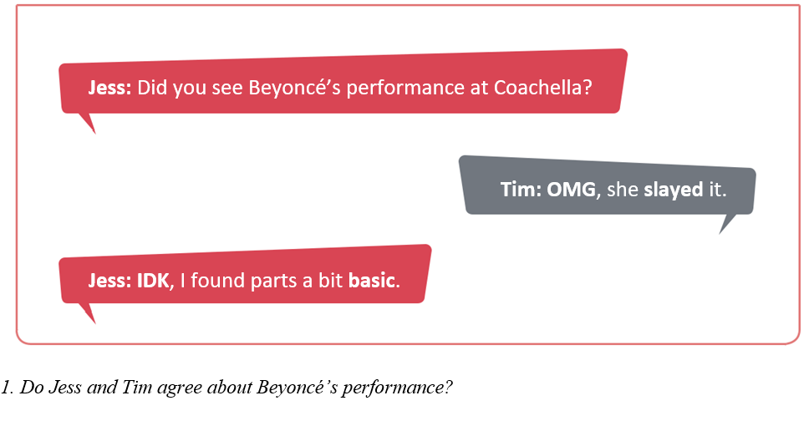
Activity 4. With your classmate, read the following four short social media chats. They each contain slang words. In pairs, discuss the question after each chat.

Slide 7
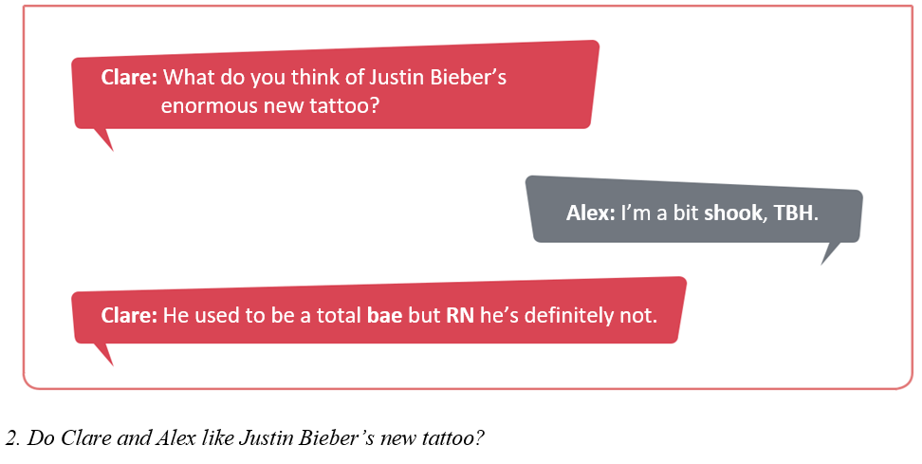

Slide 8
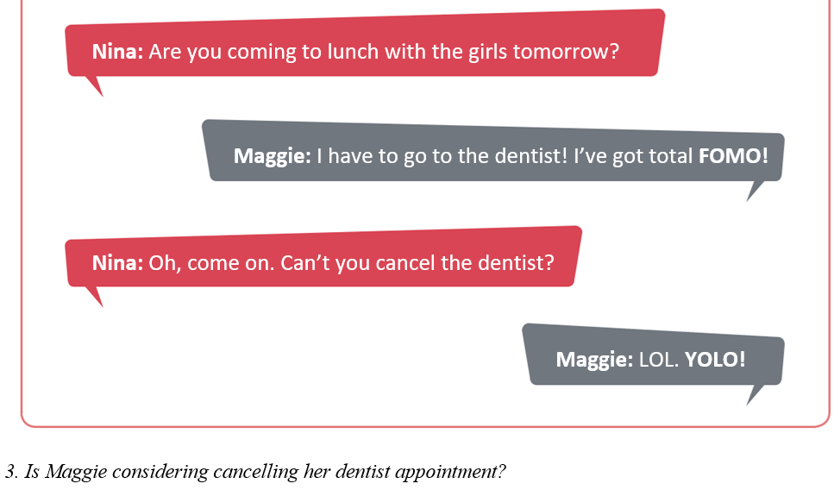

Slide 9
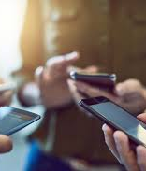
Now we turn our photocopies.
Notes:
Go to Reading worksheets

Slide 10

Activity 5. Discuss the questions below with your classmate.
  Do you know any stories about people who had lost contact but got back in touch because of social media?
  Are there any people who you would never friend on social media? Explain. (For example, your parents, your children, your partner, your ex, your teacher, your boss, etc.)
  Do you follow any famous people on social media? If so, describe their style of interaction.
  Are there any people on social media (famous or personal contacts) whose style of interaction you find irritating? Explain.
  What type of information would you be comfortable putting on a public profile on social media? (For example, date of birth, job, telephone number, interests, home address, etc.)

