Slide 1
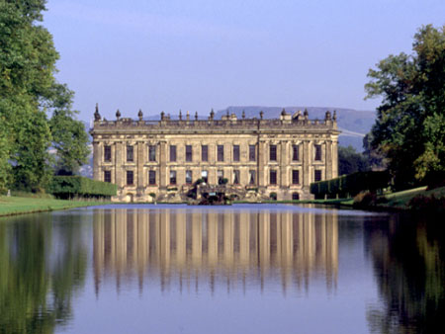
Pride and Prejudice by Jane Austen

Slide 2
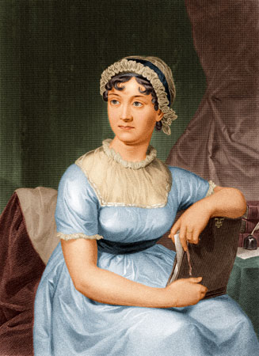
Quick Facts about Jane Austen
Austen was born in 1775
She was born in Hampshire, England
Jane never married and never had any children
Famous works:
Sense and Sensibility (1811)
Pride and Prejudice (1813)
Mansfield Park (1814)
Emma (1815)
Persuasion (1817)
Northanger Abbey (1817)

Slide 3
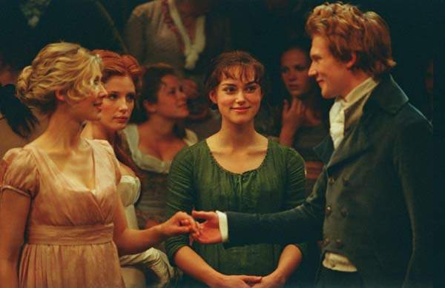
The Plot of Pride and Prejudice
As the title implies, the story revolves around characters demonstrating character flaws, like pride and prejudice throughout the story.
The story chronicles these characters’ experiences and how pride and prejudice affect their viewpoints, actions and relationships with others.

Slide 4
The Characters…
The Netherfield Party (rich)
Mr. Darcy and his sister Georgiana Darcy
Mr. Bingley and his sister Caroline
The Hertfordshire Party (middle class)
The Bennet Family
Mr. Bennet & Mrs. Bennet
Their daughters: Jane, Elizabeth, Kitty, Lydia, Mary
The Lucas Family
Mr. & Mrs. Lucas
and their daughter Charlotte Lucas
Lady Catherine de Bourg (Darcy’s aunt)
and her daughter Anne
Colonel Fitzwilliam (Darcy’s cousin)
The Gardiners
(aunt and uncle to the Bennets)
Mr. Collins
(minster/cousin to the Bennets)
Many characters occupy a middle ground and belong to neither group. The militia is one of these groups, Mr. Wickham being the most important character in that group

Slide 5
Mr. Darcy
Fitzwilliam Darcy is your typical, rich snob. He has known nothing but a life of privilege, yet he does work to maintain and distribute his family fortune.
He is a large, handsome but imposing man. Most people are uneasy in his company but that could be because he is cold, aloof and disdainful of socially with people he considers beneath him.
That does not mean he is totally unfriendly. He is a very loyal brother to his sister and a dedicated friend to all that he lets in his small circle. The opposite can be said of his enemies, though. Darcy states in the book, “My good opinion once lose is lost forever.”

Slide 6
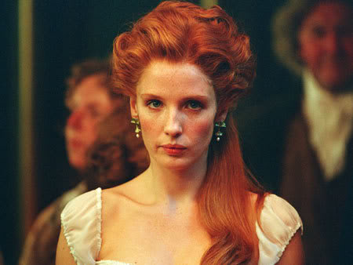
Charles and Caroline Bingley
Charles Bingley is an outgoing, wealthy young man who leases property near the Bennets' estate. He is very sociable and optimistic. He is a very good friend to all he meets but sometimes, he allows himself to be too easily swayed by the thoughts and suggestions of others.
Caroline Bingley is a debutant. She is well-bred but extremely ill-mannered. She, like Darcy, looks down on everyone around her that she considers to be inferior. She is very catty and will often be nice to a person to their face and talk about them the moment their back is turned. She is only concerned with wanting to improve her station in life by marrying rich.

Slide 7
Lady Catherine de Bourg
Lady Catherine is proud to be a woman of high society. She is the aunt of Darcy, Georgiana and Colonel Fitzwilliam. She is also a patroness of Mr. Collins. Lady Catherine is a domineering woman who believes her rank and position make her an authority on all manners. Despite her elevated status, she often lacks proper manners and is forward and rude because she thinks she is entitled to be so. She thinks nothing of insulting people to their face or ordering others around. She is dismissive of her only daughter Anne and often makes her stay in “because of her health.”

Slide 8
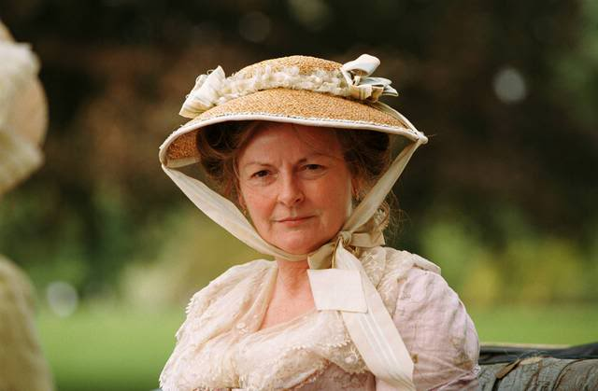
Mr. and Mrs. Bennet
Mr. Bennet is the head and the only male in the Bennet family. He is jovial and constantly looks for a laugh in all he sees. Instead of being ashamed or angry with the silliness of his wife and improper behavior of his daughters, he instead lets them learn from their mistakes.
Mrs. Bennet is the mother of the Bennet girls. She is headstrong and mainly concerned with marry her daughters off to rich, handsome young men. She is often flighty and does not consider her words before she speaks. She says things in public that shame her daughters and shock her company.

Slide 9
Jane Bennet
Jane Bennet is the oldest and most beautiful daughter of the Bennets. She is kind-hearted and tends to only see the only in everyone she meets. Her only flaw is that she has a reserved personality and tends to keep her emotions to herself. All Mrs. Bennet’s hopes are pinned on the prospect of beautiful Jane marrying well.

Slide 10
Elizabeth Bennet
Elizabeth Bennet is the second oldest daughter of the Bennet family. She is fun-loving, has a quick wit and loves to joke around. She does not take the prospect of marrying as seriously as she ought to. She is saucy and has a sharp temper but she only uses it in the defense of people she feels has been wronged. She is a good friend and looks out for her sisters but she will not compromise her ideals-even for her family. She is a good person but has some preconceived notions about rich people and the upper class in general.

Slide 11
Kitty, Lydia and Mary Bennet
Kitty Bennet is the third daughter of the Bennet family but she is immature and follows the whims of her more outgoing sister, Lydia. Her only concerns are dancing and meeting young men.
Lydia Bennett is the fourth daughter of the Bennet family. She is a flirt in the worst way and often embarrassing her family with her brazen behavior. She is only happy when receiving attention from males and take every opportunity to rub it in her sisters’ faces.
Mary Bennet is the youngest of the Bennet girls and is concerned with morals and virtue. She considers flirting and dancing to be wastes of time and concentrates on improving her mind and her mortality.

Slide 12
Charlotte Lucas
Charlotte Lucas is the daughter of a local man. Her family is middle-class and has some title. While Charlotte is a best friend to Elizabeth Bennet, she does not stand out and is very plain looking. She is older and is concerned about finding a husband because she has become burdensome to her parents. She is looking to marry someone who can take care of her- love is not the object of her match.

Slide 13
Mr. and Mrs. Gardiner
Mrs. and Mrs. Gardiner are aunt and uncle to the Bennet girls. While they do not live in a desirable part of London, Mr. Gardiner is a lawyer and Gardiners are quite wealthy. In order to show their wealth, they dress and act in high fashion and have the best of manners but they are not standoffish. Mr. and Mrs. Gardiner care deeply about their nieces and do what they can always to help them.

Slide 14
Mr. Collins
Mr. Collins is a clergyman and distant relative of Mr. Bennet. He is the only surviving male Bennet relative and stands to inherit Mr. Bennet’s estate when he passes away because women cannot get this entitled property. When not pompously full of himself, Collins is a narrow-minded sycophant, excessively devoted to his patroness, Lady Catherine de Bourg. He is always keen to show his admiration and gratitude. His goal is to marry one of the Bennet daughters to keep the house in the family and also to give his church a wife.

Slide 15
George Wickham
A dashing, handsome young soldier who attracts the attention of all women he comes in contact with. His father was the manager of the Darcy estate, so he grew up with Mr. Darcy and his sister. Though a favorite of Darcy's now-deceased father, there is bitter enmity between him and Darcy, due to his attempt to elope with Georgiana Darcy for her substantial inheritance.

Slide 16
Pride and Prejudice
All these characters weave in and out of various plots and are important to the story. It is their interactions and reactions that make Pride and Prejudice one of the finest novels ever written.
Enjoy!

