Slide 1
The Regency Period

Slide 2
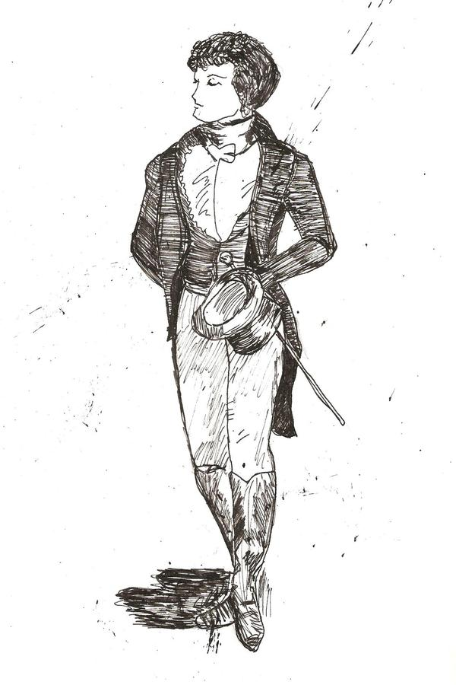
Context
Learning Objectives: We are learning about the contextual factors that shaped and drove the narrative of ‘Pride and Prejudice’.

Slide 3
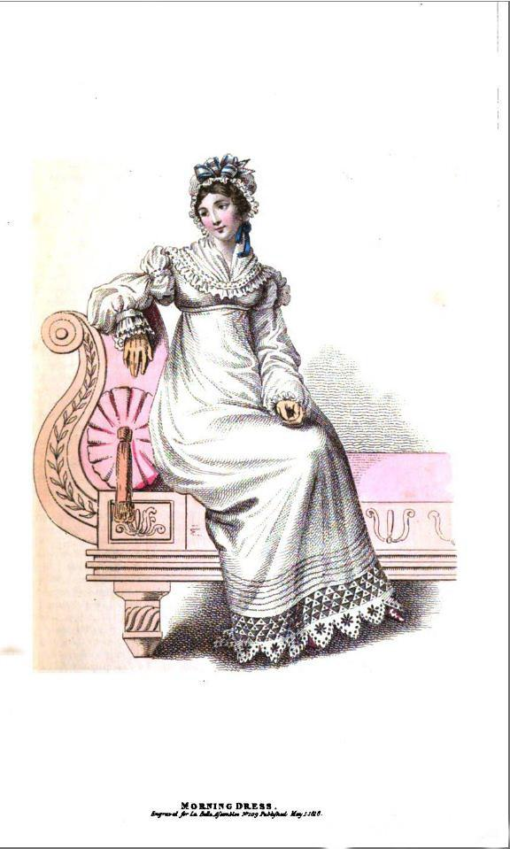
History
The historical context of the regency period

Slide 4
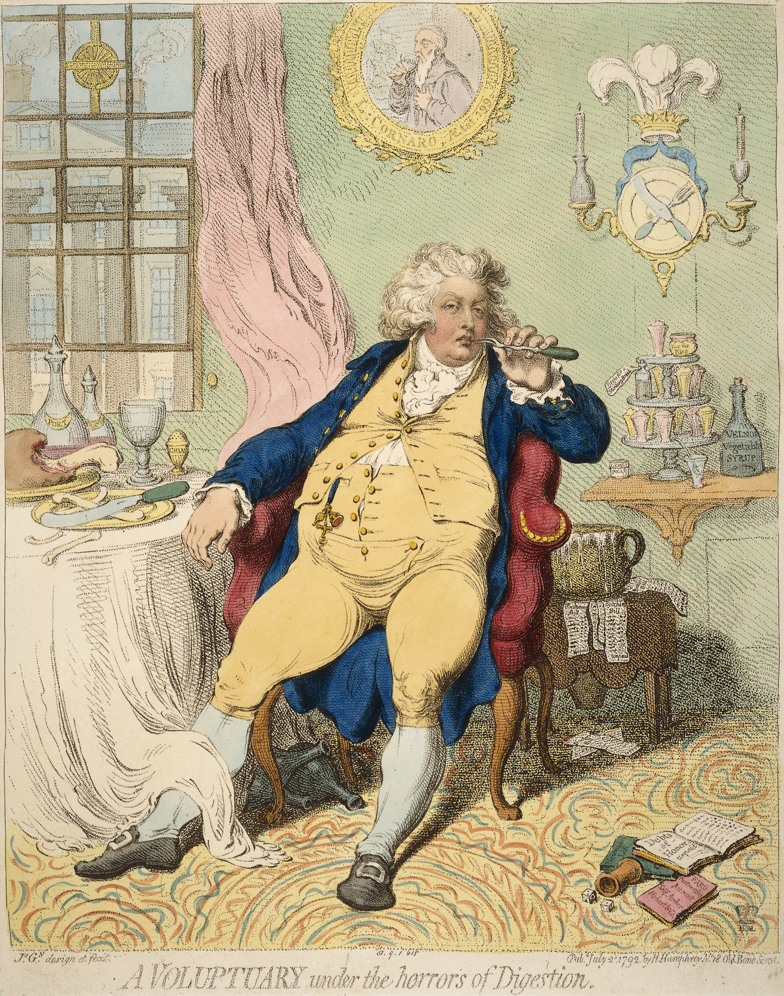
1811-1820
1
George IV
2
Highpoint of British Sophistication
3
Why was it called ‘regency’?
Informally the period lasted longer and is used to categorise a distinct period of fashion, literature and architectural style.
The “naughty prince” of the time was King George IV, who loved excess and luxury.
The regency period is considered to be the most elegant and stylish period of English history.
George IV was ‘prince regent’, as in acting King, as his father was still alive but ill and considered incapable of leading the country.

Slide 5
“Harris, I am not well. Pray, get me a brandy”.
King George upon seeing his future wife.

Slide 6
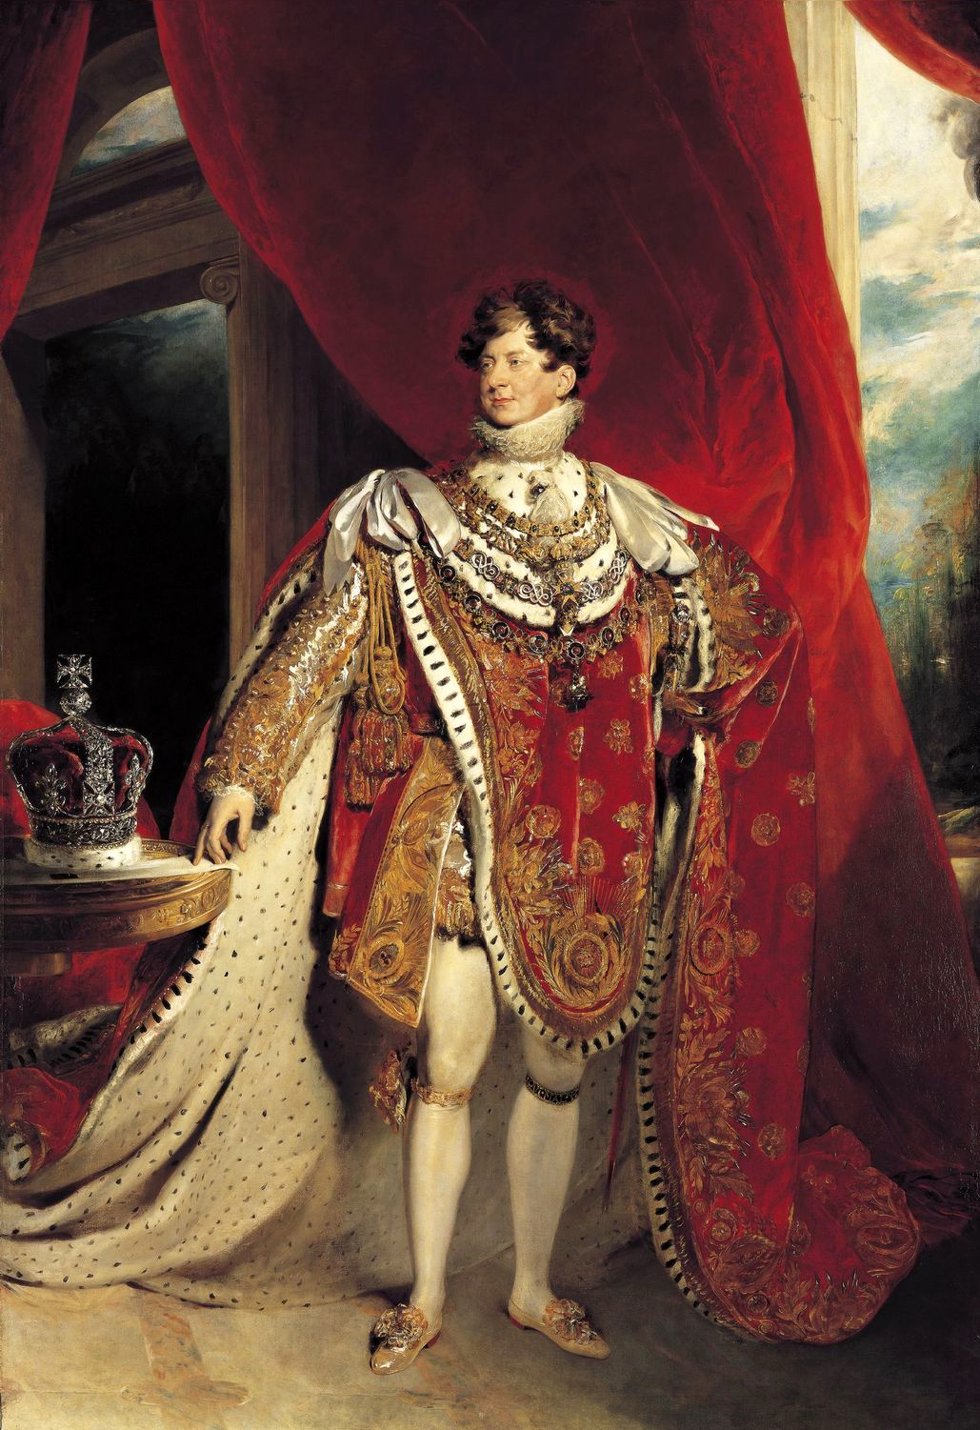
Competition with Napoleon
1
Class Structure
2
3
Before and After the Regency
The king was determined to surpass Napoleon (France) in luxury, style and excess.
The regency period had a very specific social hierarchy, which we will look at more closely soon.
The regency period was preceded by the Georgian period and succeeded by the Victorian period, upon the reign of Queen Victoria. Austen lived in Georgian and Regent times.

Slide 7
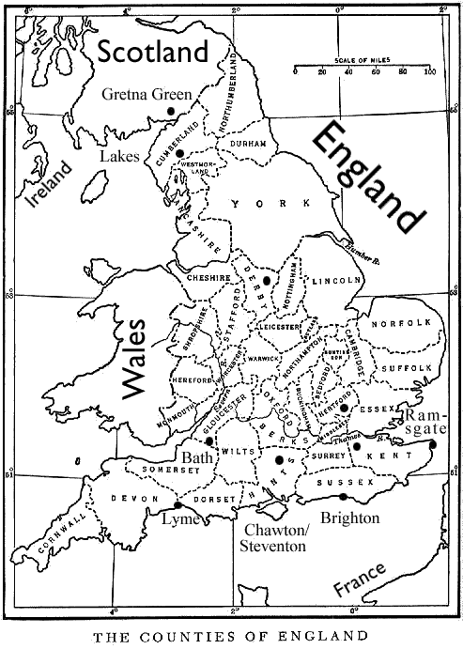
Geography
‘Pride and Prejudice’ is set in the county of Hertfordshire. However, many towns are fictional in the text, such as Meryton, Longbourn and Netherfield Park. Yet, they are likely based on real locations in England that Austen visited.

Slide 8
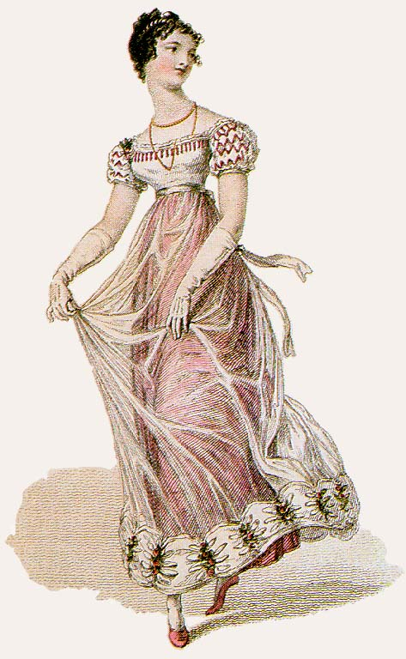
Social
The social context of the regency period

Slide 9
The social hierarchy
Plot this on a pyramid from memory in your books!
The royals were (and still are) at the top of the social hierarchy in England
The nobility were at the top of the social class (just underneath royalty, for example ladies, lords - having hereditary titles with involvement in parliament)
Knights were next in the pecking order (awarded a non-hereditary title by the monarch)
A baronet was next - they held a hereditary style of knighthood
Then came the gentry (those of high social class, often through owning or being born inheriting land that they could also rent out)
Under the gentry were the clergy and navy/army officers. (They were considered gentlemen but not of the same rank as the gentry)
The working classes came next - they were broken up into farmers and labourers - farmers generally held more respect than labourers.

Slide 10
farmers, gentry, royalty, baronet, army/naval officers, clergy, nobility, knights
Hint! You’ll need 7 lines on the pyramid. Can you guess why?

Slide 11
Because, but, so...
In your books, write a small paragraph using the following sentence starters:
Elizabeth Bennet was part of the gentry because…
but…
So...
In what way is Elizabeth’s situation similar and different to Austen’s?

Slide 12
Mr. Bennet's family estate, Longbourn House, is a residence and land located within the environs of the township of Meryton, in Hertfordshire, just north of London. From his family estate, Mr. Bennet derives an annual income of £2,000, which is a respectable income for a gentleman (but certainly not comparable to Mr Darcy's annual income of £10,000). Longbourn House also has an entailment upon it, meant to keep the estate in the sole possession of the family, down the male line, and from being divided-off amongst younger sons and any daughters; it is to passed-down amongst male heirs only. For years, Mr. Bennet had the hope and intention of fathering a son who was to inherit the entire estate; which would see to the entail for another generation, and provide for his widow and any other children he might have. Additionally, Mr. Bennet did not get along with his then-closest living male relative and male heir, his distant cousin, Mr. Collins (Sr.), who is described as an "illiterate miser" (possibly some disagreement over the entail), and did not want the estate going to him. Sadly, after 23/24-years of marriage, Mr. Bennet remains the last male scion of the Bennet family, thus marking the end of the Bennet name with his death.

Slide 13
Courtship, love and marriage
You did not marry for love - marriage and love had very little to do with each other, though it did happen occasionally
Marriage was about continuing family lines, securing financial stability and enhancing your social status
If you were not married by your mid-twenties you were actually late in the game. Women married as young as fifteen and sixteen years old, often having children by twenty.
A woman was the property of her husband and father. If a proposal was to be had, the suitor would need to ‘apply’ to the father. It was ultimately not the mother’s decision.
The courtship was an entire process, often semi-public. This was because the family was involved in the whole process and the potential husband and wife were not actually allowed to be alone together for very long.

Slide 14
Social Expectations
Read the information in your booklet and complete the activities.

