Slide 1
Etiquette in Pride and Prejudice

Slide 2
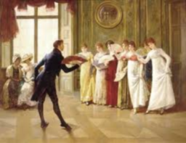
In Victorian times, having manners and etiquette were as important as being educated.
A person's etiquette and manners were associated with their status and wealth, as much as the car one drives or house one lives in today.

Slide 3
Basic Regency Etiquette and Manners
Rising to one's feet when being introduced, or when someone enters the room.
Always ask to be excused when leave the table or a conversation.
Ladies do a little curtsey and men greet with a bow.
Manners were scrutinized by others and often a talking point in conversations and gossip.
The wealthiest and most educated of families greatly emphasized the excellence of manners in education and practice of their family members.

Slide 4
Keep Calm and carry on
Emotions were often hidden, especially if they were annoyed. It was habit to assume the best in people and situations. They take this etiquette so seriously their words sound empty because it was the opposite of how they felt.
Typically, you did not say exactly how you felt. Definitely do not show if you have hurt feelings or sad.
“Stiff upper lip, old chap!”

Slide 5
Keep Calm and carry on
In the novel, Mr. Darcy was trying to write a letter but was constantly interrupted by Mr. Bingley's sister. She was very annoying with her barrage of opinions on what he should write. He simply said, (paraphrased) "Do allow me to convey your sentiments to my sister another time, I do not have room (in the letter) to do justice to your words."

Slide 6
Manners: The Key to Marriage
Mothers would try to train their daughters to be “accomplished”
This was seen as the civil way to obtain a husband\
Every woman’s goal was to gain a husband to take care of them for the rest of their lives
An unmarried woman was a burden to her family since they would have to take care of her forever.

Slide 7
The Accomplished Lady
Play music, or sing
Have talent in drawing
Be able to dance
Speak other languages
Have a certain “something” in her air
Walk properly
Have a pleasant tone of voice
Read interesting books
Watch your facial expressions

Slide 8
For men
Ladies first!
Offer your hand to ladies stepping up or down.
Open doors for ladies
Carry heavy things for them
Do not boast, brag or be pretentious. It was considered vulgar.
One should always remain humble.

Slide 9
grooming
Grooming was of high importance.
No one came down to their breakfast in pajamas.
A lady's hair was always tied up in a chignon, in a bonnet unless she is still very young.
The ladies always dressed modesty, in good taste and in very feminine colours with beads, laces and ribbons.

Slide 10
Socializing
The art of conversation was highly regarded. It was their way of entertaining and leisure. No TVs or movies. No mobile phones.
Their social calendar would include travelling to visit friends and family, going on walks, sports, watching someone paint or draw, hearing someone read or play the piano.
They also were fond of hosting teas, balls (parties), and dinners.
Be good at socializing so you keep getting invitations to these.

Slide 11
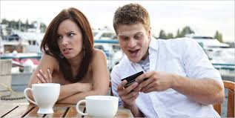
Are we so different?
What are some similarities today? Write down the rules you have to follow in life.
What things have changed?
Focus on women. How is it the same, and how different?
Spend a few minutes writing your thoughts then share with your Team.

Slide 12
Source: Victorian Etiquette at Elegant Woman
http://www.elegantwoman.org/victorian-etiquette.html

