Slide 1

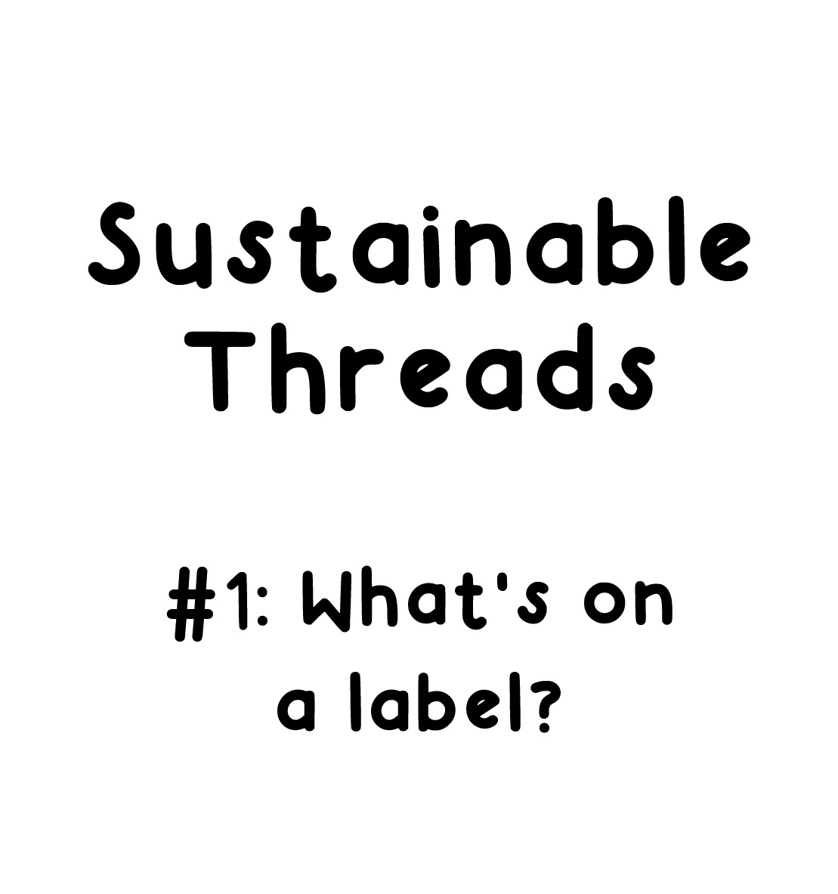

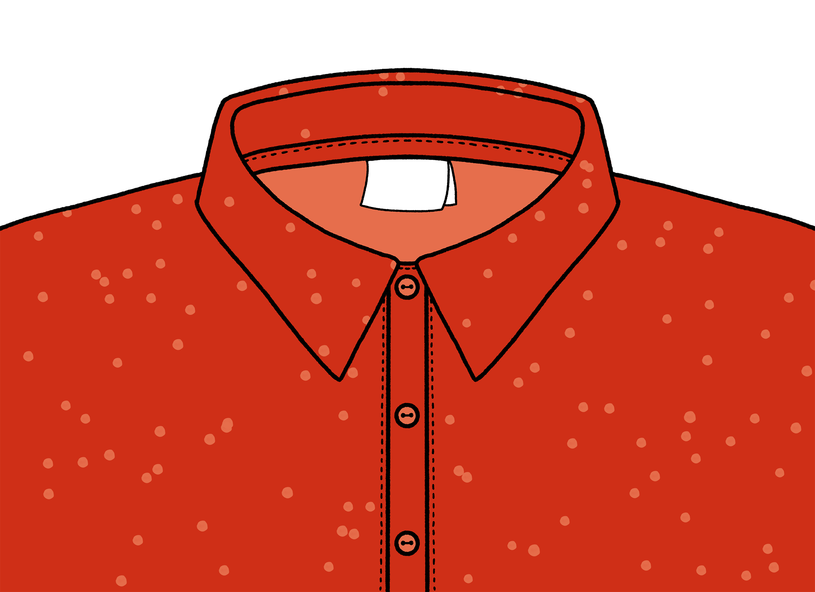

Slide 2
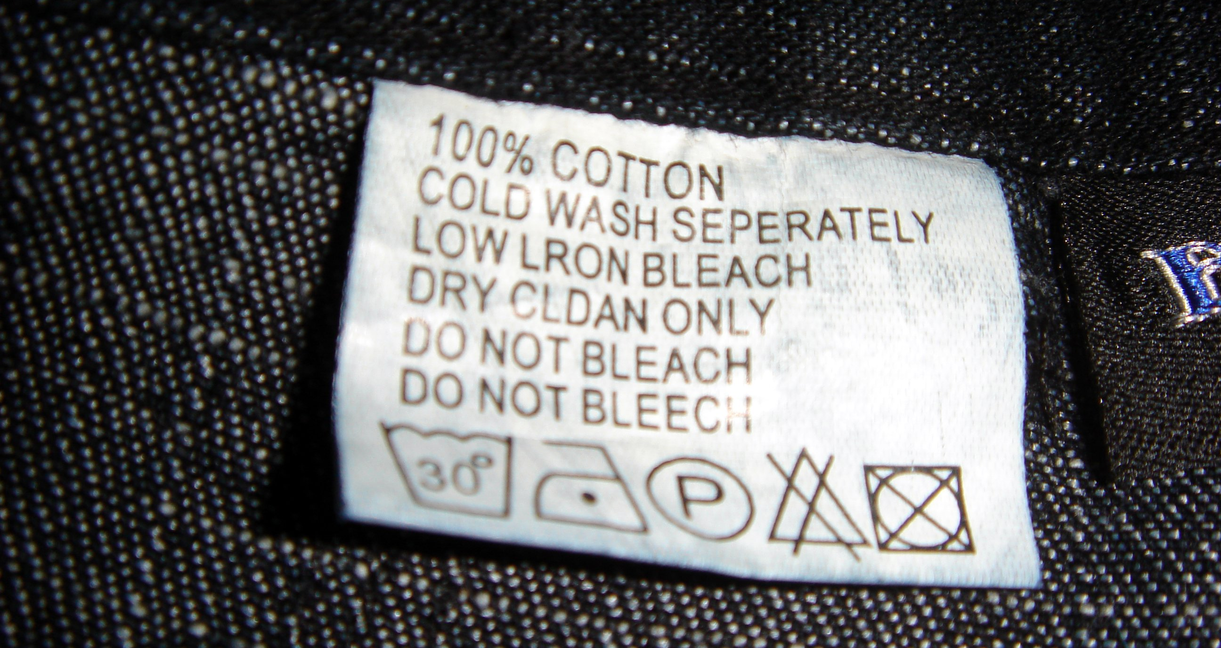
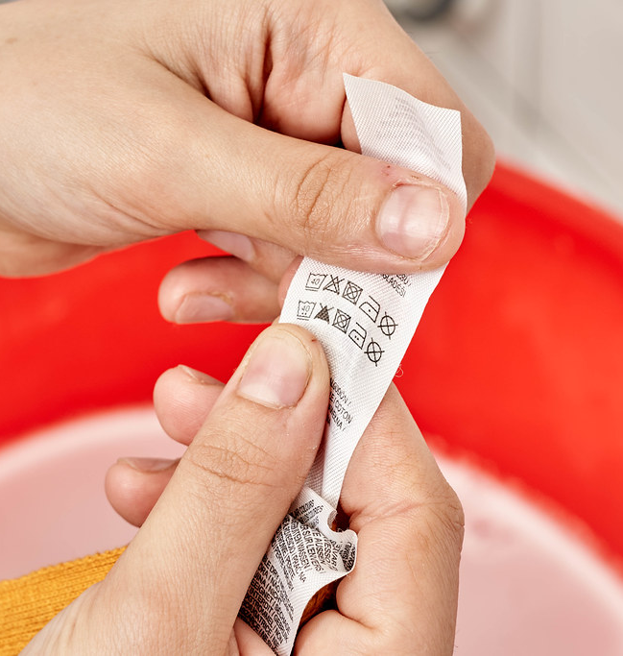
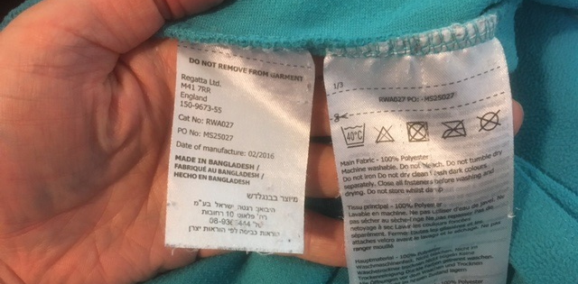

Slide 3
Task 1 : Turn a piece of clothing inside out and read the garment care labels.
What information is on there? Collect the information using survey A.
Then, working in your group, share the information you have collected, and continue to complete survey A, adding the information about garments that others in your group have looked at.
Survey A
Whose clothing? | What is it? | Where was it bought? | Where was it made? | What is it made from?
e.g. Lily | White and grey t shirt | H&M | Turkey | 41% Cotton 34% Polyester 25% Modal

Slide 4
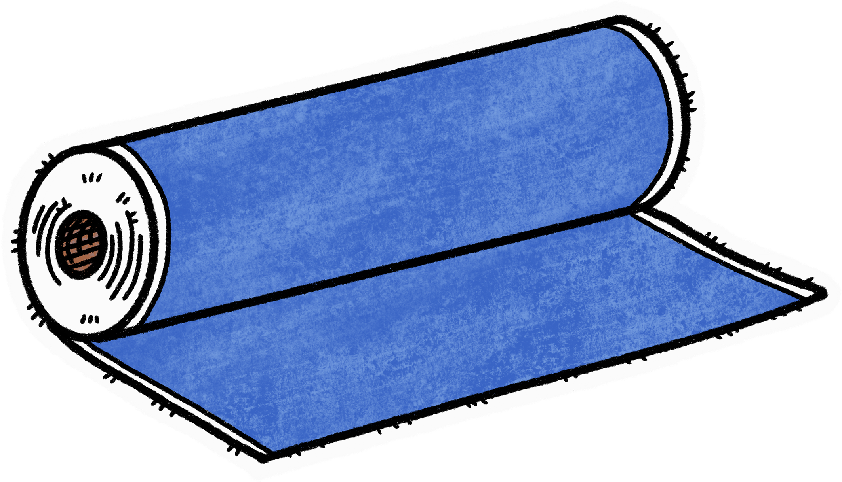
Materials used for clothing manufacture and their properties
For more information about synthetic fibres check out BBCBitesize
Cotton | a fibre from the seed of a plant, now mainly grown in India and the USA.
Polyester / nylon / acrylic / neoprene / spandex | all synthetic fabrics which are made in factories. They are mainly made from non renewable coal and oil that have been refined.
Viscose | a manufactured fibre made from wood pulp which is known to use a lot of chemicals in its production and pollute environments close to factories.
ECONYL | uses recycled ocean plastic and waste fabrics to form new nylon fabrics.
Lyocell / TENCEL | made from the pulp of eucalyptus trees which don’t need much water or pesticides.
Modal | made from the pulp of beech trees.

Slide 5
Task 2: Working as a class complete these surveys using information from Survey A
Survey B Survey C
Where made? | How many?
Made from what? | How many?

Slide 6
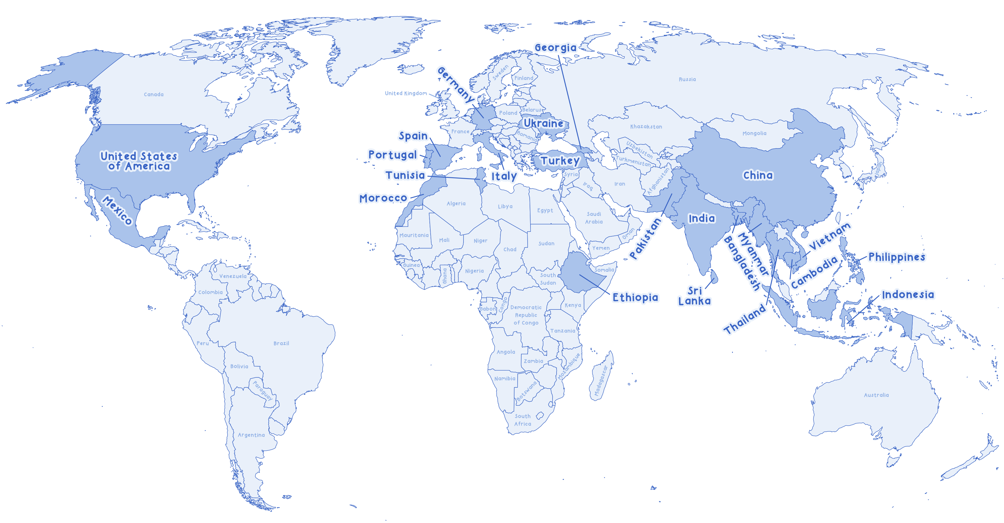
Task 3: Working as a class, map where your clothes were made.
Many of the clothes in our wardrobes are made in the countries named on the map.
How do your findings compare?

Slide 7
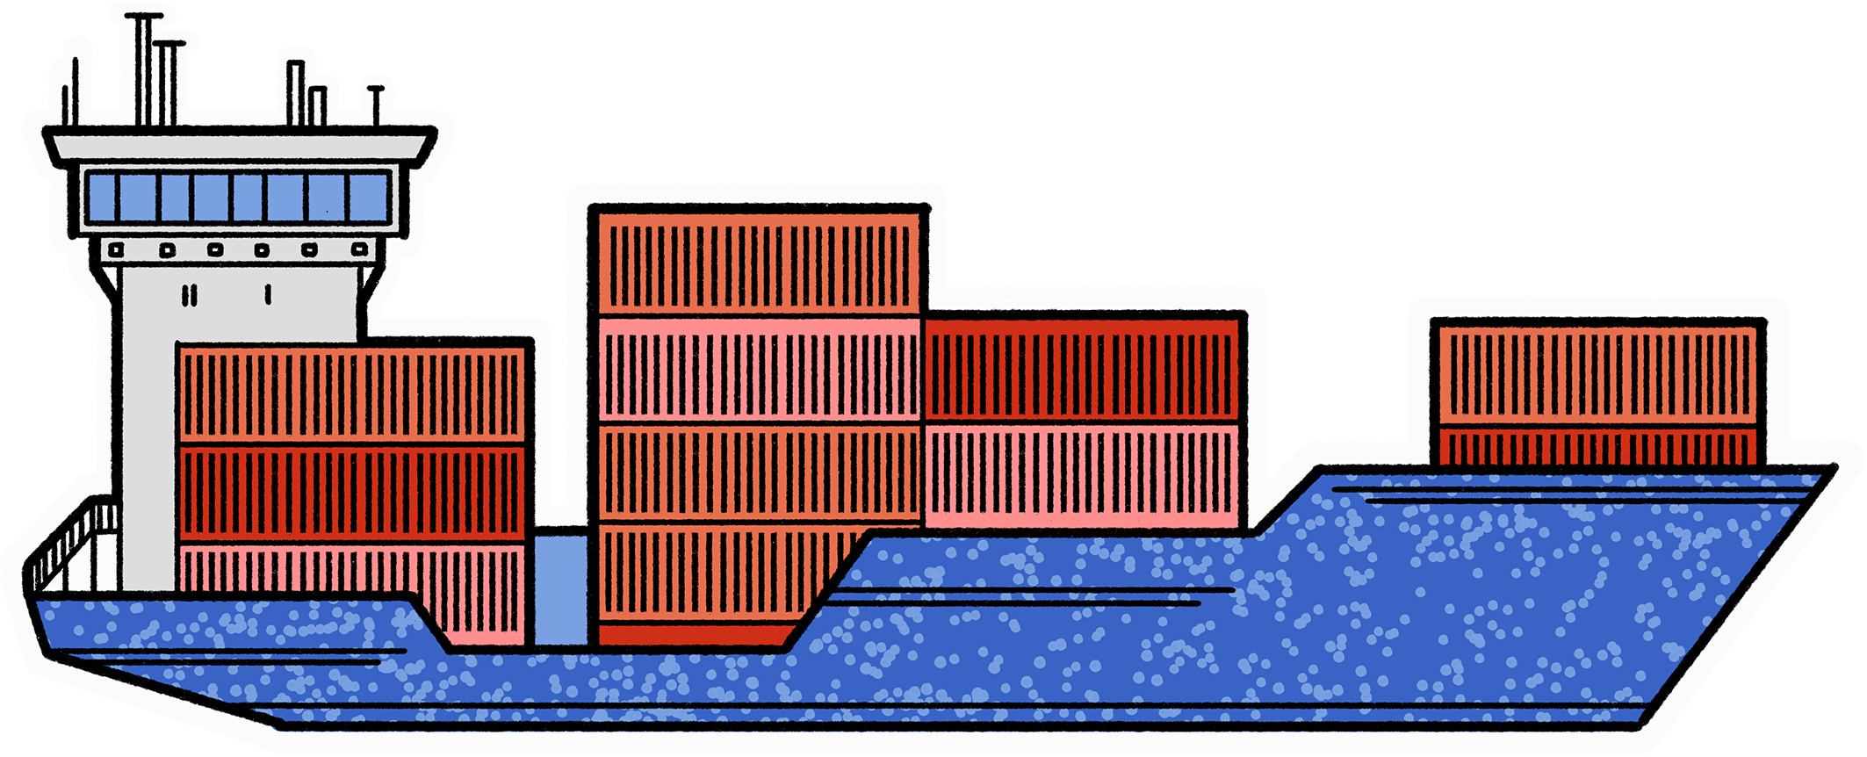
10% of all global carbon emissions are linked with the fashion industry
(mainly produced through manufacturing and transportation). This is more
than international flights and maritime shipping combined.
Source: https://www.worldbank.org/en/news/feature/2019/09/23/costo-moda-medio-ambiente

Slide 8

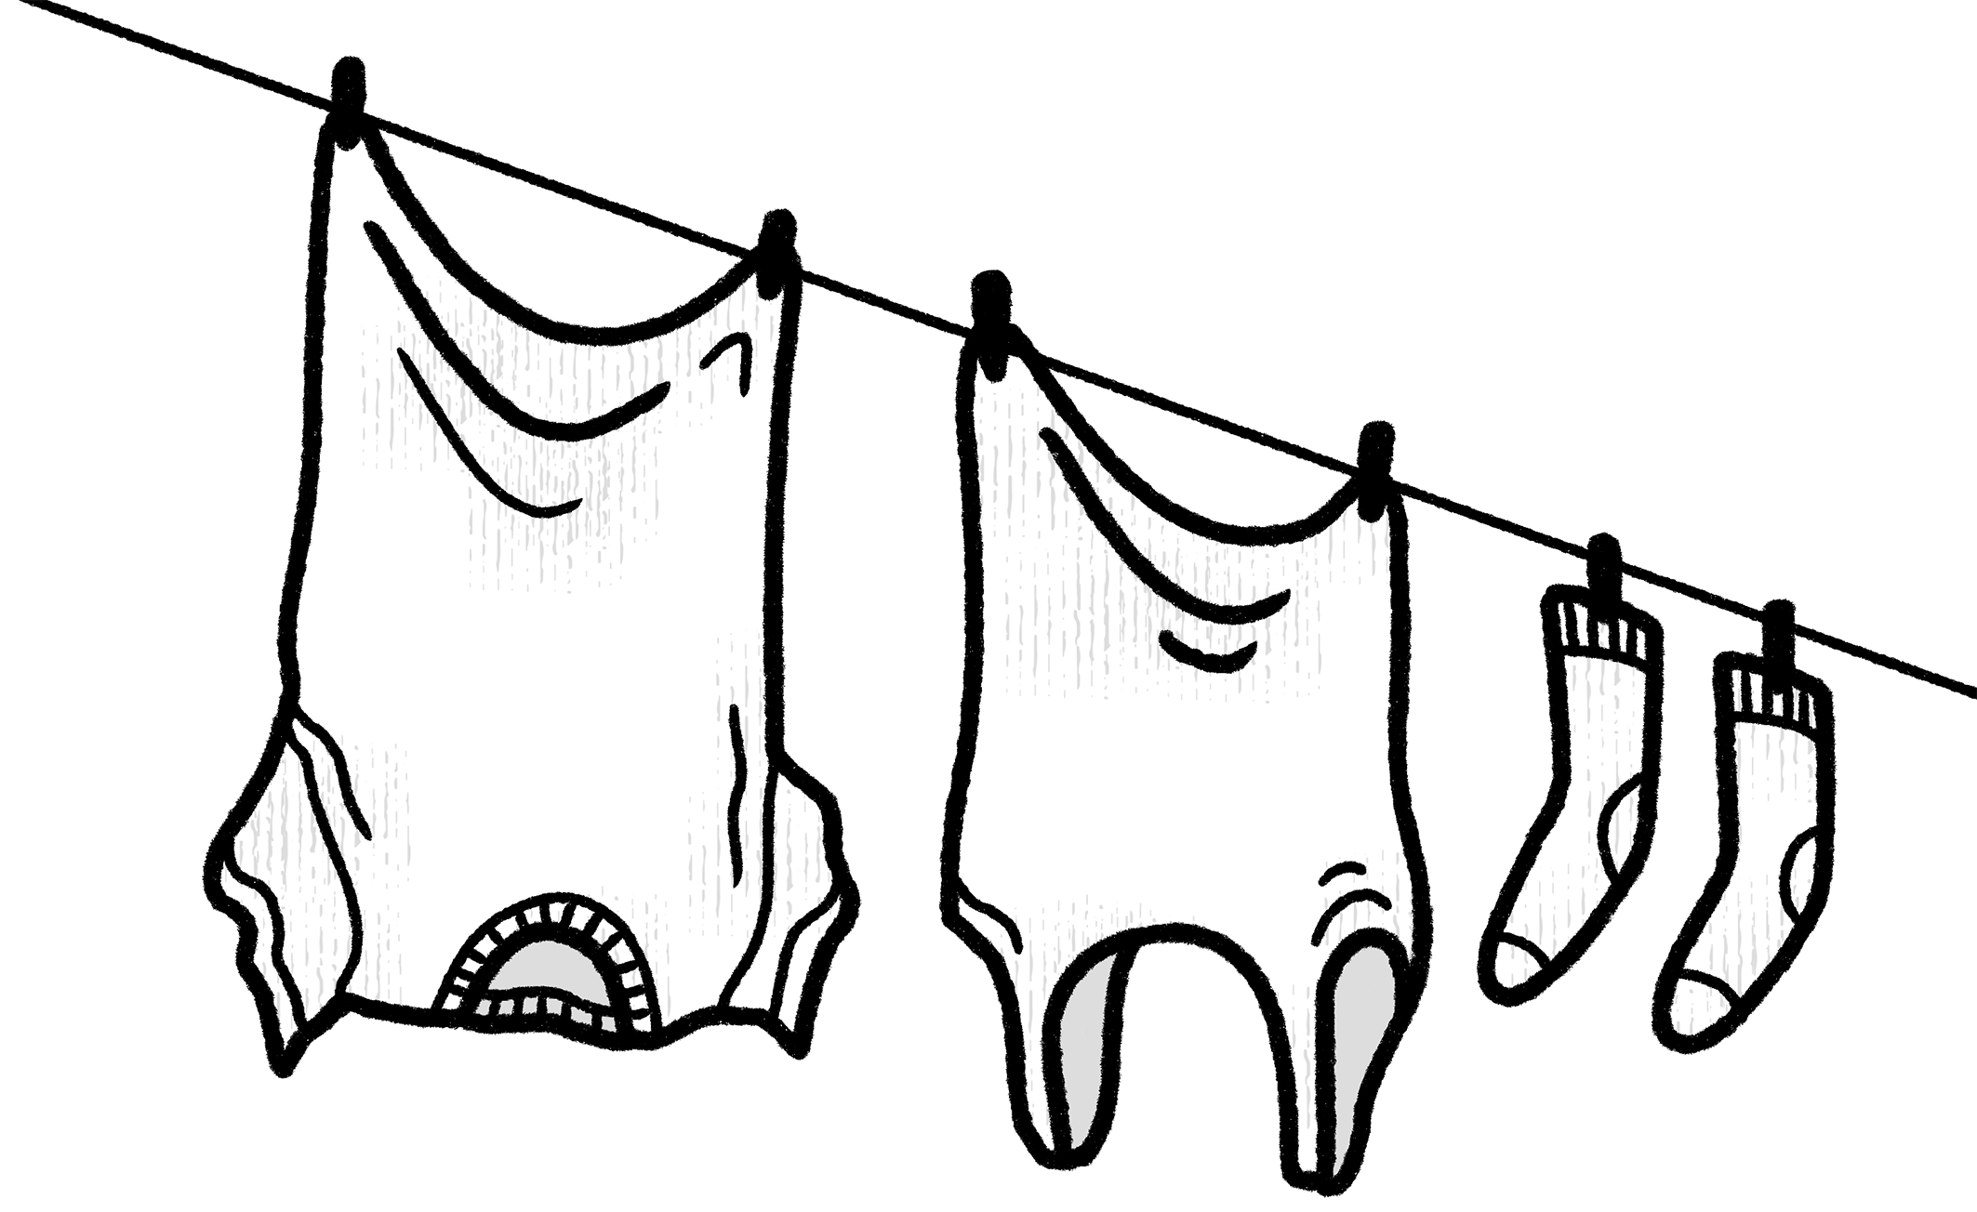
Task 4: as a class discuss the following
is there anything you are surprised by from the data collection?
What do you notice about where your clothes were made?
What do you think the impact of your clothing being made in these places and out of these materials might be?
How does that make you feel? How might we reduce the impact?

Slide 9
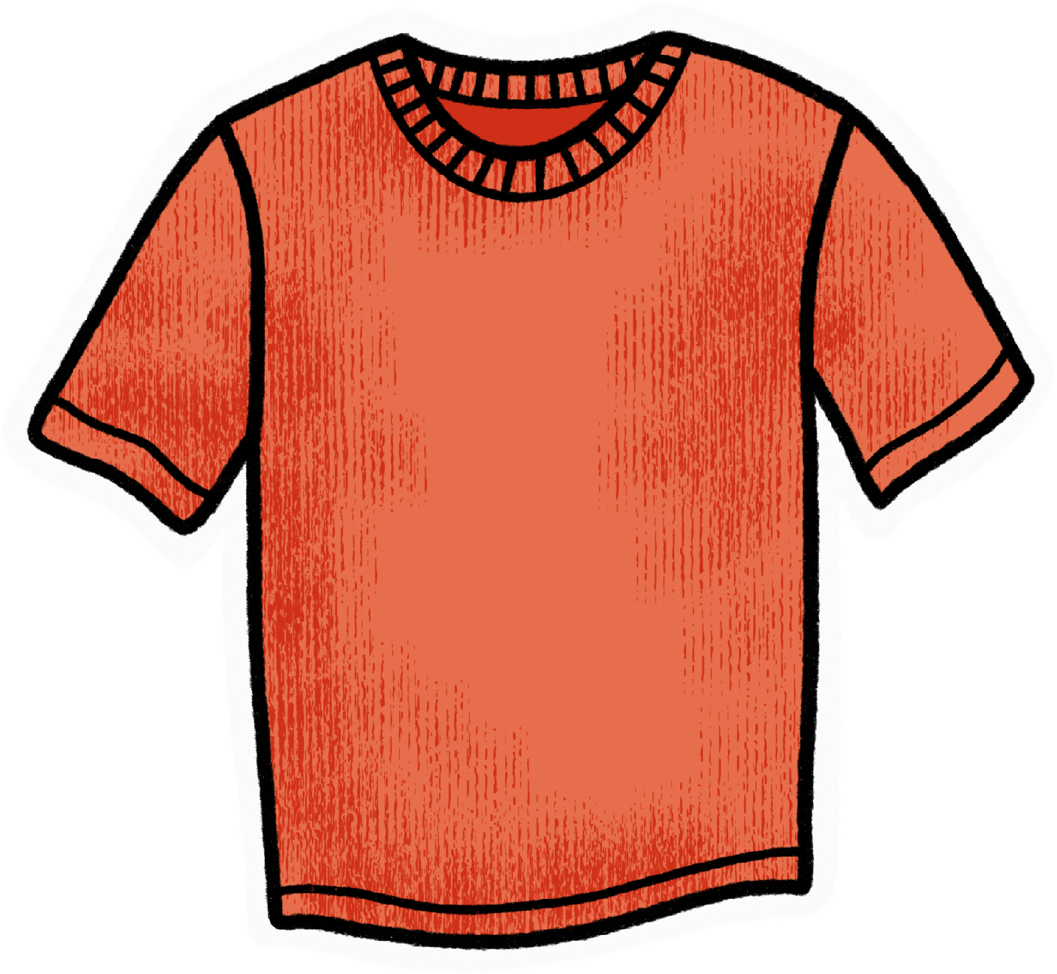
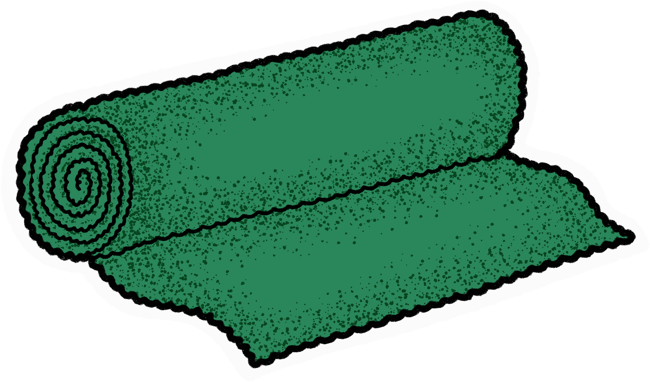
How might we reduce the impact? Some suggestions:
Look at the label before you buy an item of clothing.
Think before you buy. Do you need it? Will you wear it?
Do you recognise the materials used to make it?
Where was it made? Do you know where that is?
How do you feel about the information on the label?
Do you still want to buy the garment? Could you choose to borrow / buy second hand / alter an existing item of clothing / look into a more sustainable alternative instead?
What are
your clothes
made from?
Check the label
and do a bit
of research
to find out
Choose natural fibres
like linen when buying
new clothes. They shed fewer microplastics with each wash

