Slide 1
ΓΝΩΡΙΜΙΑ
Κουζιώκα Βιολέττα

Slide 2


Slide 3
Εξεταστέα ύλη
https://edu.klimaka.gr/panelladikes/exetastea-ylh-lykeiou/88-exetastea-ylh-anaptyxh-efarmogwn-programmatistiko-perivallon

Slide 4
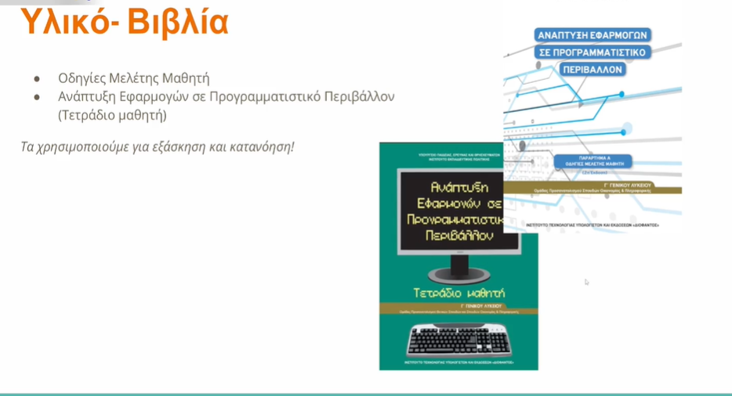

Slide 5


Slide 6
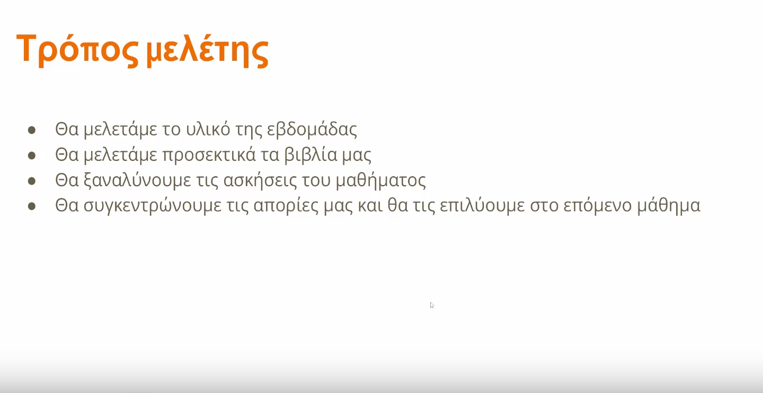

Slide 7
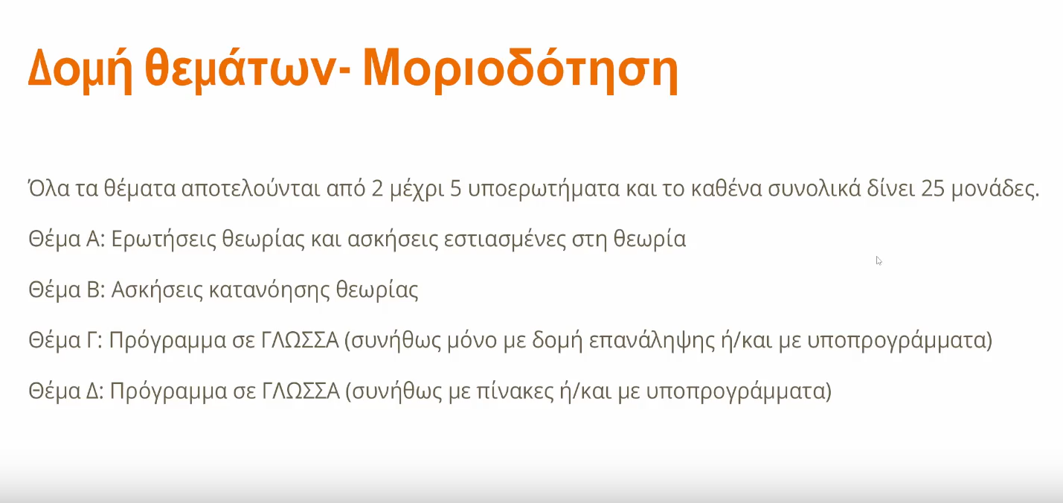
https://www.panellinies.net/wp-content/uploads/2025_them/2025_them_gel/aepp_2025.pdf

