Slide 1
ATSMUN Rules of Procedure

Slide 2
Roll call & Quorum
The Quorum is set at two thirds of the delegates present. If this number is not met, the Committee cannot proceed to voting.
During the roll call, you are to raise your placard when you hear your country’s name and state Present.
If you don’t hear your country’s name, send a note to the Chairs or notify them when they ask!

Slide 3
Points
Point of Information
Used to ask the speaker to clarify a previously made point.
Point of Personal Privilege
Used to refer to a delegate’s well being or audibility. Only when audibility is concerned it may interrupt a speaker.

Slide 4
Points
Point of Order
Used when a delegate believes there has been a violation in the Rules of Procedure.
Point of Information to the Chair
Used when a delegate wants a piece of information on the agenda items.
Point of Parliamentary Inquiry
Used when a delegate needs information on the Rules of Procedure.

Slide 5
Motions
Motion to move to the previous question
A motion which proposes that debate on the current resolution/ amendment is closed and the committee proceeds to voting. In case it is raised during time in favour of an amendment, it suggests moving to time against.
Motion to extend debate time
May be granted at the discretion of the Board.

Slide 6
Motions
Motion to adjourn the debate
Calls for the temporary disposal of debate.
Motion to withdraw a resolution
Must be raised only if all Co-Submitters agree.
The chairs can withdraw a resolution in cases of plagiarism or other important reasons.

Slide 7
Motions
(On Voting!)
Motion to vote by roll call
Voting state by state in alphabetical order.
Motion to retake the vote
Raised when the delegate feels that the staff/Chairs have not taken the vote correctly.
Motion to reconsider a resolution
Needs a ⅔ majority!
Motion to divide the House
Voting again without abstentions allowed.

Slide 8
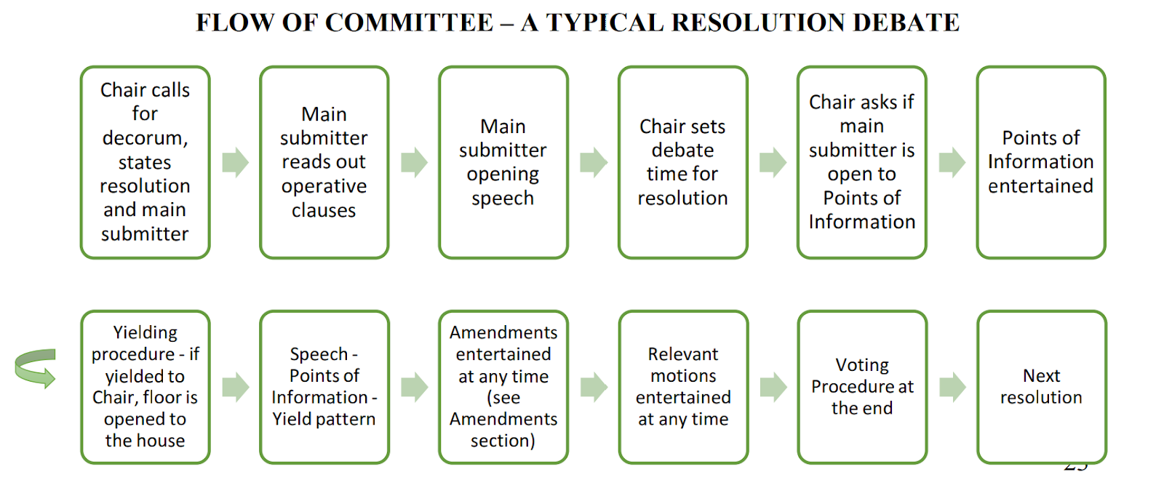
Committee Flow

Slide 9
Lobbying & Debating
While lobbying, delegates are trying to form alliances and submit a resolution which reflects their country’s policy.
While debating, the Committee examines one resolution at a time and after the debating and amending procedure, the Committee votes in favour or against the resolution.

Slide 10
Amendments
To submit one, the delegate can type their amendment and send it to the Board.
The amendments entertained are picked by the Expert Chair of the topic according to how fruitful they are for the debate and how much time is left for debating the current resolution.
The Committee votes on amendments.
There can be a second degree amendment, but it has to refer exactly to the same point the first degree amendment alters.

Slide 11
What’s New?
The new Web Edition of ATSMUN requires you to take an even more active and proactive role.
This is why you are encouraged to:
Create a presentation on latest developments and the direction in which you want the debate to go.
Help delegates during lobbying, as creating new documents may be challenging.
Even during the pre-conference communication, you can highlight parts of the topic and encourage delegates to share their drafts.

Slide 12
Welcome aboard!

