Slide 1
FEMALE ARTISTS OF THE RENAISSANCE
From a Florentine Nun to a Flemish Portraitist

Slide 2
Plautilla Nelli (1524–1588)
a nun of the Dominican order at the convent of St. Catherine of Siena in Florence
the first-known woman artist of Renaissance Italy
self-taught painter
Nelli’s work recently came into the limelight for her immense painting Last Supper, dating to 1568

Slide 3
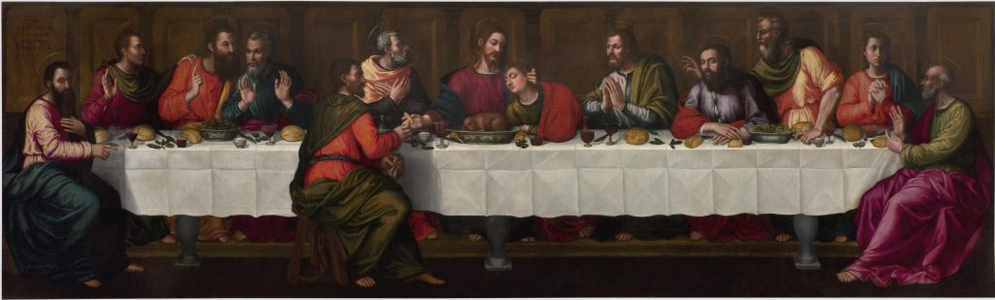
Plautilla Nelli, The Last Supper (ca. 1568). Collection of the Basilica of Santa Maria Novella, Florence.

Slide 4
Catharina van Hemessen (1528–after 1565)
daughter of prominent Mannerist painter Jan Sanders van Hemessen,
the earliest Flemish woman painter with verified work that still exists today
her greatest claim to fame is that she is attributed with completing the first known self-portrait of an artist at their easel, which has become a pillar of the art historical canon, as it has been taken up by artists ranging from Rembrandt van Rijn to Norman Rockwell

Slide 5
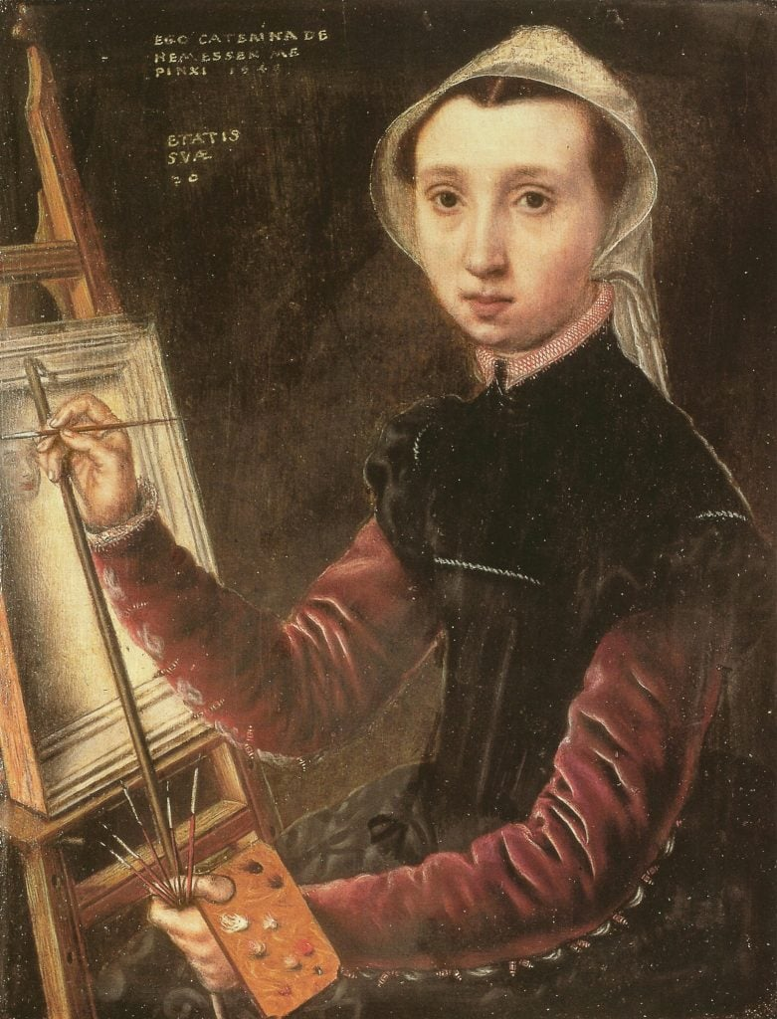
Catharina van Hemessen, Self-Portrait (1548). Collection of Kunstmuseum Basel.

Slide 6
Sofonisba Anguissola (ca. 1532–1625)
one of the most successful women artists of the Renaissance, with a reputation that rose to international acclaim in her lifetime
born into a noble Milanese family
began her formal training as a teenager; first apprenticing with Bernardino Campi for three years before working with Bernardino Gatti.
her position also allowed for her to become acquainted with Michelangelo
joined the court of King Philip II of Spain in Madrid in approximately 1559

Slide 7
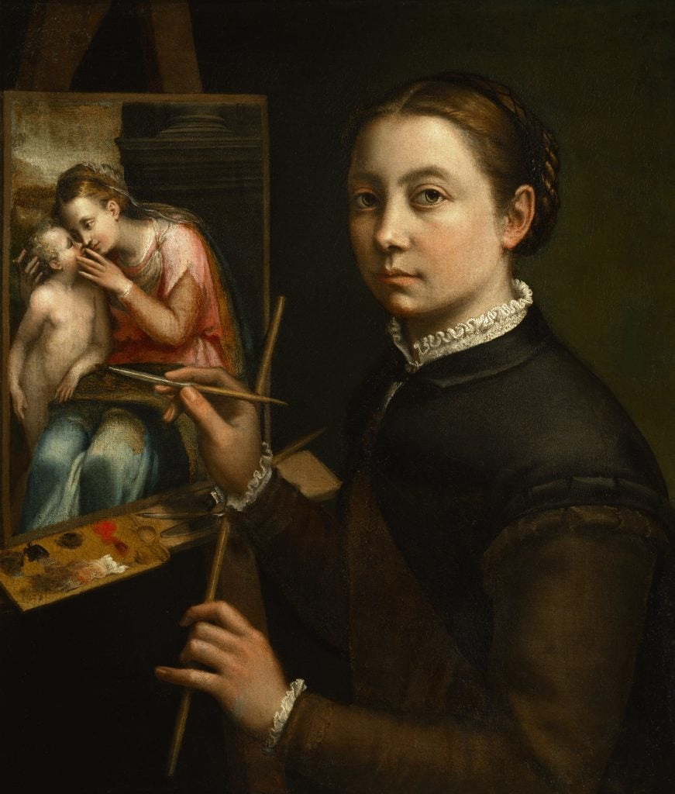
Sofonisba Anguissola, Self-portrait (ca. 1535–1625). Collection of Łańcut Castle Museum, Poland.

Slide 8
Lavinia Fontana (1552–1614)
trained by her artist father Prospero Fontana, a teacher at the School of Bologna
is considered the first professional woman artist insofar as she supported herself and her family solely on the income from her commissions
unconventional for the time, her husband acted as her agent and took a primary role in childcare for their 11 children
she also created large-scale mythological or religious paintings that occasionally featured female nudes
appointed as an official portraitist at the Vatican
one of the first women elected to the Accademia di San Luca in Rome

Slide 9
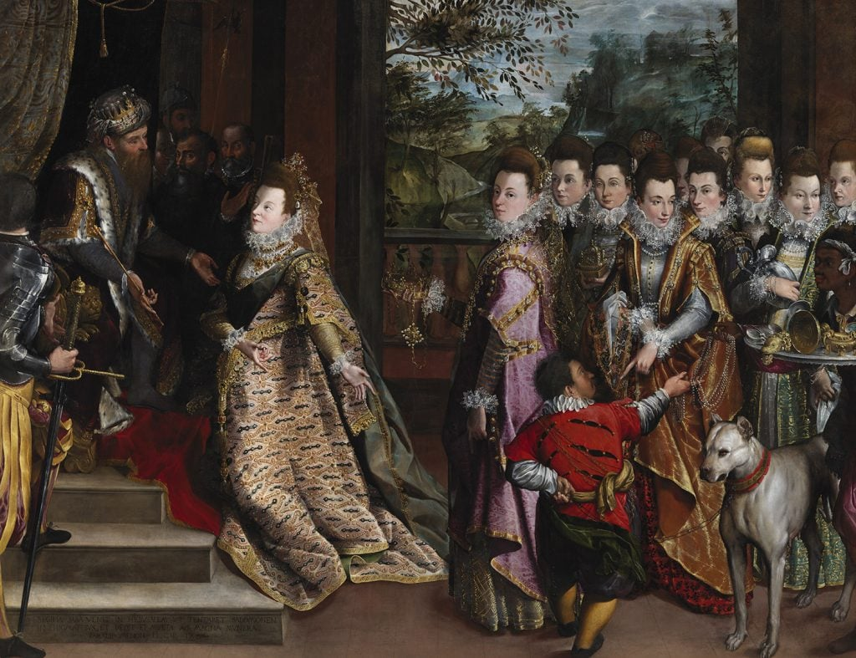
Lavinia Fontana, The Visit of the Queen of Sheba to King Solomon (1599). Collection of the National Gallery of Ireland, Dublin.

Slide 10
Artemisia Gentileschi (1593–1653)
her father was the painter Orazio Gentileschi, who trained Artemisia starting at an early age
inspired greatly by the work of Caravaggio and his use of high-contrast compositions, her paintings garnered and maintained attention for their naturalism and nuance
has maintained a level of renown over the centuries, with her dramatic and dynamic oeuvre that was unprecedented in her own time
her Baroque compositions helped usher in a new era of painting

Slide 11
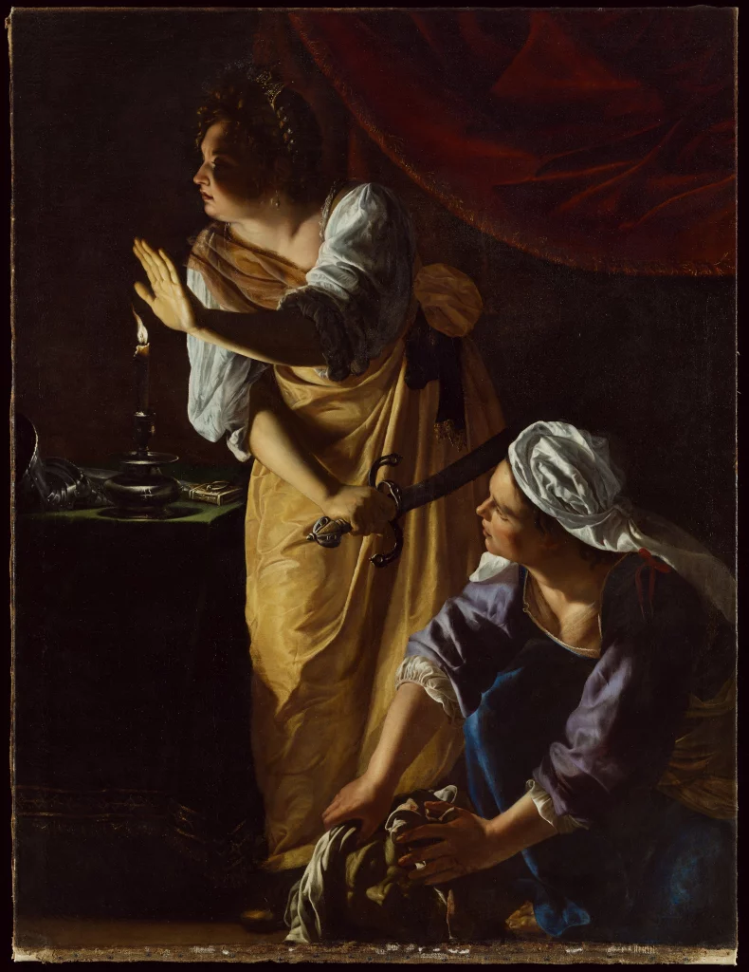
Artemisia Gentileschi, Judith and Her Maidservant with the Head of Holofernes (ca. 1623–1625). Collection of the Detroit Institute of Arts.

Slide 12
Bibliodraphy
5 Women Artists Who Ruled the Renaissance, From a Florentine Nun to a Flemish Portraitist
Στο σύνδεσμο αυτό θα βρείτε το πλήρες άρθρο για τις γυναίκες ζωγράφους της Αναγέννησης.

Slide 13
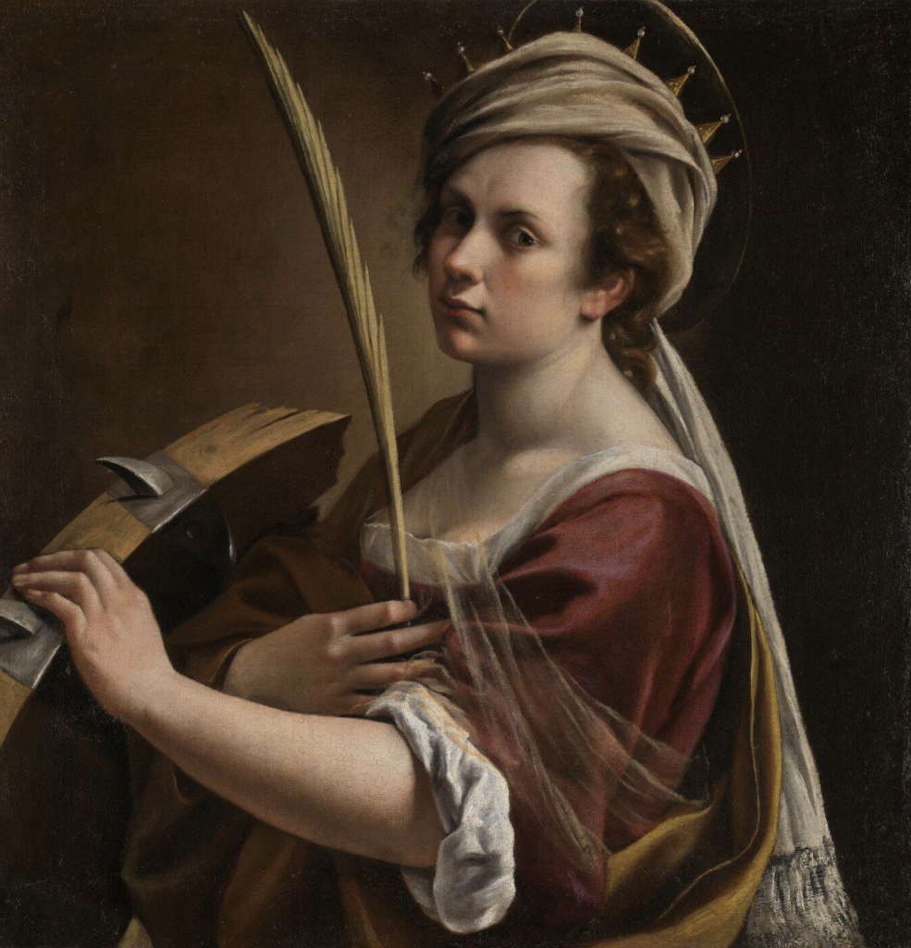
Thank you
Artemisia Gentileschi, Self Portrait as Saint Catherine of Alexandria (ca. 1615–17). Collection of the National Gallery, London.

