Slide 1
Join our club

Slide 2
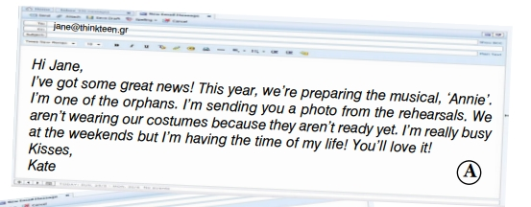
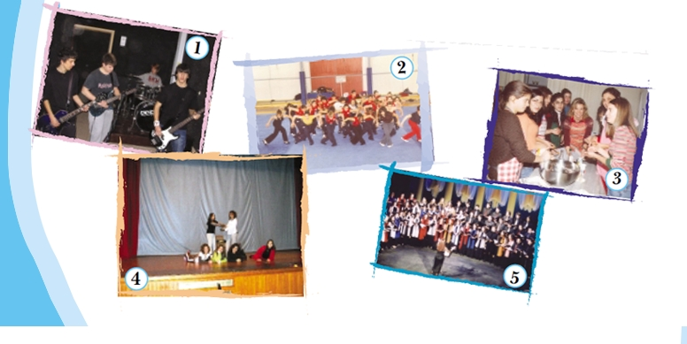
Read the following e-mail. Which photo from the ones on your right best suits it?

Slide 3
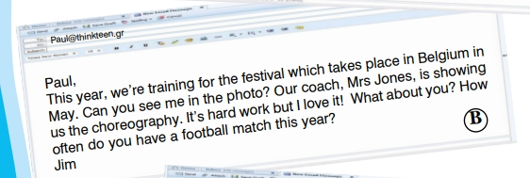
Read the following e-mail. Which photo from the ones on your right best suits it?

Slide 4
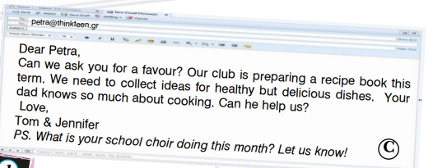
Read the following e-mail. Which photo from the ones on your right best suits it?

